Slide 1
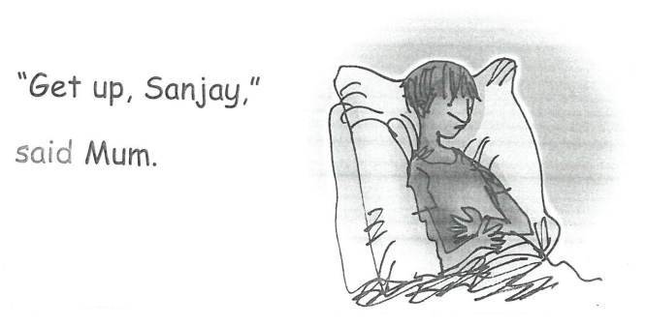

Why does Sanjay’s mum want him to get up?
How does Sanjay feel?

Slide 2
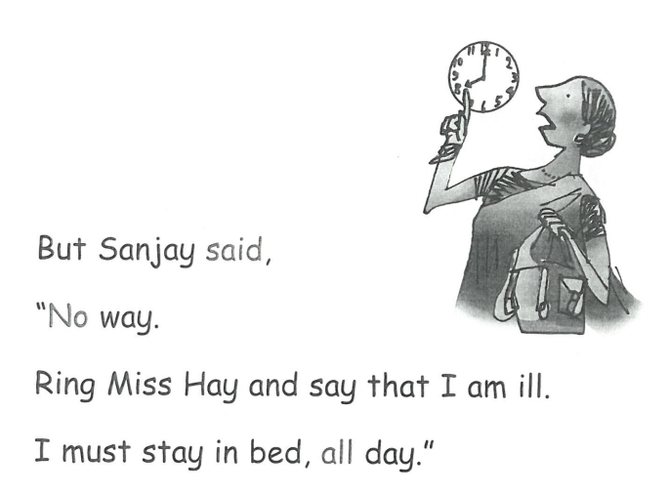
Why doesn’t Sanjay want to get up? What does he want his mum to do?

Slide 3
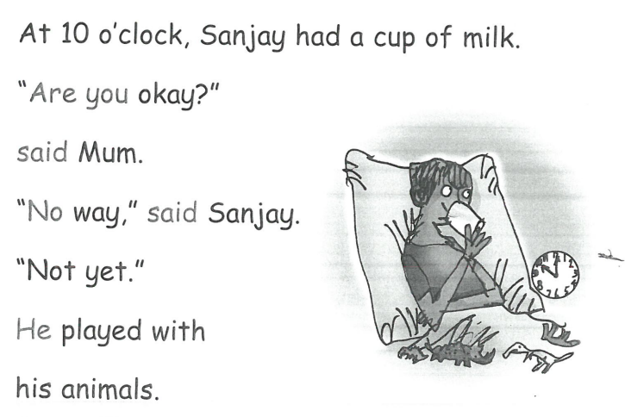
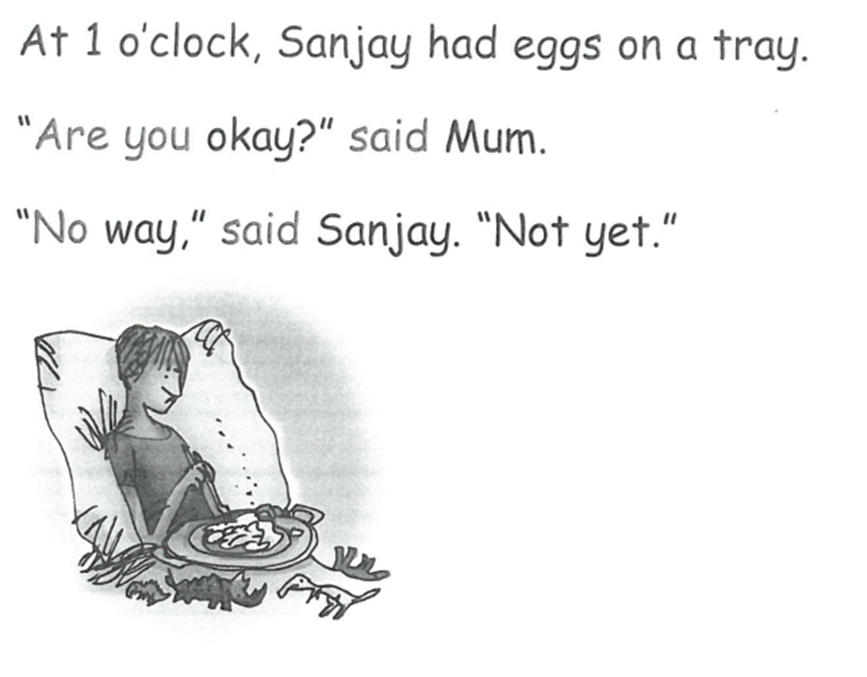
Why doesn’t Sanjay think he’s ok yet?

Slide 4
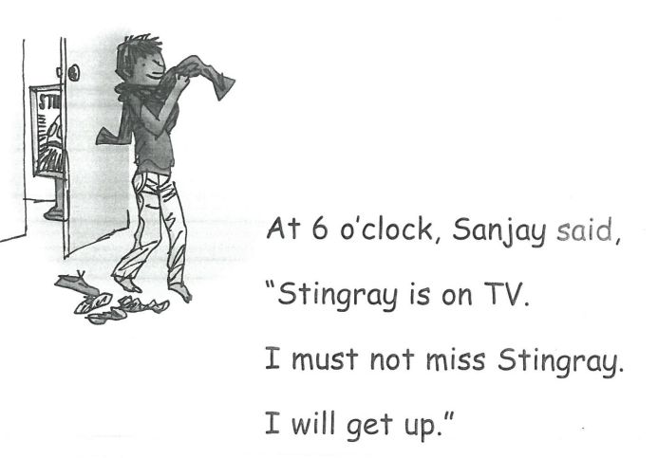
Why does Sanjay want to get up now?

Slide 5
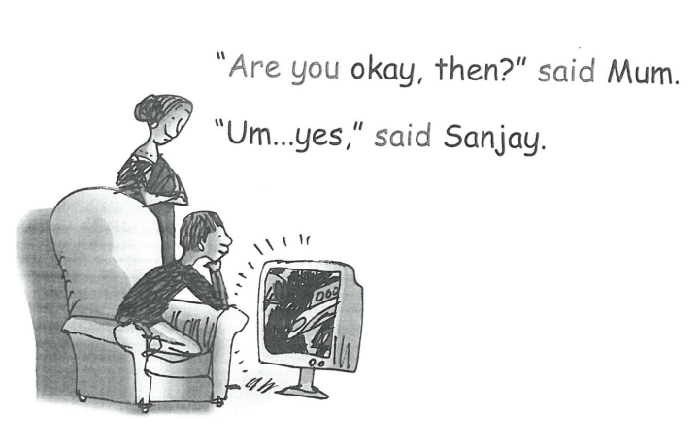
Why does Sanjay feel ok now?
How is he feeling about being able to watch his programme?
What is mum thinking?

