Slide 1
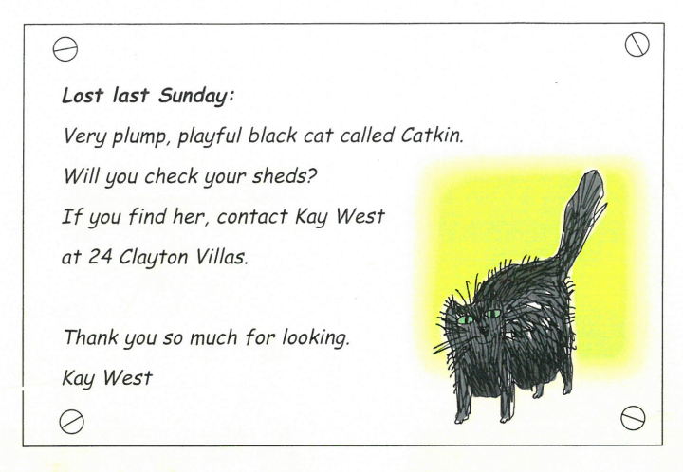

Who has put up a lost poster and why? Where might she have put it? How is Kay feeling and why?

Slide 2
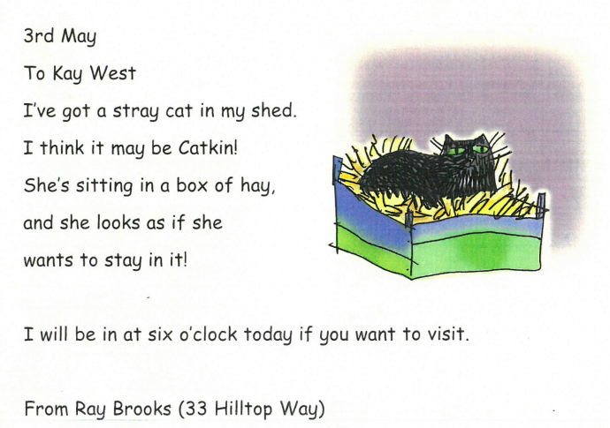
Where does Ray find Catkin? Who is in the bed with her? How does Ray feel?

Slide 3
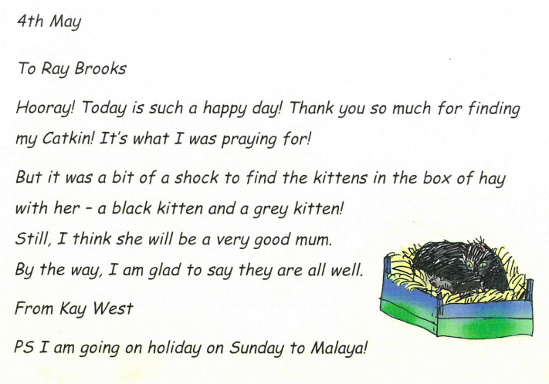
How does Kay feel now?

Slide 4
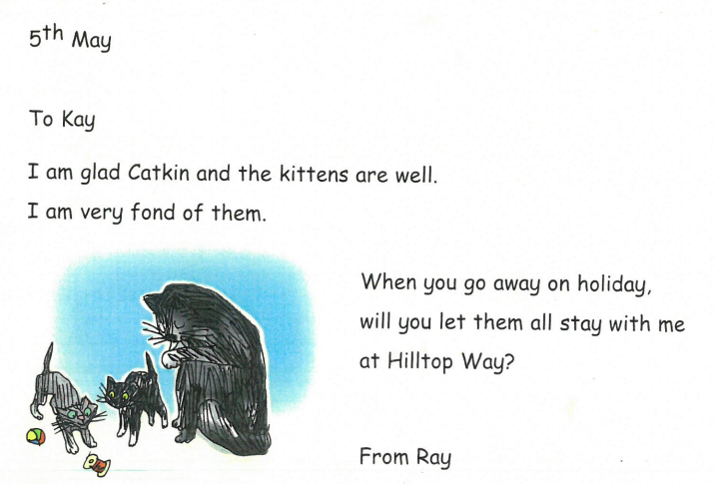
What does Ray ask Kay?

Slide 5
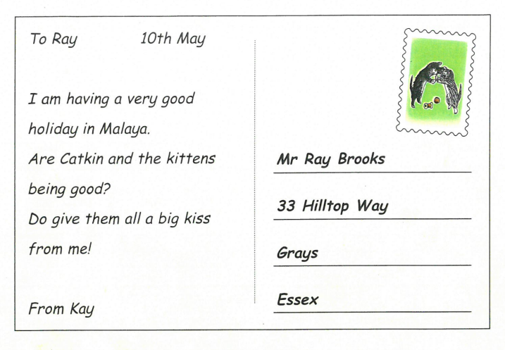
What does Kay want to know about Catkin and the kittens? Where does she post the postcard from?

Slide 6
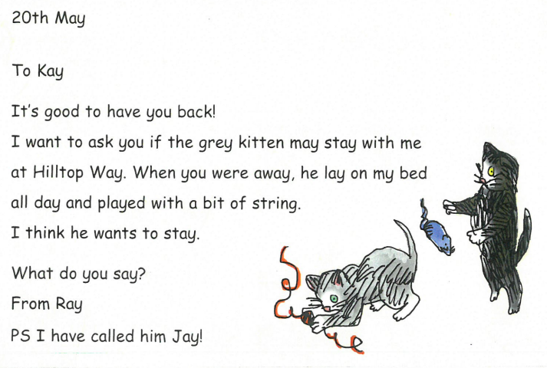
Why does Ray think that the grey kitten should stay with him?

Slide 7
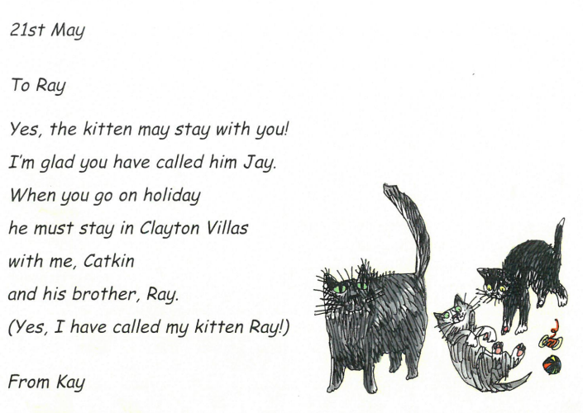
What does Kay say she will do to help Ray?

