Slide 1
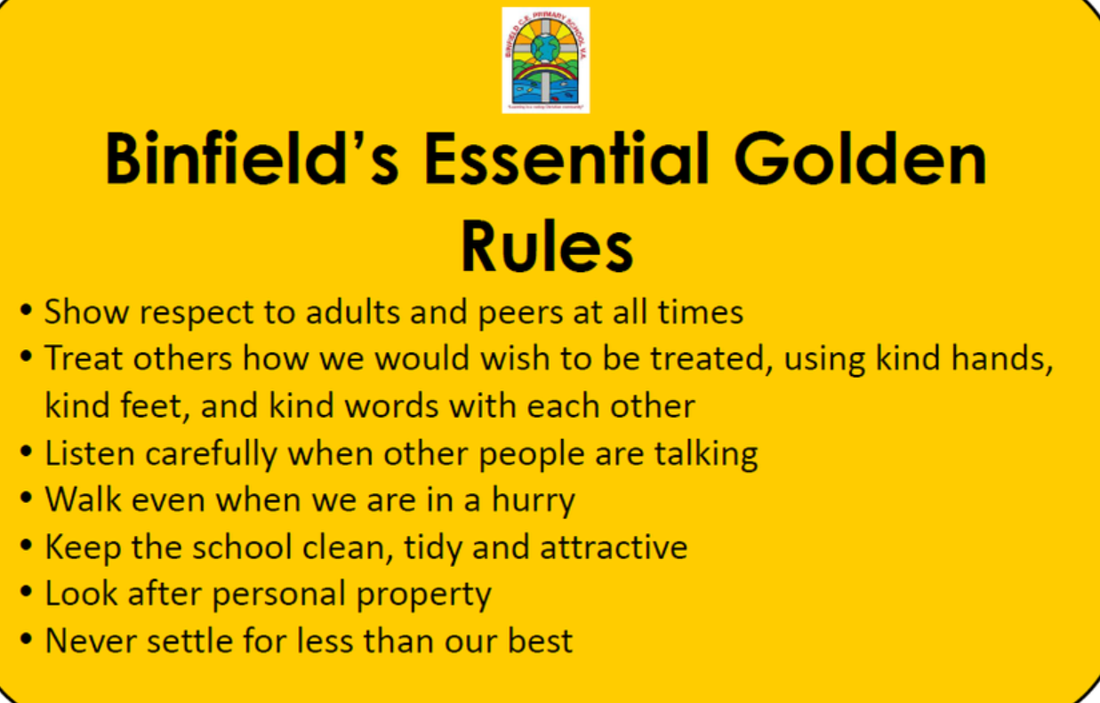
Recap Binfield Golden rules and Extra golden rules

Slide 2
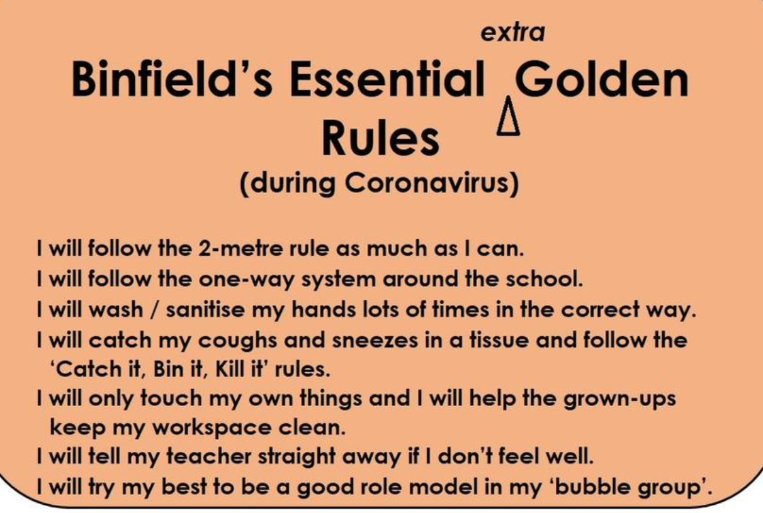

Slide 3
Connect us – The family game
Play ‘The family game’. Give each child a ‘family card’ and ask them to find the ‘rest of their family’ by making the noise of their family or an action of their family. Emphasise that they are not allowed to talk!
When they have found their ‘family’, each group forms a circle and stops making their relevant noise! Then ask the family groups in turn to say together “We are a family of...”

Slide 4
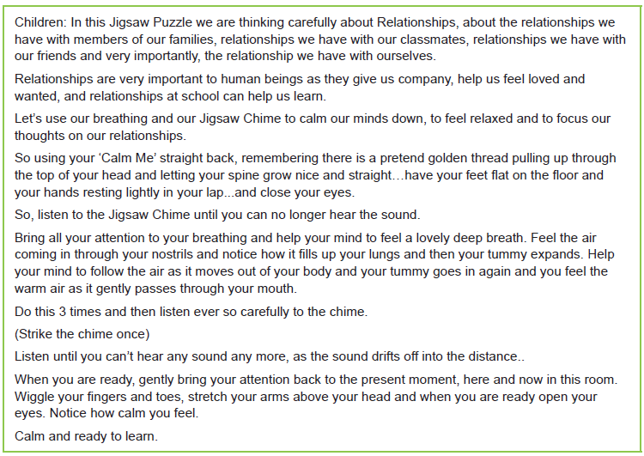
Calm me

Slide 5
Open my mind
With the children seated in a circle, start off a round by saying, “I’m … and someone in my family is my…….” (mum, sister, brother, dad, step brother etc.) Ask the children in turn round the circle to follow suit and see how many different family members the class as a whole can refer to. They can include close family, extended family, step family, etc.

Slide 6
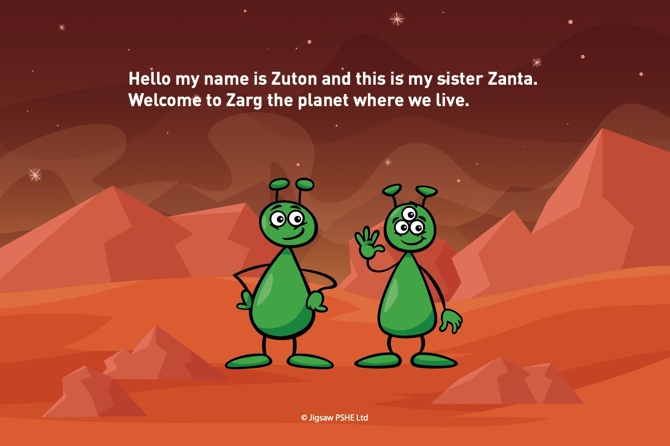

Slide 7
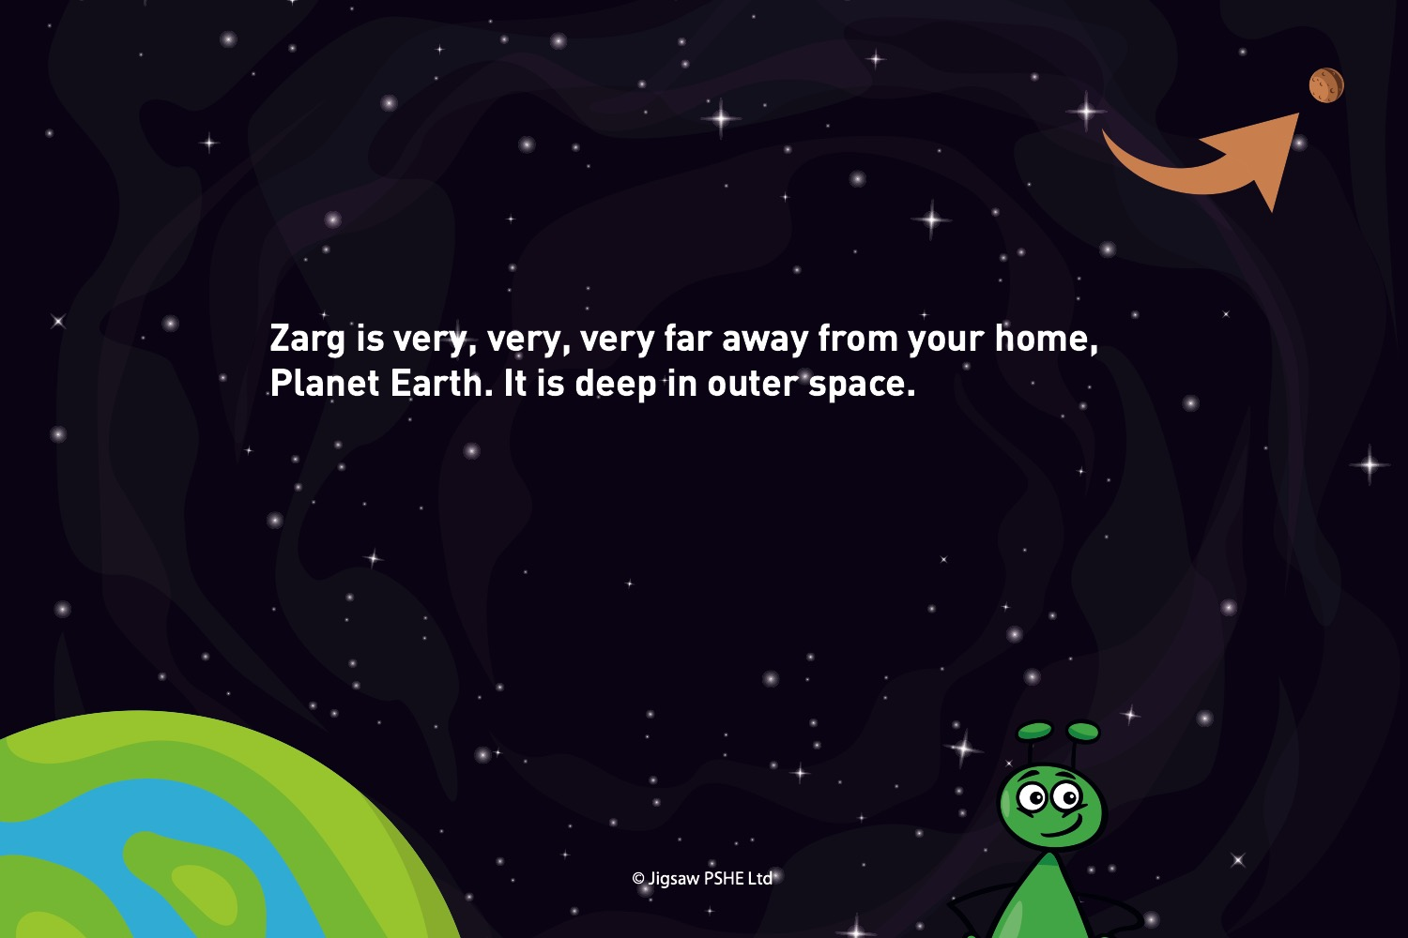

Slide 8
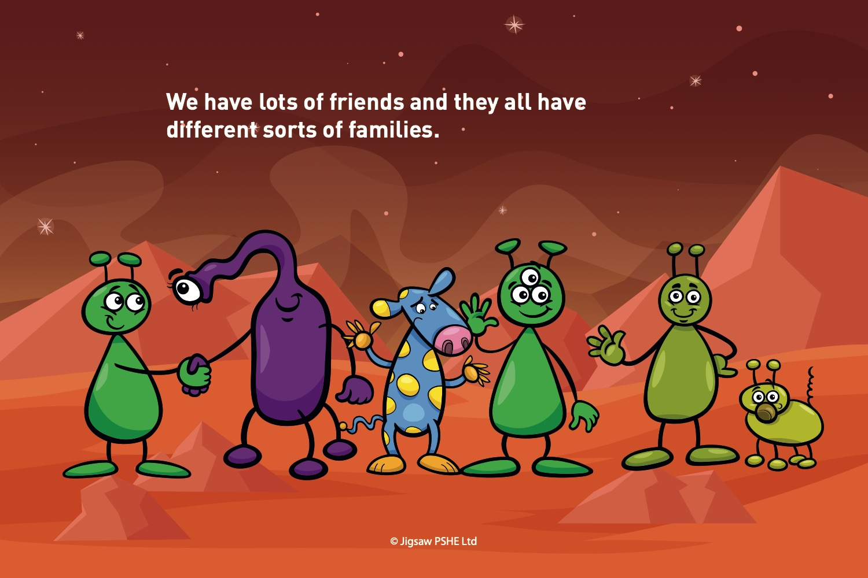

Slide 9
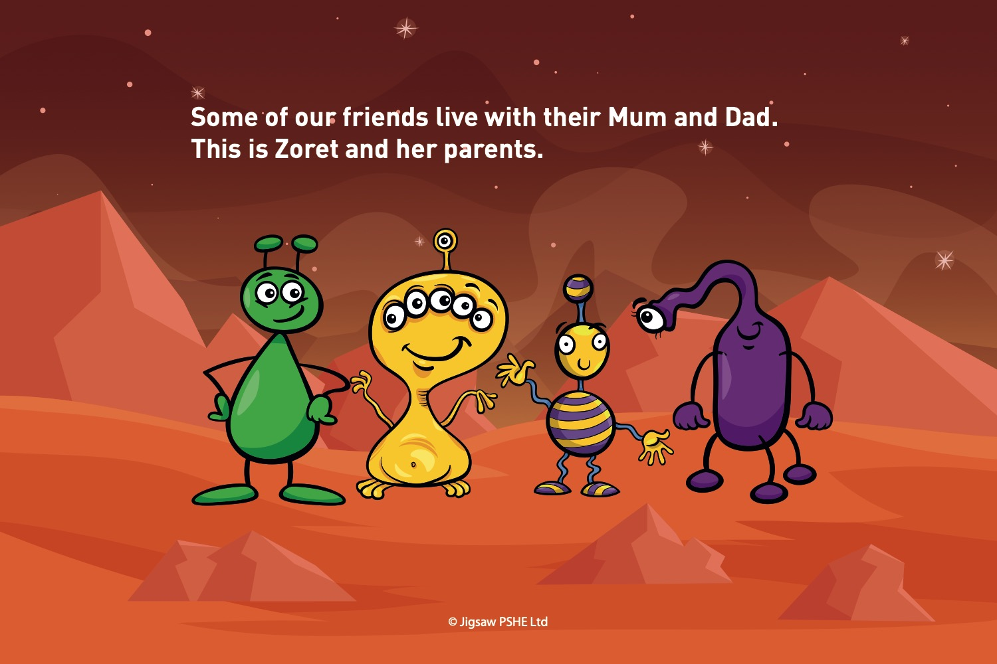

Slide 10
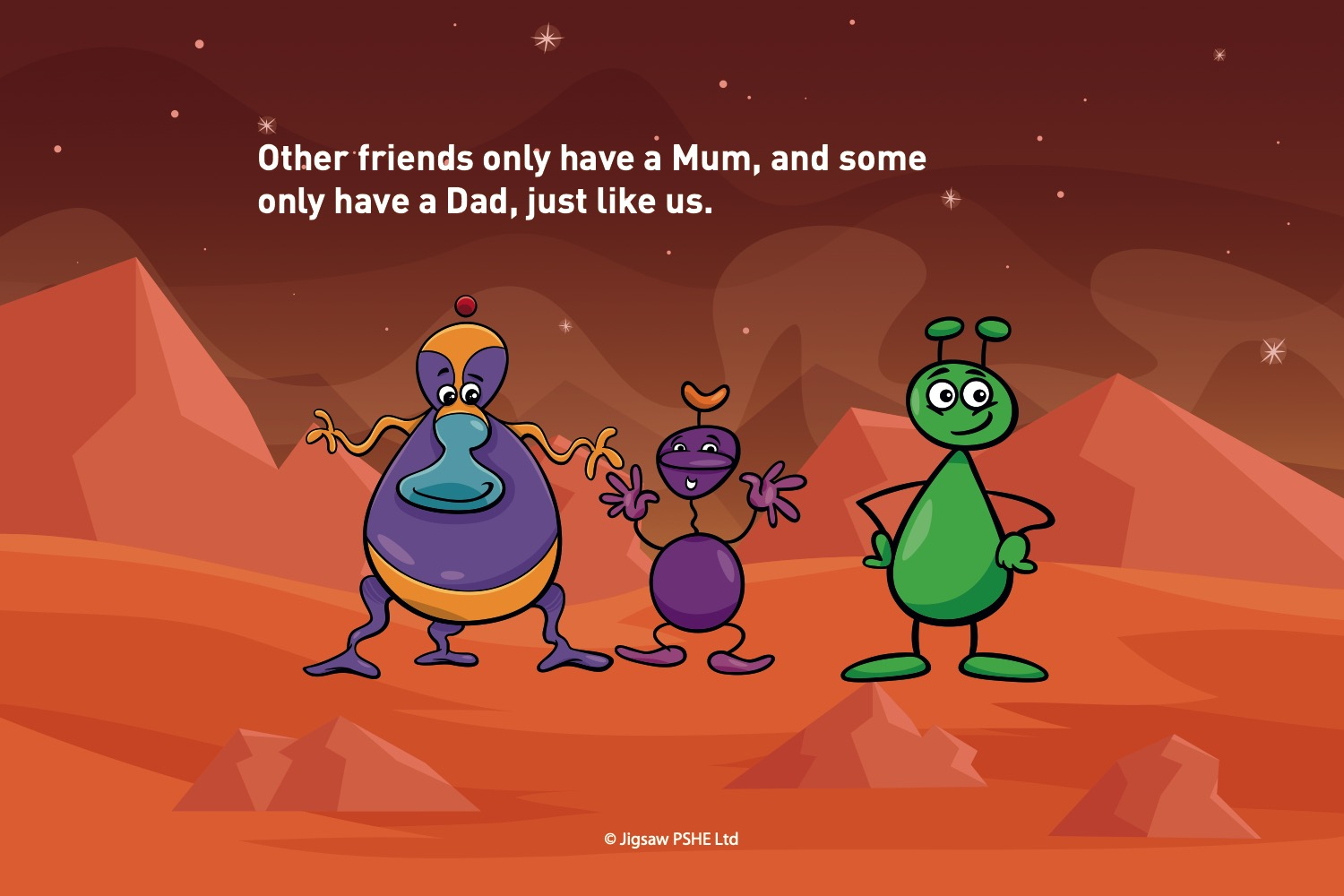

Slide 11
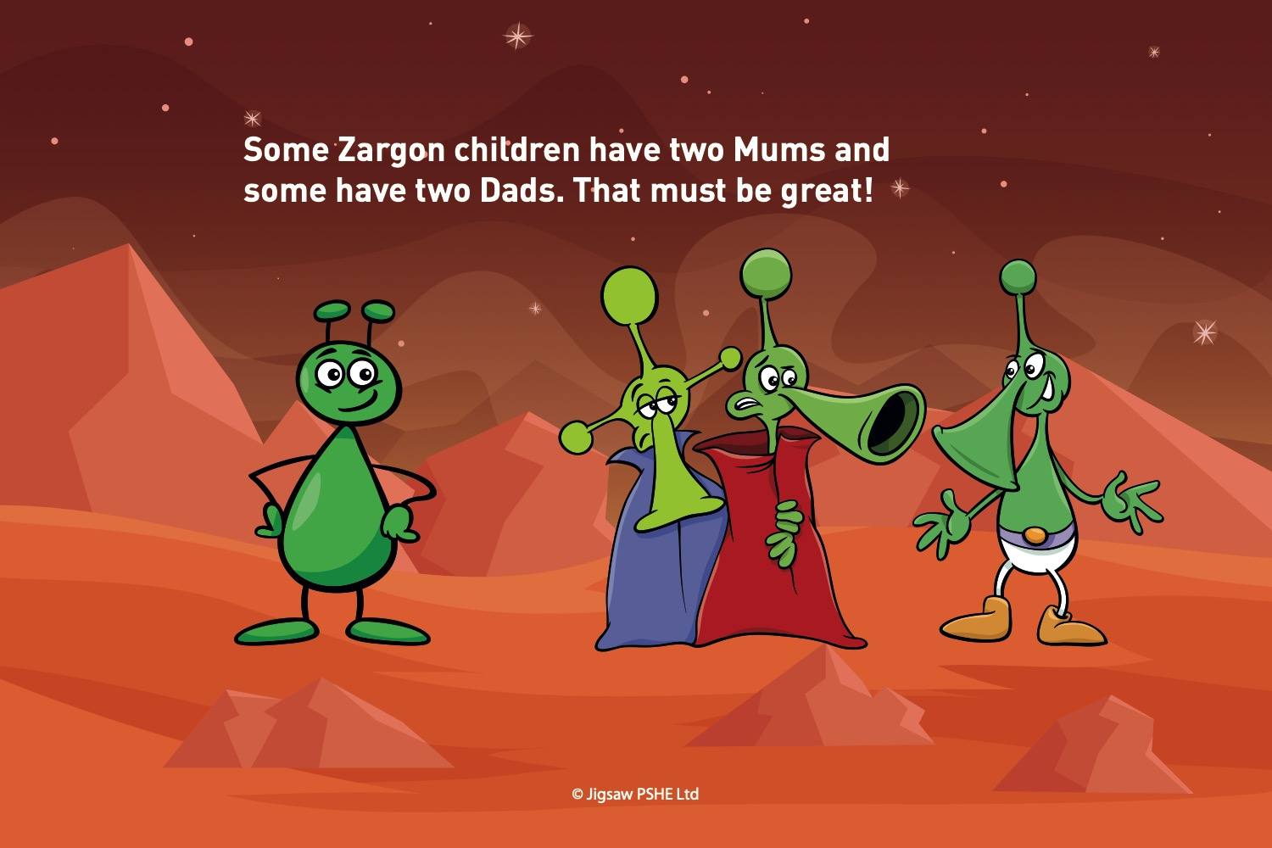

Slide 12
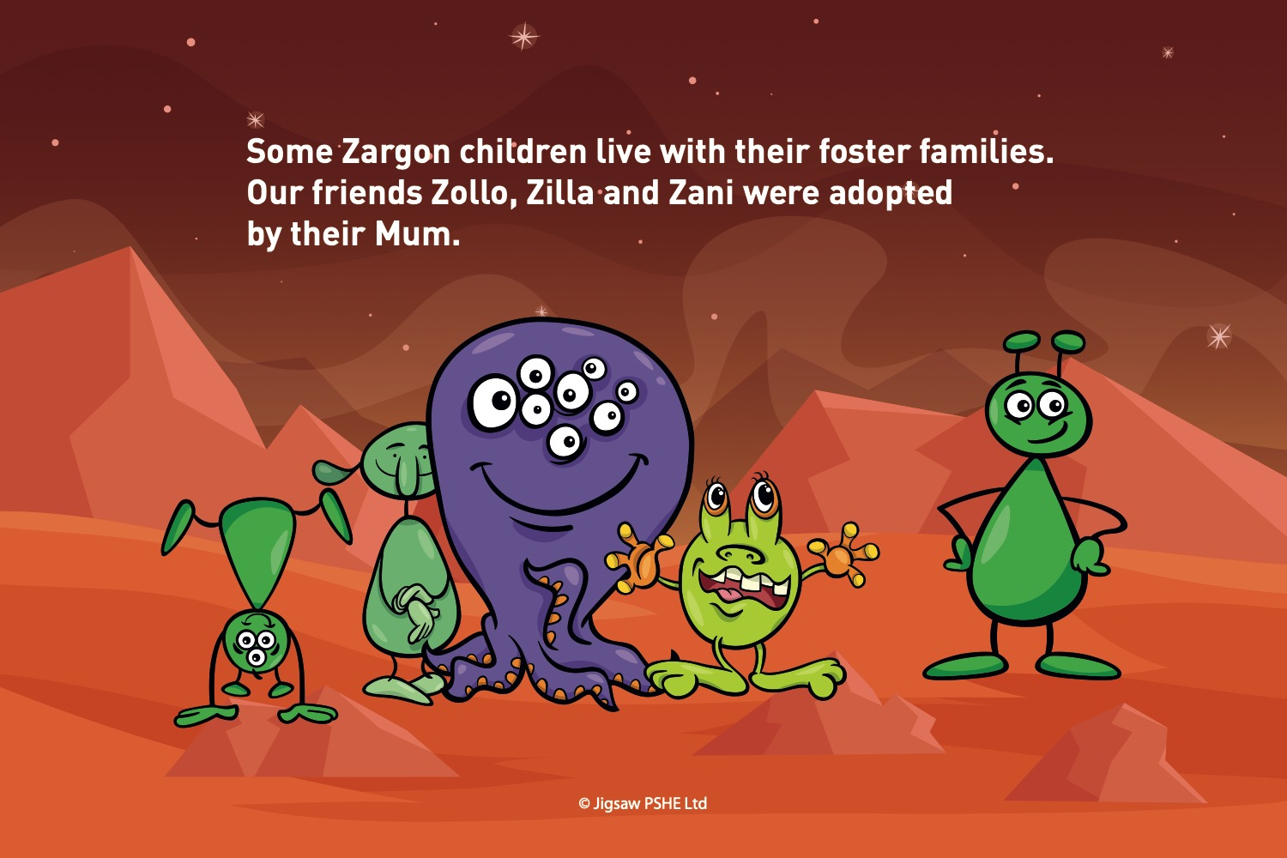

Slide 13
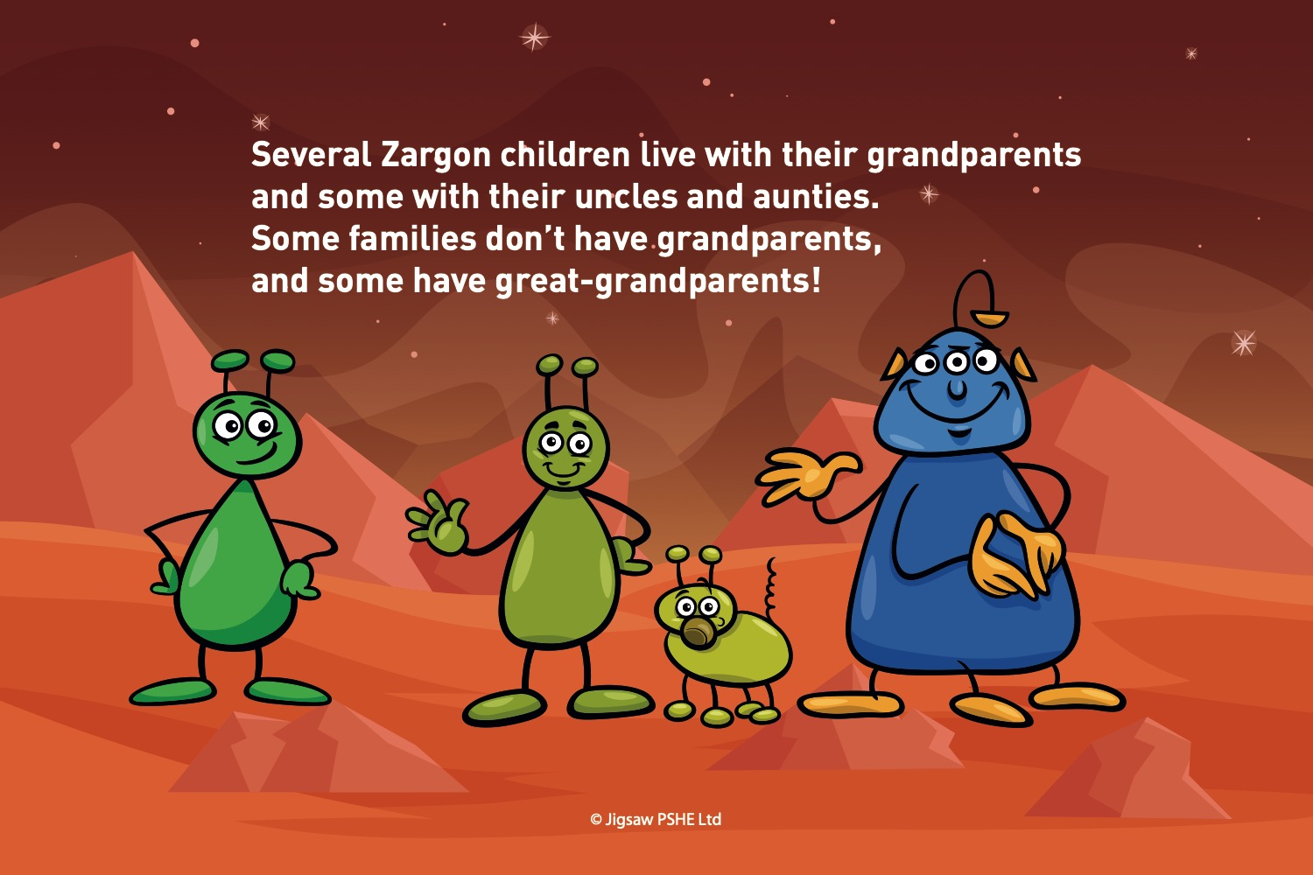

Slide 14
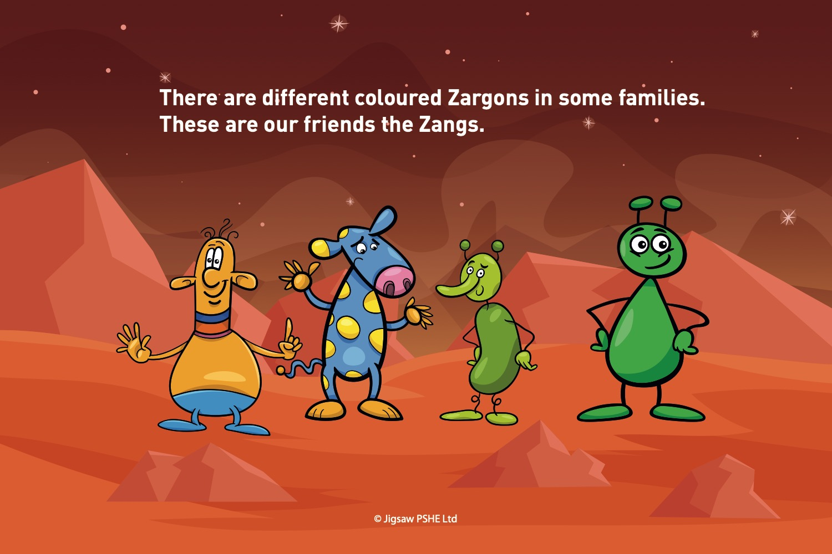

Slide 15
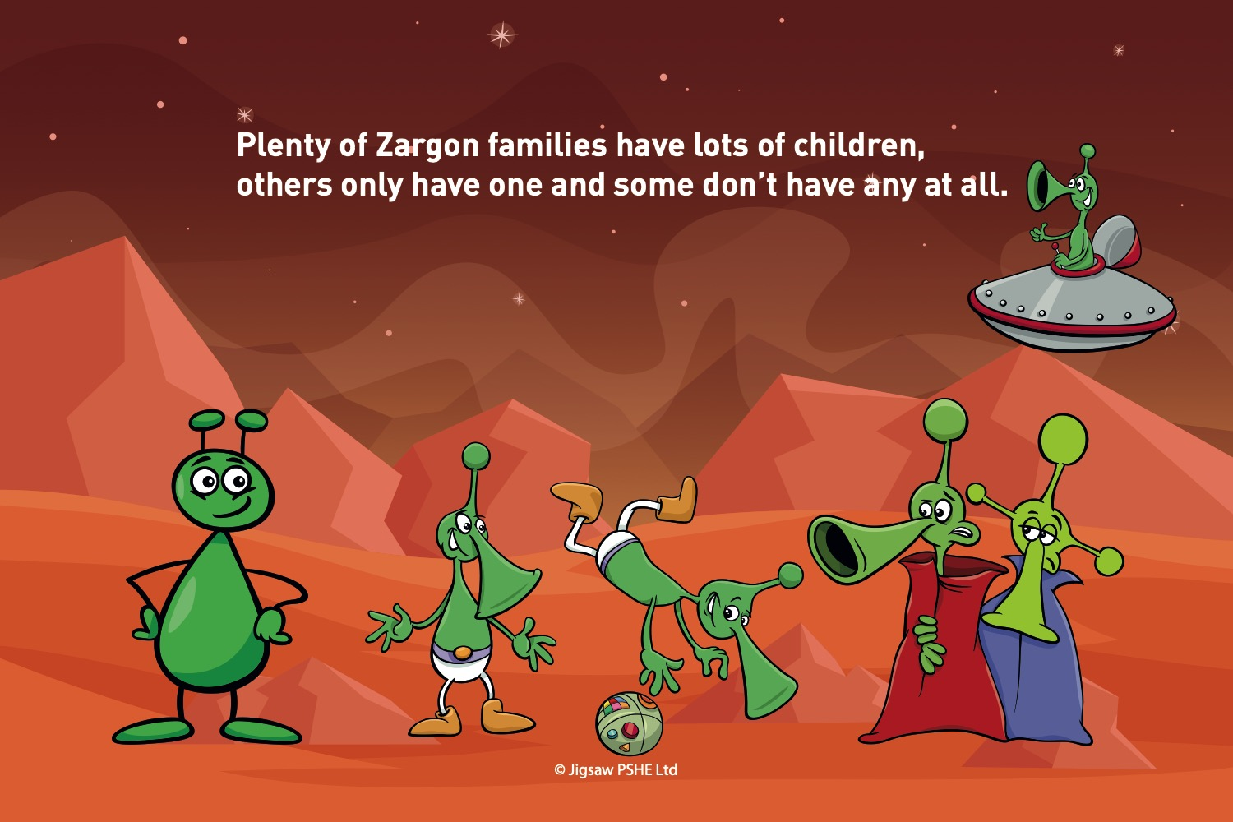

Slide 16
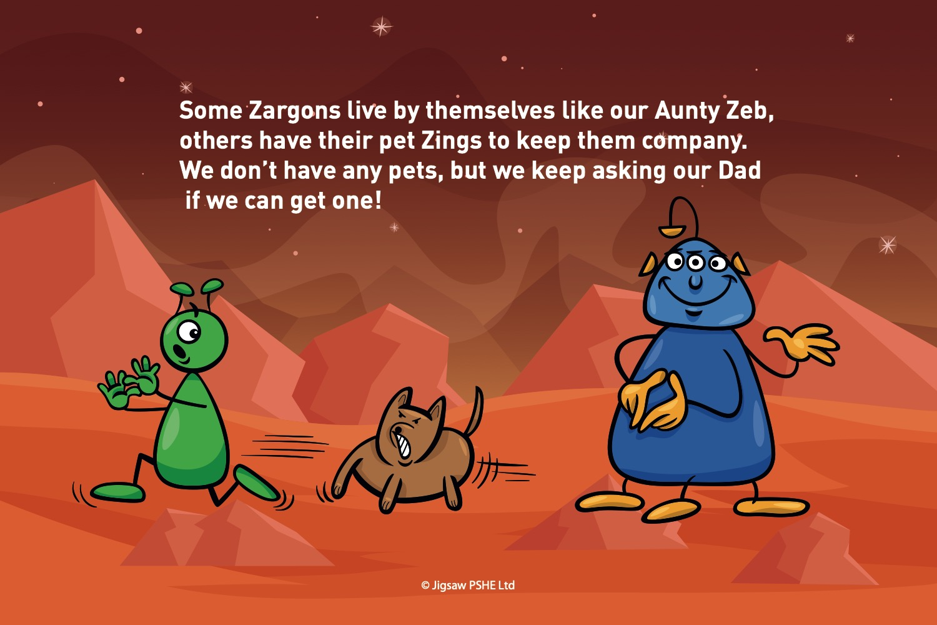

Slide 17
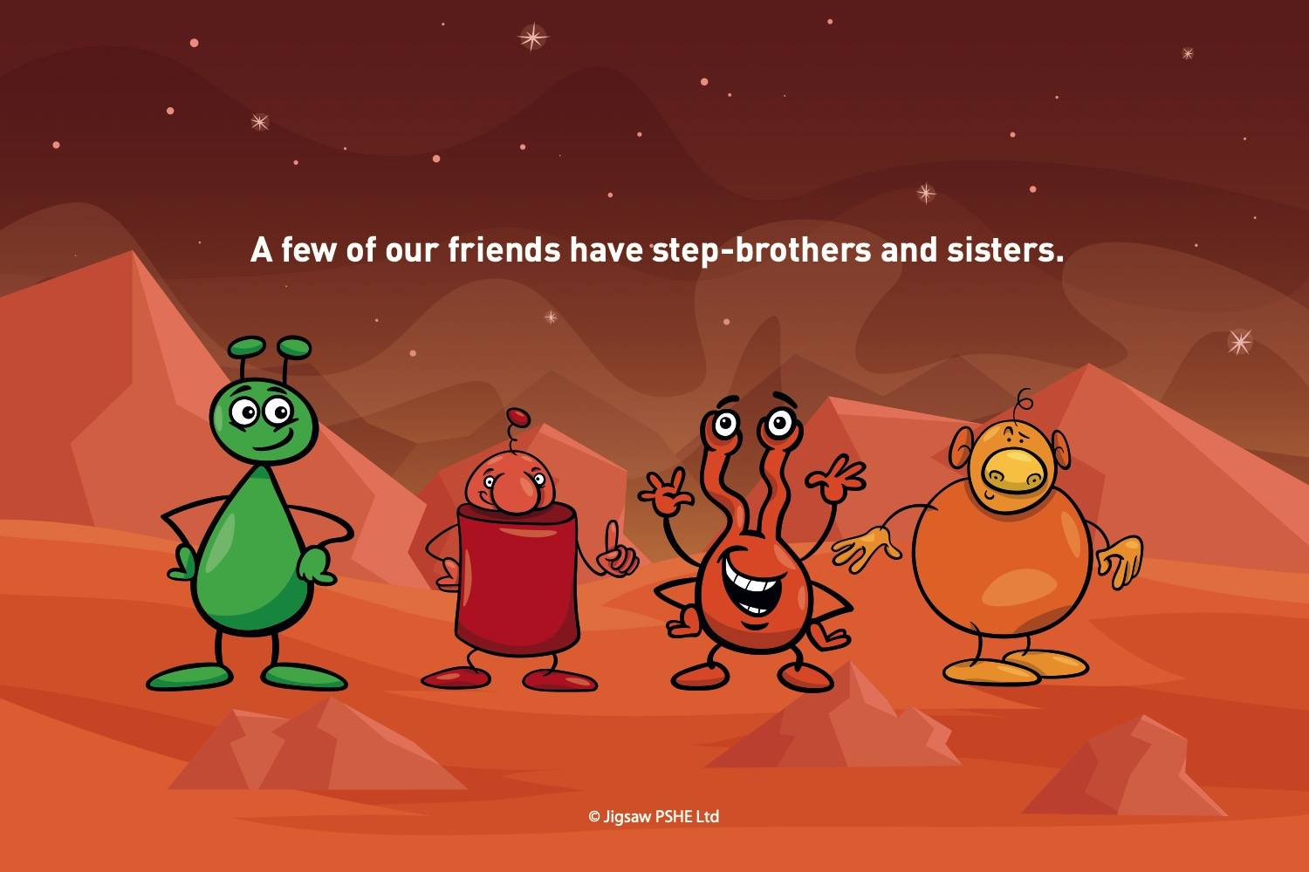

Slide 18
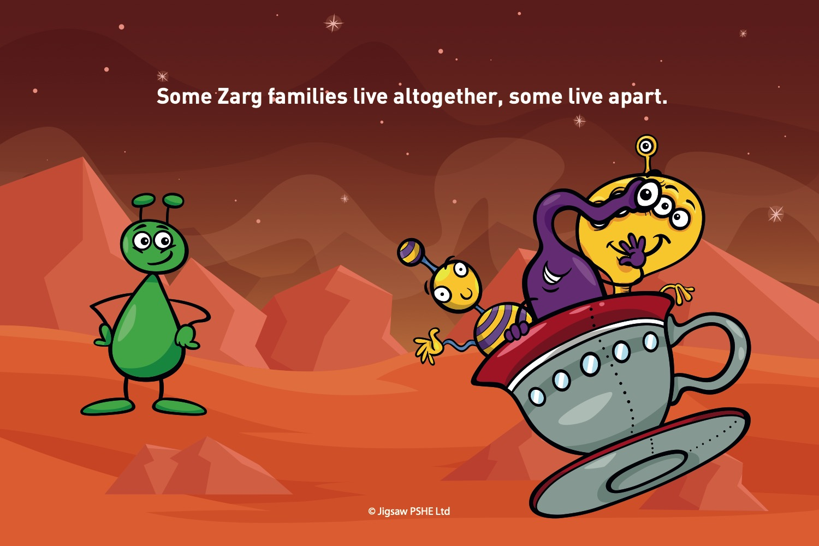

Slide 19
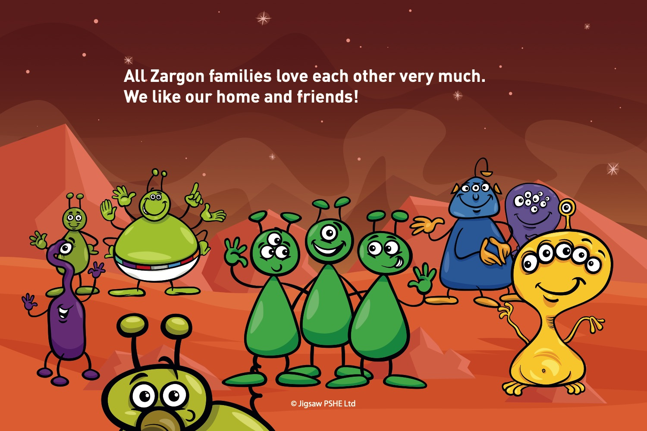

Slide 20
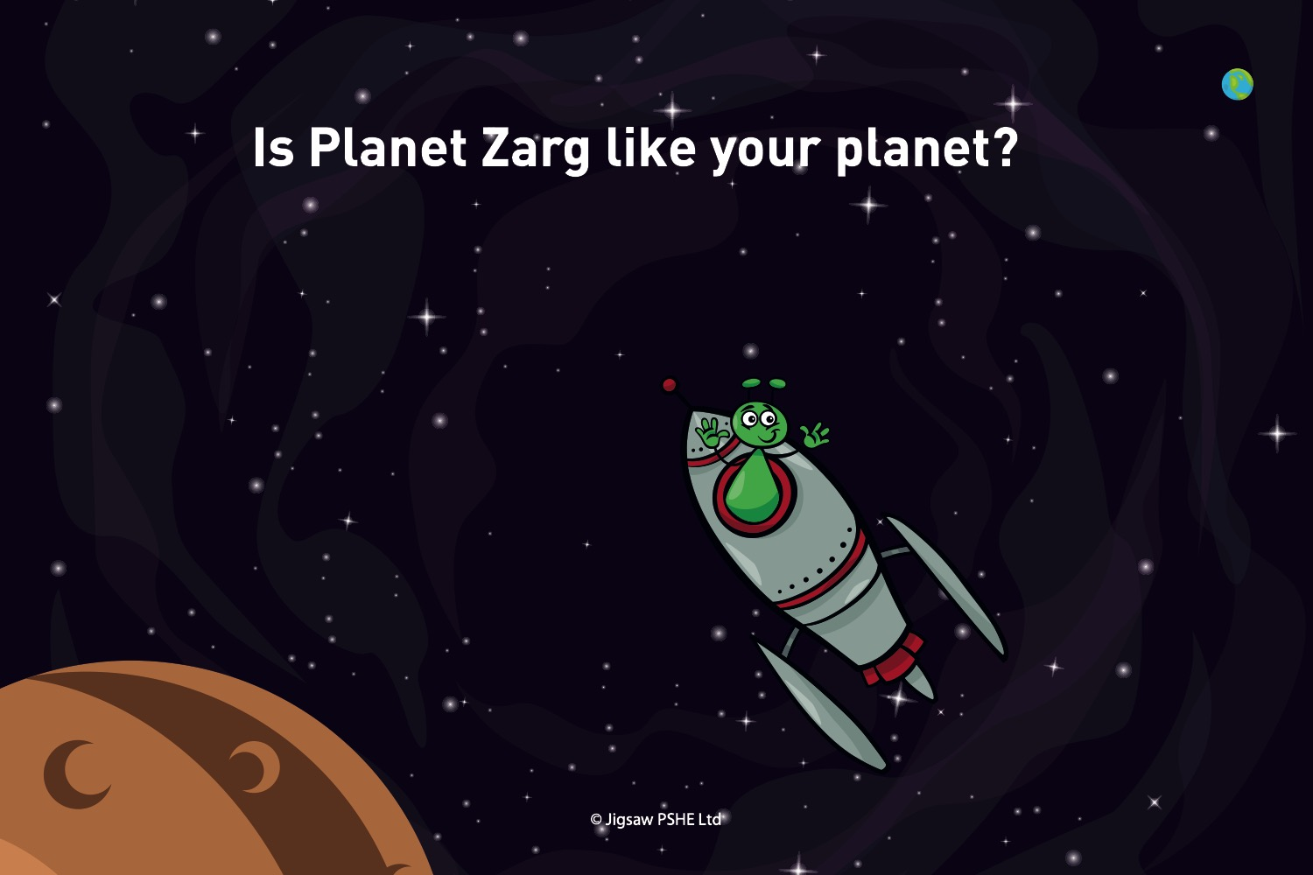

Slide 21
Tell me show me: Why do we have families?
Discuss:
Are all families the same?
What is a family?
Can some people be part of your family and not live in the same home as you?

Slide 22
Let me learn: Who is in your family?
When you think about the word family, does this also mean your pets?
How does it feel to be part of a family?
Who are the members of your family?
How do you feel in your family home?

Slide 23
Task
Snorkellers/paddlers: Draw and label a picture of your family in your PSHE book.
Divers: First, draw and label a picture of your family in your PSHE book.
Next, choose one person from your family. Describe them and say why they are special to you.

