Slide 1
LO: To reflect
Is Shabbat important to Jewish Children?

Slide 2
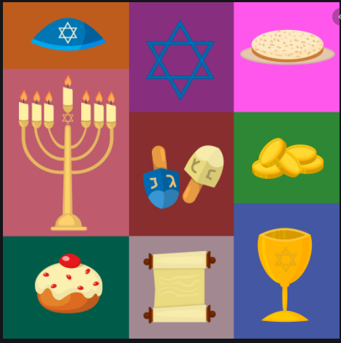
What can you remember from our previous study of Judaism?
Watch
Introduction to Shabbat - KS1 Religious Education - BBC Bitesize
Celebrating Shabbat at the synagogue - KS1 Religious Education - BBC Bitesize

Slide 3
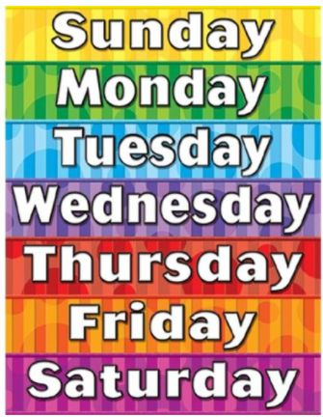
Talk to partner about the days of the week and about which day is the most special to you. Why is this day special?

Slide 4
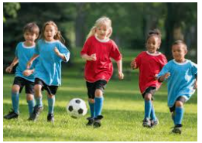
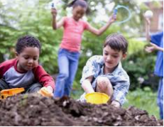
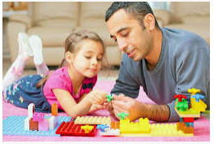
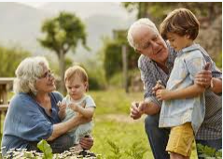
What do you do on a Saturday? Who do you spend it with? How does this differ from the rest of the week?

Slide 5
Task
Paddling: (Illustrate and Label)
Draw/label what you do on Friday and Saturday
RP – Which day is the most special to you? Why?
Snorkelling (Label and Define)
Draw what you do on a Friday and Saturday. Explain which day is the most special to you and why.
Diving: (Compare)
Compare what you do each day with a Jewish family. (Pictures or sentences)

Slide 6
Red pen – Is the most important day for you the same or different to a Jewish family? Why?

