Slide 1

Wednesday 26th May 2021
L.O: NFER- Filling the Gaps
C: Days in the month

Slide 2
Let’s start by playing a game!
Can we order the months together?

Slide 3
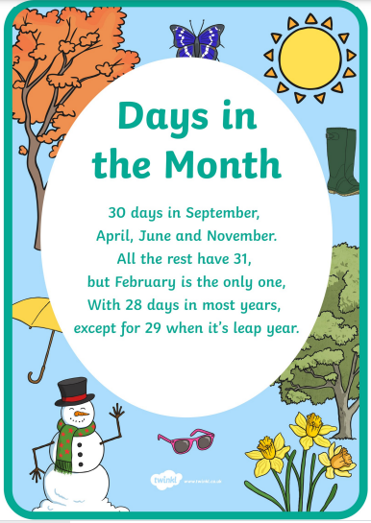
Let’s practice this rhyme to remember how many days there are in each month.

Slide 4
Let’s practice some questions together:
- I do
- We do
- You do

Slide 5
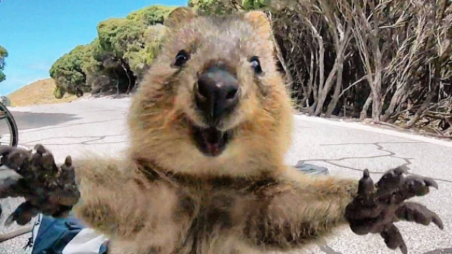
I Do:
Wilbur the quokka eats 5 bundles of leaves everyday in April. How may bundles of leaves did he eat that month?

Slide 6
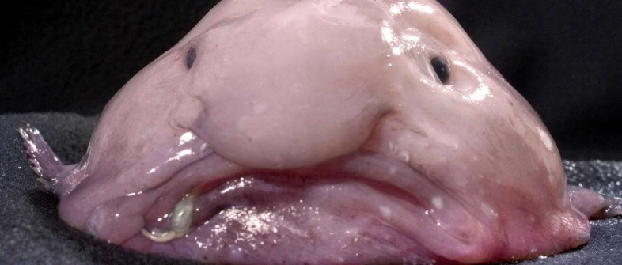
We Do:
Barry the blobfish has been in the aquarium from 1st February - 30th April. How long has he been in the aquarium?

Slide 7
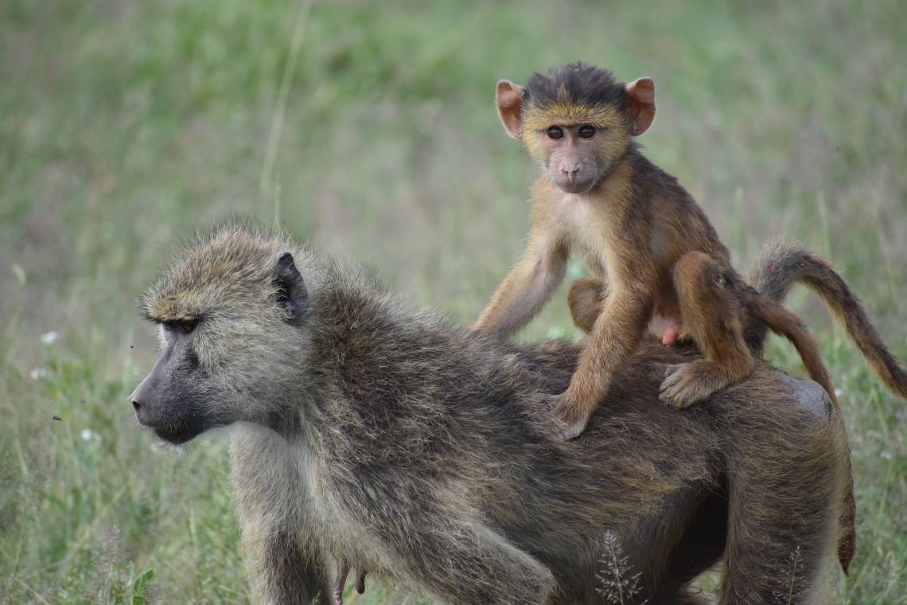
You Do:
Benji the baboon is has swung around the jungle for 6 hours a day throughout October. How long was he swinging for in total?

Slide 8
It’s your turn! Have a go at some of the problem cards ☺

Slide 9

Red Pen Question
I was born in ……………………... I now know this month has …………………….. days.

