Slide 2

Jesus arrived in Jerusalem on Palm Sunday. The people were happy to see Jesus and waved palm branches.

Slide 3

Some important people were jealous of how much the people loved Jesus.

Slide 4

Judas was one of Jesus’ special friends. The important people gave Judas money to tell them where Jesus was so they could arrest him.

Slide 5

Jesus had a special dinner called a Passover meal with his friends. This meal is now known as the Last Supper.

Slide 6

Jesus gave his friends bread and wine. He then told them that one of them had turned against him.

Slide 7

Jesus said that Peter would pretend he didn’t know Jesus before the morning arrived and the cock crowed.

Slide 8

Then Jesus went to pray in the garden of Gethsemane.

Slide 9

Judas told the important people where Jesus was. Jesus was arrested.

Slide 10

Peter followed Jesus and waited outside where he was being held. Someone asked if he was Jesus’ friend. Peter said he didn’t know Jesus.

Slide 11

Then the cock crowed. Peter remembered what Jesus had said and felt
very sad.

Slide 12

Pontius Pilate set Barabbas free instead of Jesus. The crowd wanted Jesus punished.

Slide 13

Jesus had to carry a heavy cross through the streets of Jerusalem.

Slide 14

Simon carried Jesus’ cross to the hill.

Slide 15

Jesus died on the cross. His friends and family were very sad.

Slide 16

When Jesus died, the earth shook. The curtain in a special place called the Temple was torn in two.

Slide 17

Jesus’ body was put into a tomb. A large, heavy stone was put in front of the entrance.

Slide 18

On the third day, Mary and some of Jesus’ other friends went to the tomb. Jesus’ body wasn’t there and the stone had been rolled away. An angel told them that Jesus had risen from the dead.

Slide 19

Jesus visited his friends before going to heaven.

Slide 20
What parts of the Easter story make you feel sad?
What parts make you feel happy?
Remember to use the word ‘because’ when you explain your answers.

Slide 21
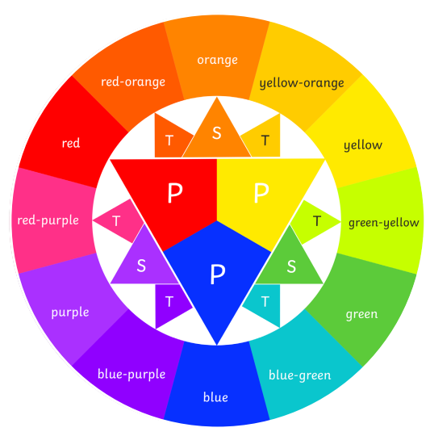
Look carefully at the colour wheel. Which are the sad colours? Which colours make you feel happy when you look at them?

Slide 22
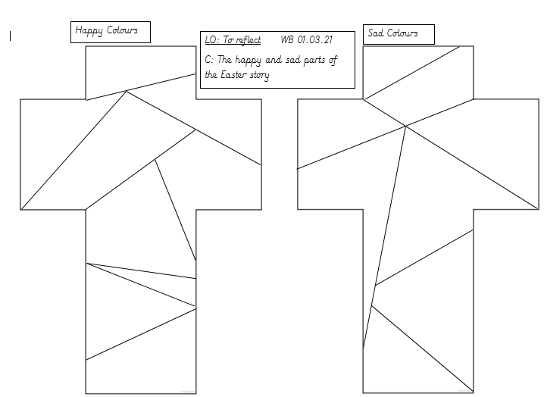
Task (Part 1)

Slide 23
Please keep your crosses safe for next week as you will need them for the next lesson as well.

