Slide 1

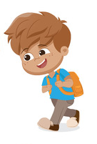
Billy walked for two miles every day in May. How far did he walk altogether?

Slide 2
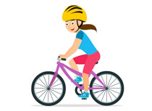
To improve her fitness, Amber rode her bike to school everyday in January and February. How many days did she ride her bike in total?

Slide 3
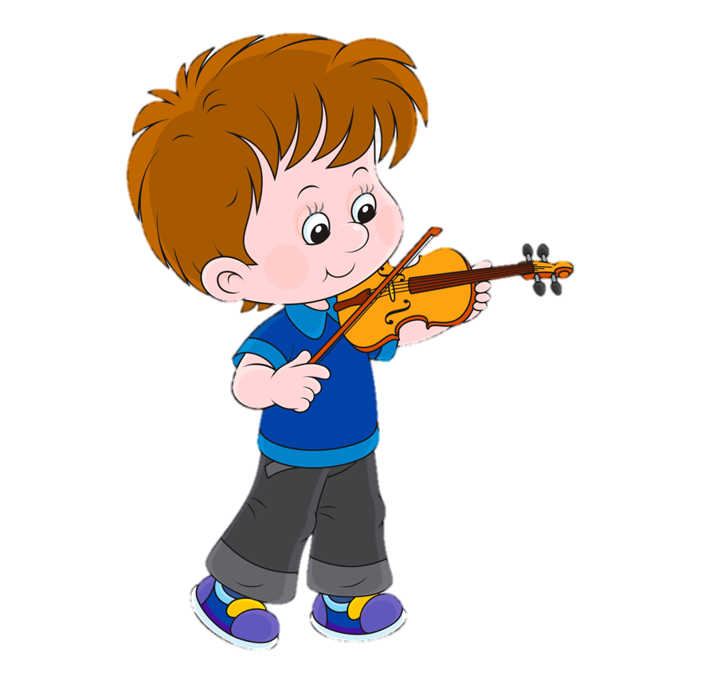
Due to his concerts, Jacob practiced the violin everyday in January, November and June. In which month, did he practice the most? How do you know?

Slide 4


Michael ate his 5-a-day every day in July! How many portions of fruit and vegetables did he eat in total?

Slide 5

Lola sold lemonade and made £3 a day in June and £2 a day in July. Which month did she earn more money? How do you know?

Slide 6

Nina is selling Christmas cards. She starts with 100 and sells 2 each day in November. How many does she have left at the end of November?

Slide 7


Owen’s birthday is on 29th May. It’s currently 3rd March. How many days are there until his birthday?

Slide 8
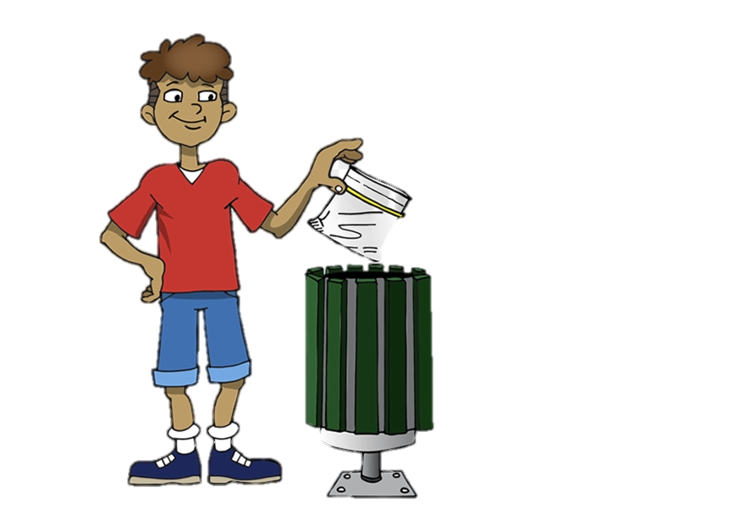
Robert walks to the beach everyday to collect litter. He picks up 4 bags worth each day in February, and 2 bags worth each day in January. How many bags does he collect all together?

Slide 9
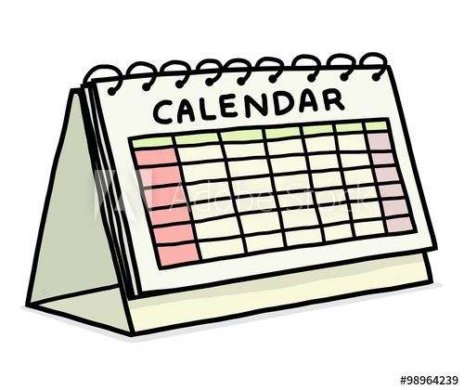
How many days in total do all the months beginning with J and A have?

