Slide 1
LO: I know who can help me in my school community.
I know when I need help and know how to ask for it.
C: Relationships.

Slide 2
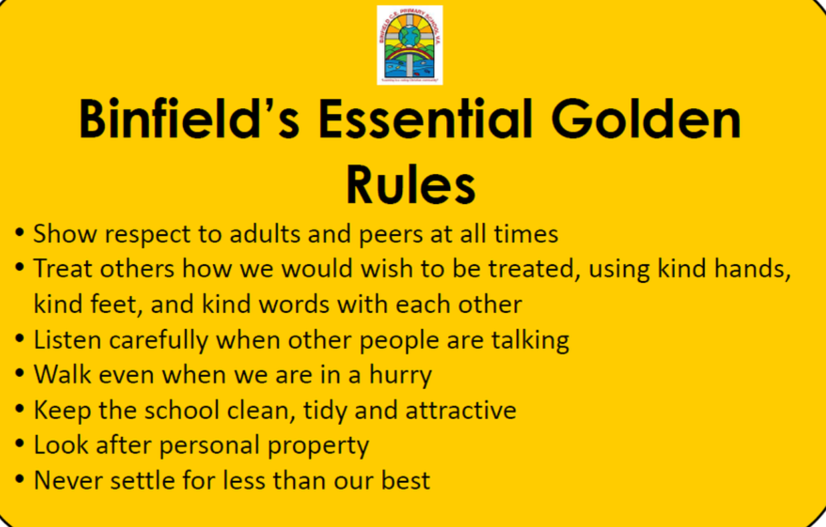
Recap Binfield Golden rules and Extra golden rules

Slide 3
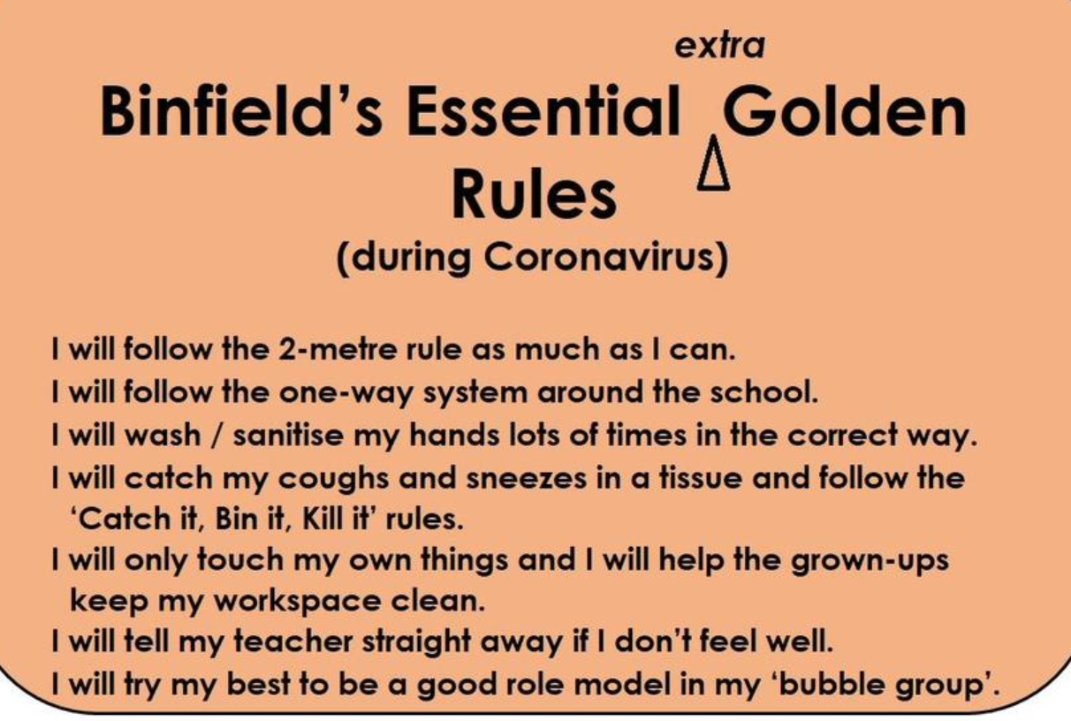

Slide 4
Connect us
Play Squeeze (as in Piece 3)
Tell your partner something that somebody has helped you with today that you couldn’t have done by yourself.

Slide 5
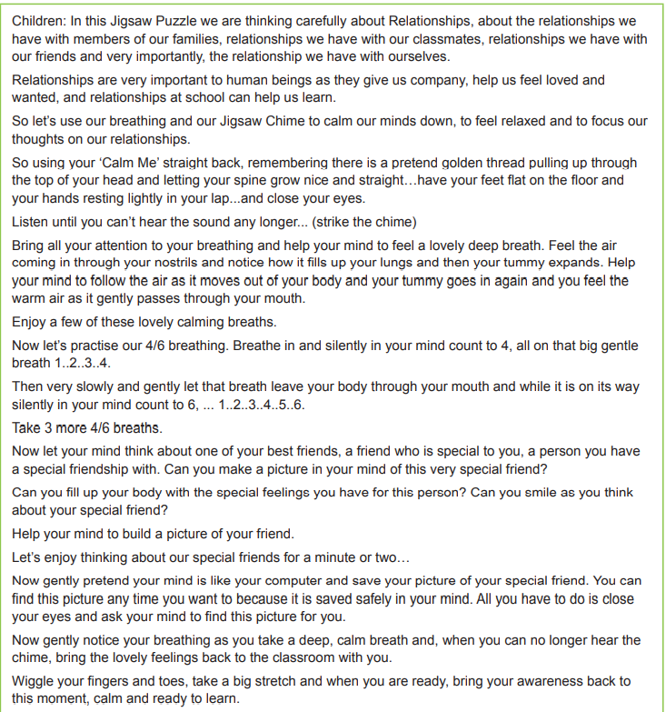
Calm me:

Slide 6
Open my mind: TPS
Who has helped you in school this week?
Think, pair, share.

Slide 8
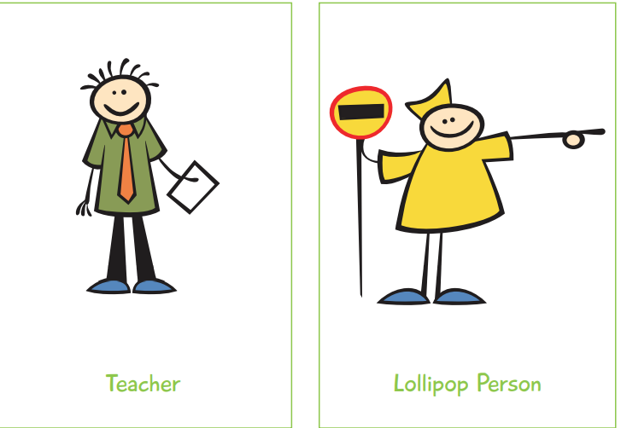
Let me learn:
Cut out the pictures and stick them into two groups.
People who help me in school and people who help me out of school.

