Slide 1
LO: To Reflect
Identify the things that are important in their own lives and compare these to religious beliefs.

Slide 2
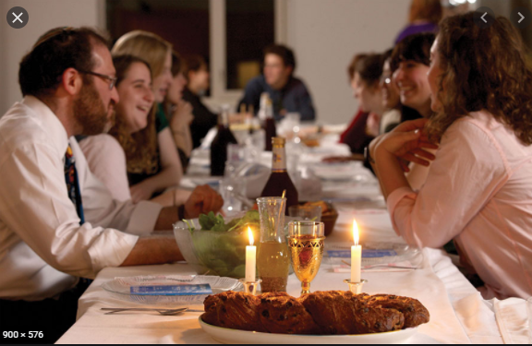
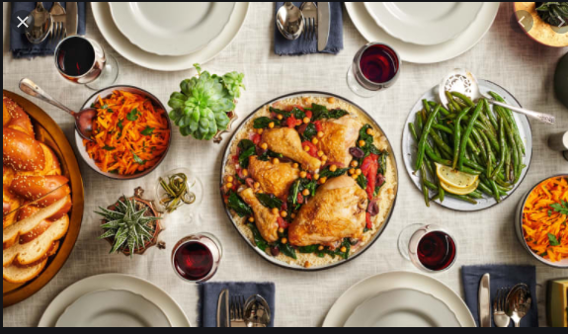
Revise the meal that Jewish families have on Shabbat
Celebrating Shabbat in a Jewish home - KS1 Religious Education - BBC Bitesize

Slide 3
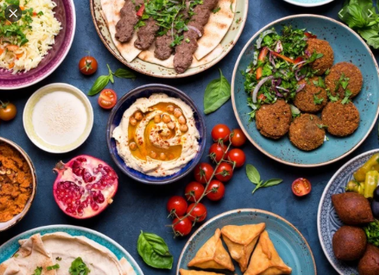
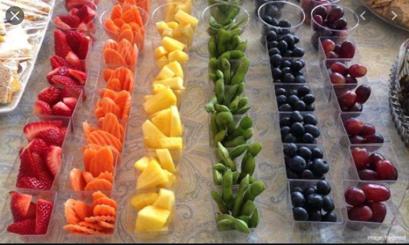
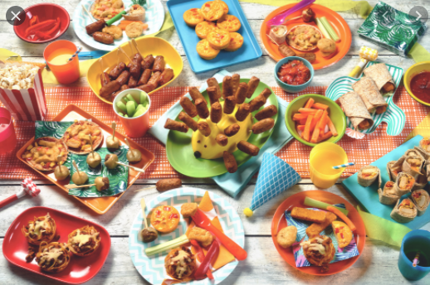
What special meals do we have as a class?
How is this different to normal lunch?
Imagine we want to have another special meal as a class.
What foods would you choose for the special meal?

Slide 4
Task
Paddling: Design a special meal for us to have together as a class.
Snorkelling: Design and label a special meal for us to have as a class.
Diving: Design and label a special meal for us to have as a class. Explain why you have chosen each food or item.

Slide 5


