Slide 1
LO: I know how to keep myself clean and healthy and understand how germs can cause illness.
I know that household products including medicine can be harmful if not used properly.
C:Healthy Me

Slide 2
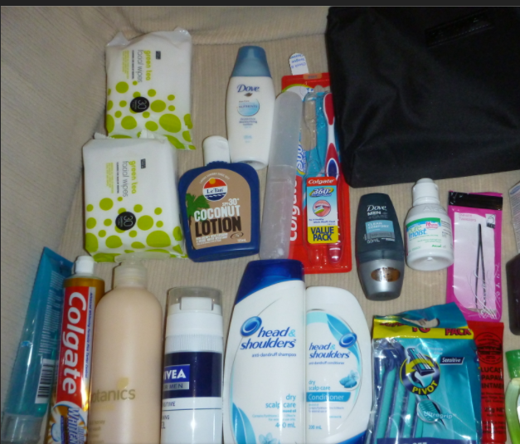
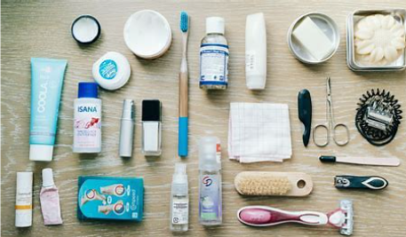
Open My Mind: Why do we need to keep ourselves clean?
Personal hygiene is important to keep us healthy.
How to these items help keep us healthy?

Slide 3
What are germs and how are they spread?
Read story: Germs are not for sharing
Germs Are Not for Sharing (the-eye.eu)

Slide 4

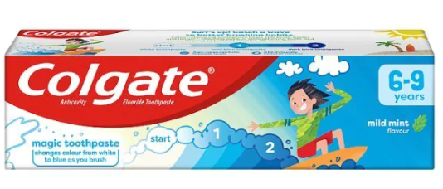
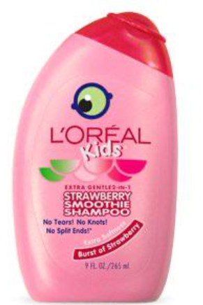
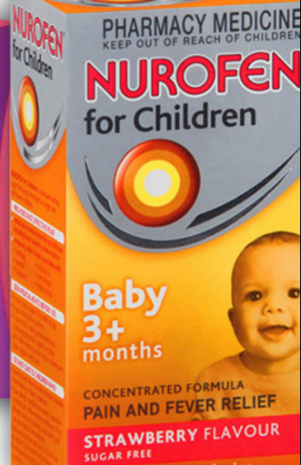
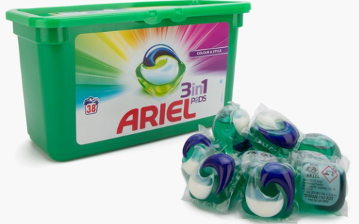
How can we stay safe at home?
We use many products to keep ourselves and our houses clean. But are they all safe for us to touch?

Slide 5
Let me learn:
Look at the following household items.
Where in the home would you find them?
Are they safe or not safe?
Decide where in the house you would find/use them and then sort them into two groups. Safe and not safe.

Slide 6


