Slide 1

Wednesday 26th May 2021
L.O: To write with purpose
C: Persuasive Letter

Slide 2

Today we are going to write the first main section of our letters.

Slide 3
First, let’s look at some persuasive phrases we could use!

Slide 4
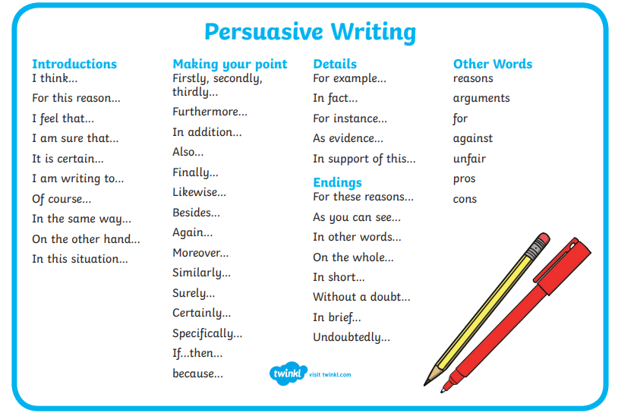

Slide 5
I’m going to model how to write up a P.E.E paragraph using the plan and a word bank.
Problem 1: Plastic Packaging
Point | McDonald’s Happy Meals contain lots of plastic packaging. Particularly milk bottles and fruit bag packets.
Evidence | Children should make balanced choices: Milk and fruit. 50% try to choose this option. Both the milk and fruit come in plastic packaging. 88% bin this within 1 hour of purchase.
Explain | Milk bottles- paper cartoons. Fruit bags- self-sealed/contained fruit. E.g. bananas, apples, oranges.

Slide 6
It’s your turn to write your first P.E.E paragraph! Use the word bank and model to help you. ☺

