Slide 1
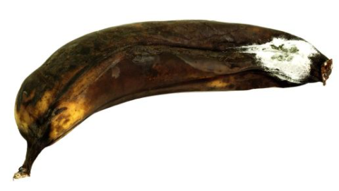

Build a sentence
Mmmmm. This banana is ...
Soft/squishy/black/brown/slimy/bad/
disgusting
Mmmm. This banana is soft and squishy.
Mmmm. This banana is brown, slimy and disgusting.

Slide 2
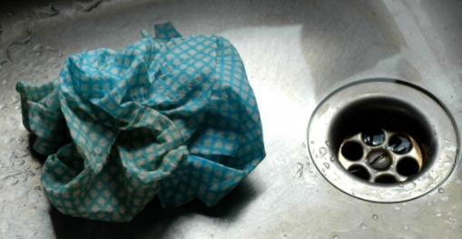
blue, grey, white, slimy, smelly, dirty

Slide 3
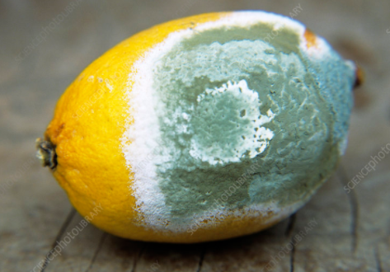
green, mouldy, white, powdery, wrinkly, disgusting

