Slide 1
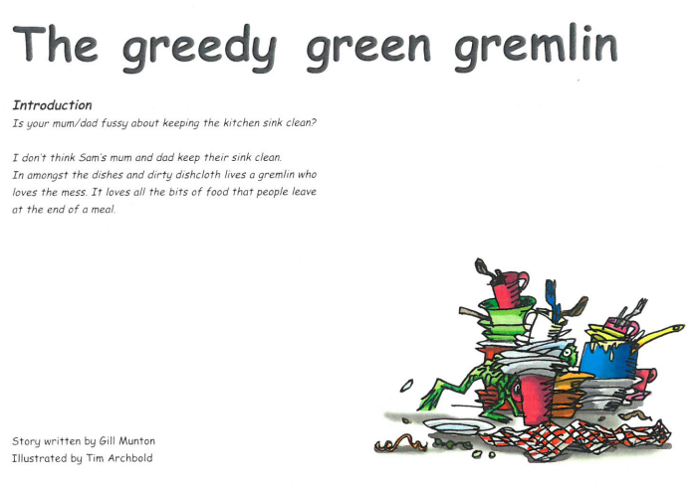


Slide 2
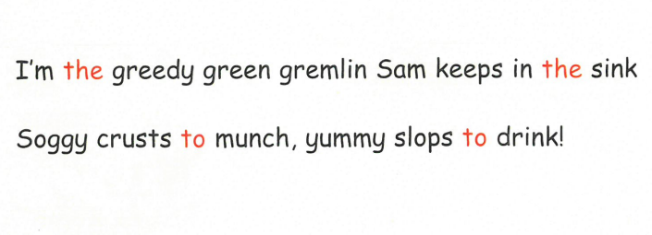
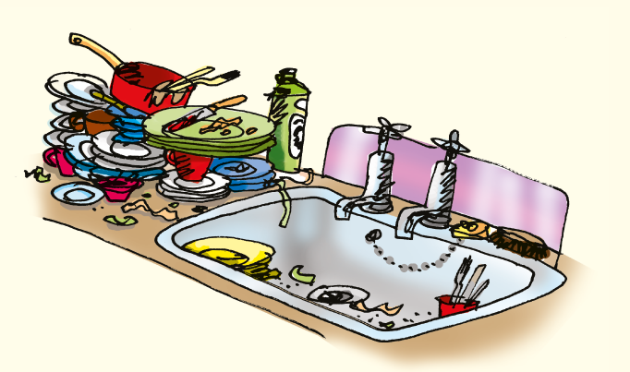
How is Sam’s kitchen so unclean?
What is Sam’s expression when he sees the sink?
What do you think Sam says when he sees the mess?

Slide 3
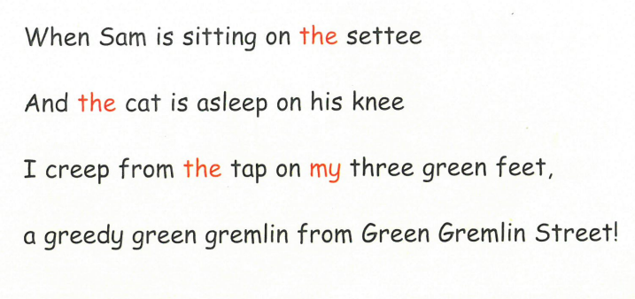
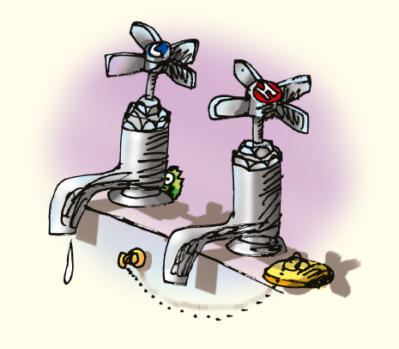
Where is the Gremlin from?
How does it get in Sam’s sink?

Slide 4
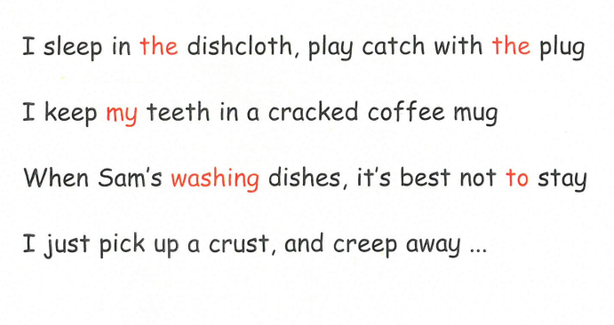
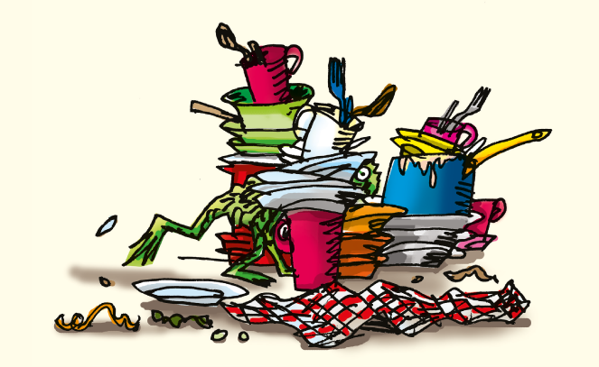
What does the gremlin like to do?

