Slide 1

Friday 28th May 2021
L.O: To write with purpose
C: Persuasive Letter

Slide 2

Today we are going to finish and sign off our letters.

Slide 3
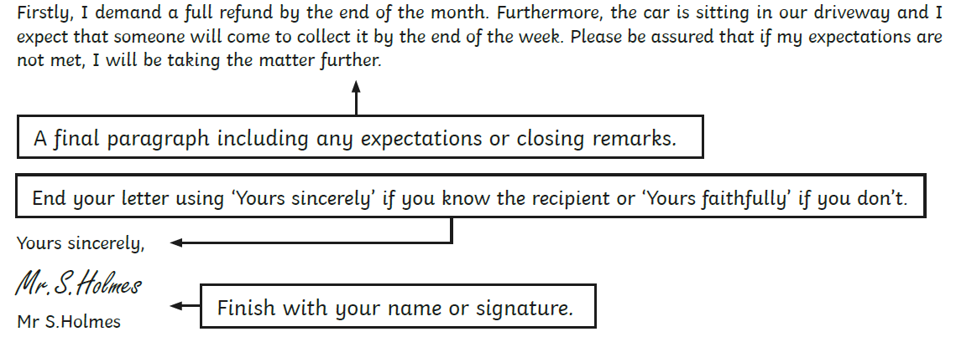

Slide 4
I truly hope you consider all of the problems I have raised and begin to reflect on the manageable and cost-effective solutions I have offered. With growing concerns regarding Climate Change, I expect to see some imminent changes to your company.
Yours Faithfully,
Miss Watton

Slide 5
Let’s magpie some key phrases!

Slide 6
I truly hope you consider all of the problems I have raised and begin to reflect on the manageable and cost-effective solutions I have offered. With growing concerns regarding Climate Change, I expect to see some imminent changes to your company.
Yours Faithfully,
Miss Watton

Slide 7
It’s now your turn to write your conclusion! It should be quite short and concise. ☺

