Slide 1
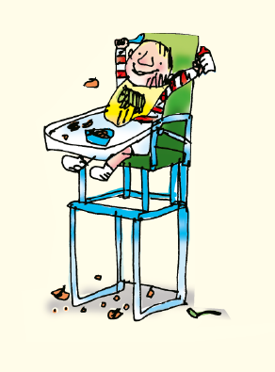
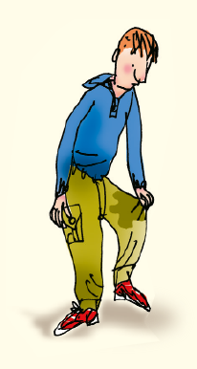

Everyone thinks babies are cute.
What do people say to babies?
(coochy coo/Who’s a lovely, jubbly, bubbly baby)
What does Dan think of the baby?
I don’t think babies are cute.
Why doesn’t he like babies?
They wee on the carpet and scream all night.
They are sick on their clothes and drop food everywhere.
Now write your own sentence for Dan. Start with ‘I don’t think babies are cute.’

