Slide 1
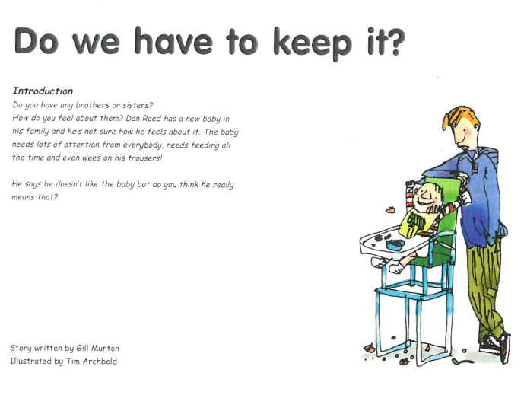


Slide 2
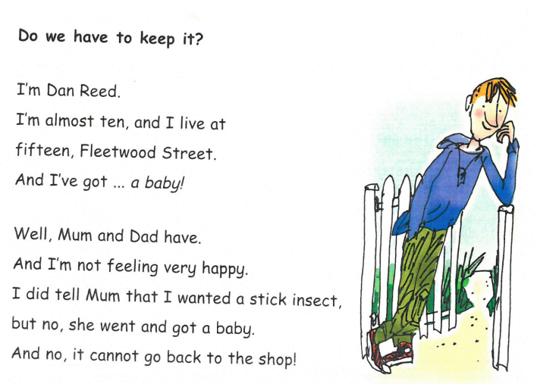
Who is telling the story?
How is he feeling and why?

Slide 3
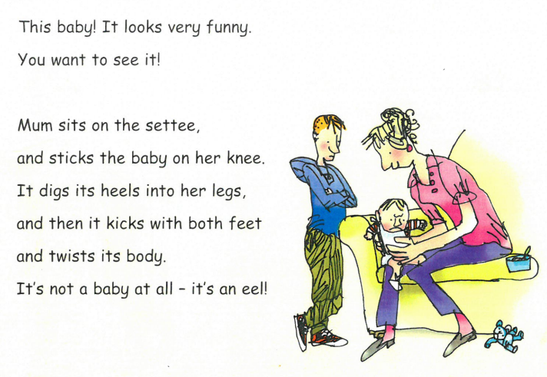
How does Dan describe the way the baby moves?

Slide 4
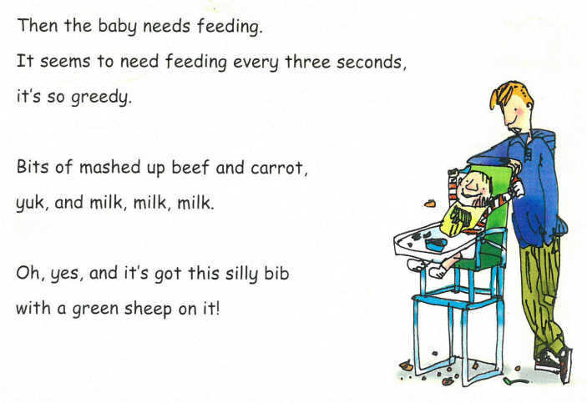
What does Dan think about how the baby eats?

Slide 5
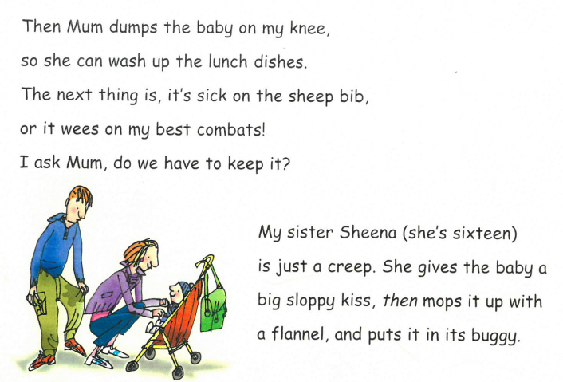
Why does the baby annoy him?
Why does he think his sister Sheena is a creep?

Slide 6
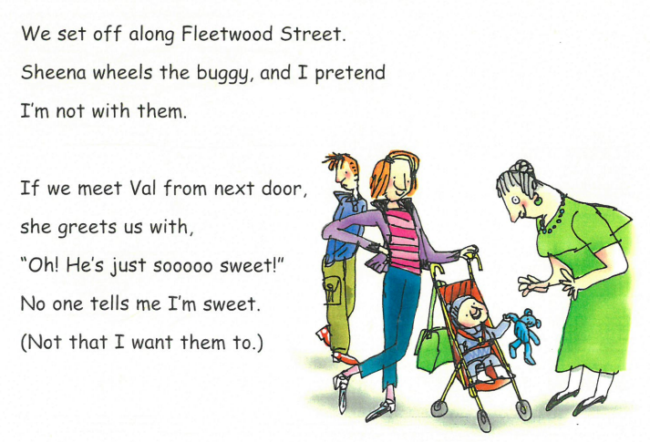

Slide 7
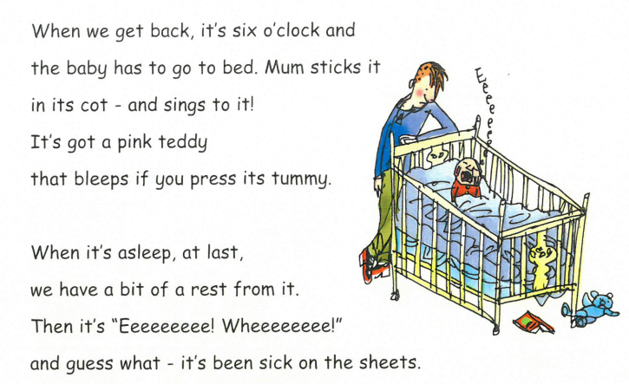
How does Mum get the baby to sleep?
How does Dan feel when the baby wakes up?

Slide 8
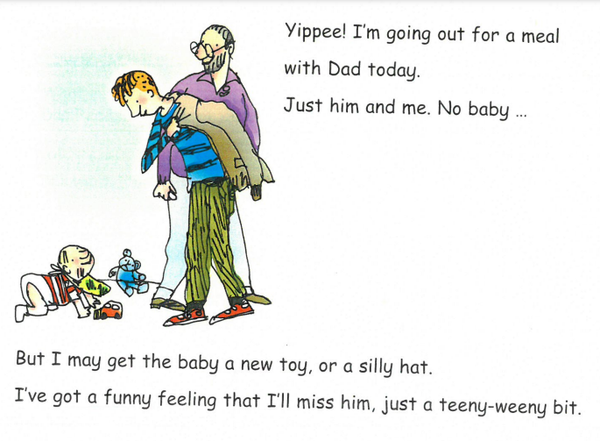
Show me Dan’s expression as he gets ready to go out.
How is he feeling and why?
What is Dan’s funny feeling at the end?

