Slide 1
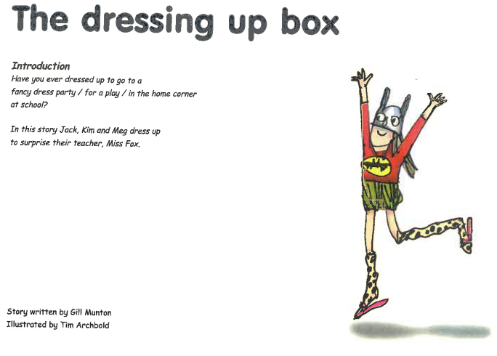


Slide 2
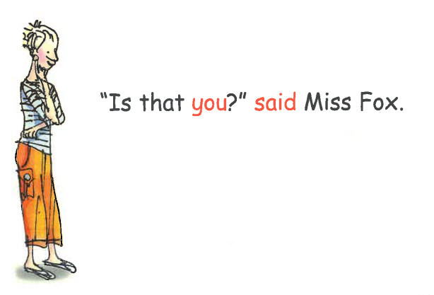
Why is Miss Fox asking who it is?

Slide 3
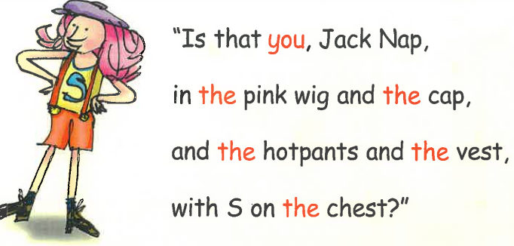
How is Jack pretending to be a funny character in a film?

Slide 4
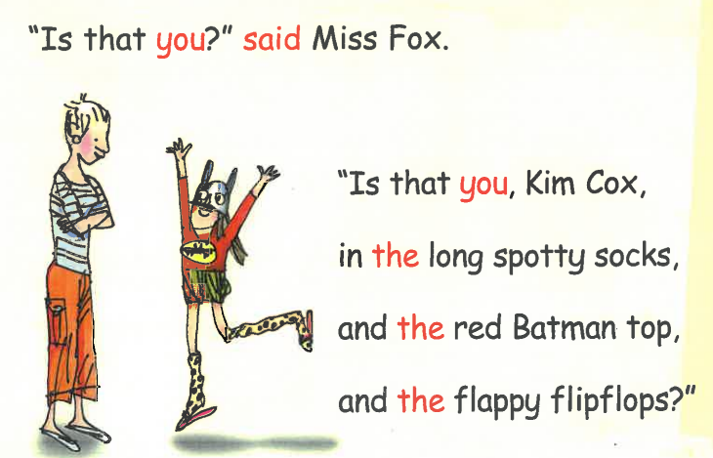
Why isn't Miss Fox sure who it is?

Slide 5
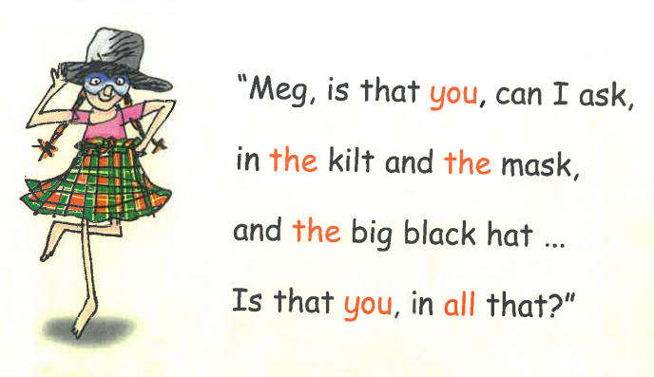
What is Meg wearing? How is she feeling?

Slide 6
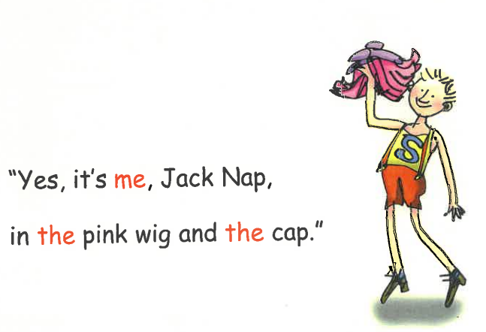

Slide 7


