Slide 1
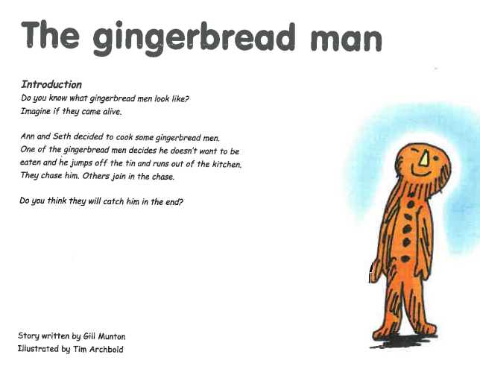


Slide 2
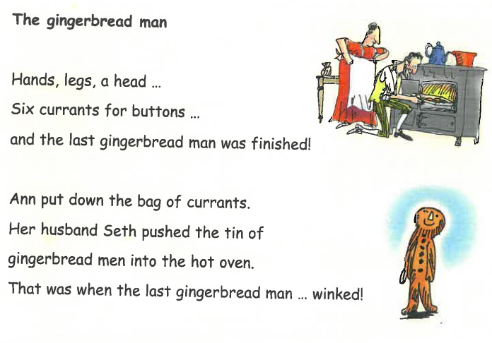
Why doesn't Seth notice the last gingerbread man wink?

Slide 3
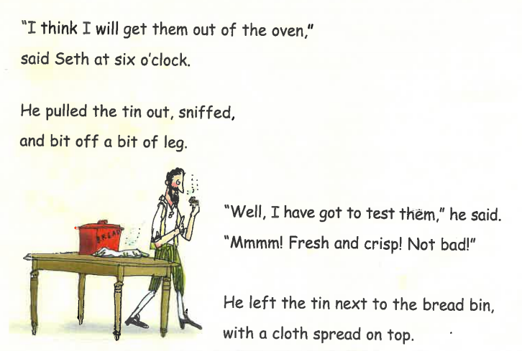
What does Seth do after he gets the gingerbread men out of the oven?

Slide 4
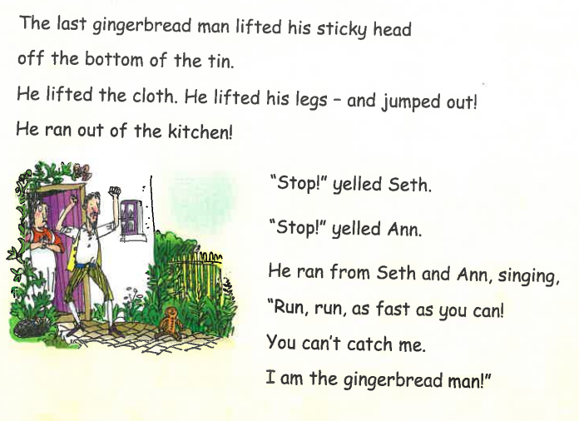
How is Seth feeling and why?

Slide 5
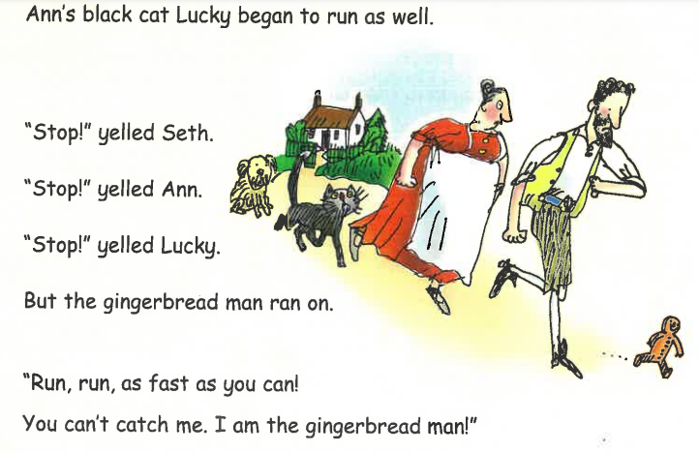
What does the gingerbread man do and say?

Slide 6
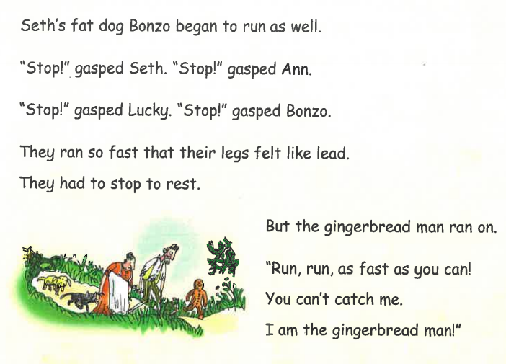
Who helped Seth and Ann chase the gingerbread man? Why did the gingerbread man keep on running?

Slide 7
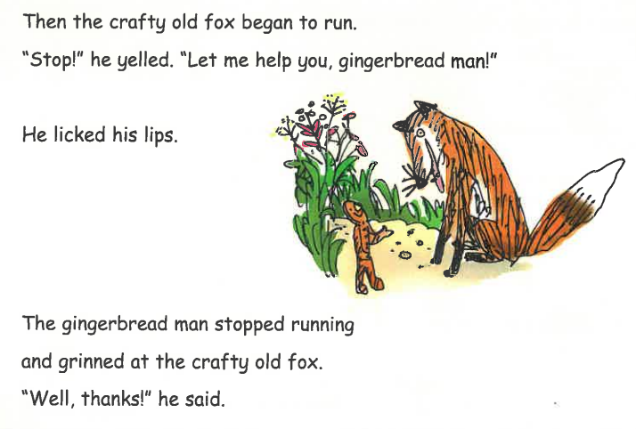
What does the fox offer and why does the gingerbread man accept?

Slide 8
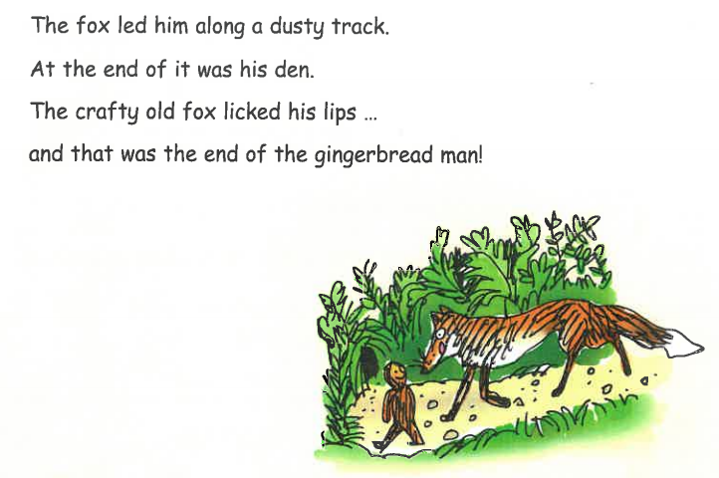
What is the fox going to do with the gingerbread man? Do you think the gingerbread man is clever or foolish? Explain why.

