Slide 1


Slide 3


Which representations show 100?
Have a think
20 | 20 | 20 | 20 | 20

Slide 5


How many different ways can you represent 100?
Use your representations to divide 100 into 2 equal groups
Now divide 100 by 4
What do you notice?
Have a think
100 $÷$ 2 $=$ 50
100 $÷$ 4 $=$ 25

Slide 6


Now use your representations to divide 100 into 5 equal groups
And then 10 equal groups
What do you notice this time?
Have a think
100 $÷$ 5 $=$ 20
100 $÷$ 10 $=$ 10

Slide 7



The children are investigating different ways to divide 100 by 2, 4, 5 and 10
I will use a
place value grid.
I will use 100
squares.
I will use the partitioning method.

Slide 8

The children are investigating 100 divided by 2, 5, 4 and 10
Tens | Ones
I will use a
place value grid.
100 $÷$ 2 $=$ 50
Have a think
Use Amir’s method to divide 100 by 4, 5 and 10
Will any of the divisions need an exchange?

Slide 9

Use Jack’s method to divide 100 by 2, 4 and 10
How will you partition the 100 each time?
Is there more than one way?
100
100 $÷$ 5 $=$ 20
50
50
Have a think
÷ 5
÷ 5
10
10
I will use the partitioning method.
10 + 10 =
20

Slide 10



I will use a 100
square.
Have a think
100 $÷$ 2 $=$ 50
Use Annie’s method to divide 100 by 4, 5 and 10
Is there more than one way to cut the 100 square into equal parts each time?

Slide 11
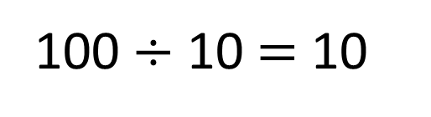
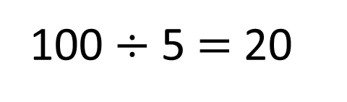
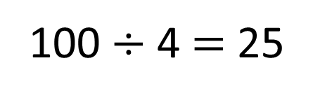
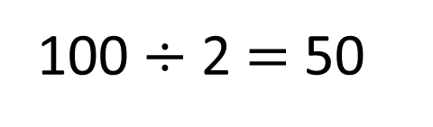
Do you notice any patterns?
100 $÷$ 2 $=$ 50
100 $÷$ 5 $=$ 20
double
half
double
half
100 $÷$ 4 $=$ 25
100 $÷$ 10 $=$ 10
50 | 50
20 | 20 | 20 | 20 | 20
25 | 25 | 25 | 25
10 | 10 | 10 | 10 | 10 | 10 | 10 | 10 | 10 | 10

Slide 12



Have a think
$\text{100} ÷$ $=$ $×$
$\text{100} ÷$ $=$
$\text{100} ÷$ $= +$
$\text{100} ÷$ $= + +$
What is the value of each shape?

Slide 13
$\text{100} ÷$ $=$ $×$
2
5
10
$\text{100} ÷$ $=$
10
10
$\text{100} ÷$ $= +$
5
10
10
4
$\text{100} ÷$ $= + +$
10
10
5
$=$ 2 $=$ 10 $=$ 5 $=$4

Slide 14

Here are some 100 squares for you to cut into equal parts.

Slide 15
In your books, pick the method you found the easiest for dividing 100 by 2, 4, 5 and 10 and show your working for each of these division.
RP: Explain why you preferred this method.

