Slide 1

Friday 12th March 2021
L.O: To understand texts- inference skills
C: Boy

Slide 2
Starter:
How many negative emotions can you think of?

Slide 3
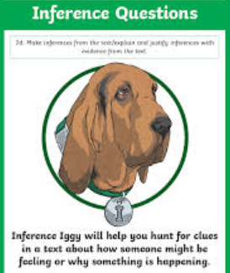
We are going to continue reading the story today.
We will be using our Inference Iggy skills today!

Slide 4
Class Read: p.15-18

Slide 5
Can you make a mind map bubble to show the emotions the Dahl family went through during the troubled times?
sad

Slide 6
Despite feeling all of these awful emotions, Roald Dahl’s mother managed to carry on.
Discuss with your partner how you think she managed this. You can use the book to help you.

Slide 7
Now you have discussed…
Please record your findings in your book.
I think she managed to carry on by…

Slide 8

Red Pen Challenge:
How does Roald Dahl portray his mother as a strong woman?

