Slide 1
LO: I can identify what being a good friend means to me.
I know how to make a new friend.
C: Relationships – piece 2

Slide 2
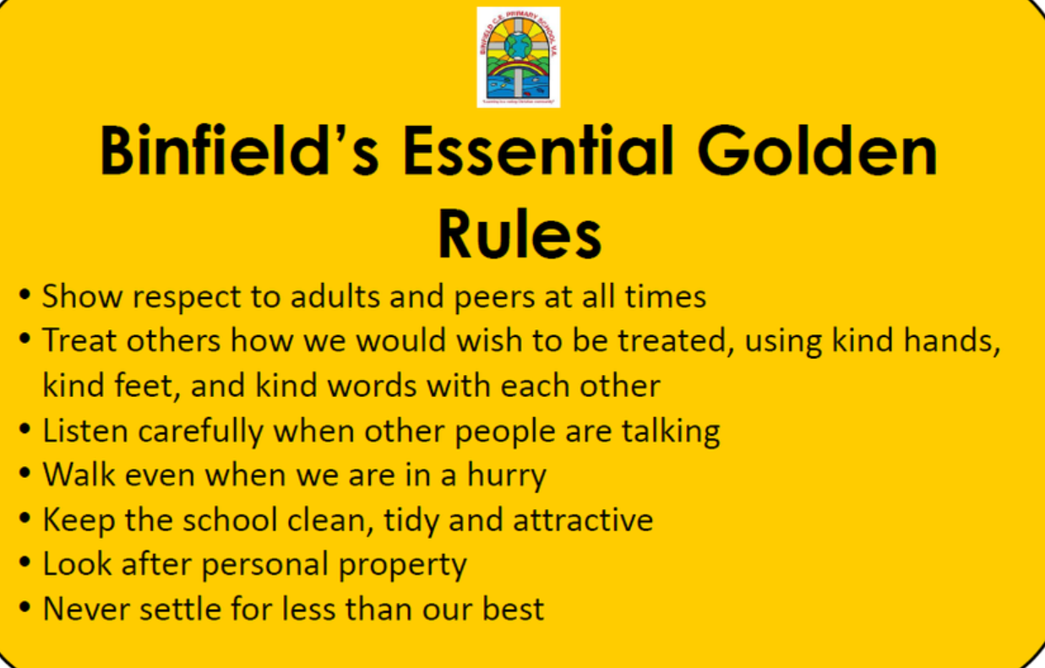
Recap Binfield Golden rules and Extra golden rules

Slide 3
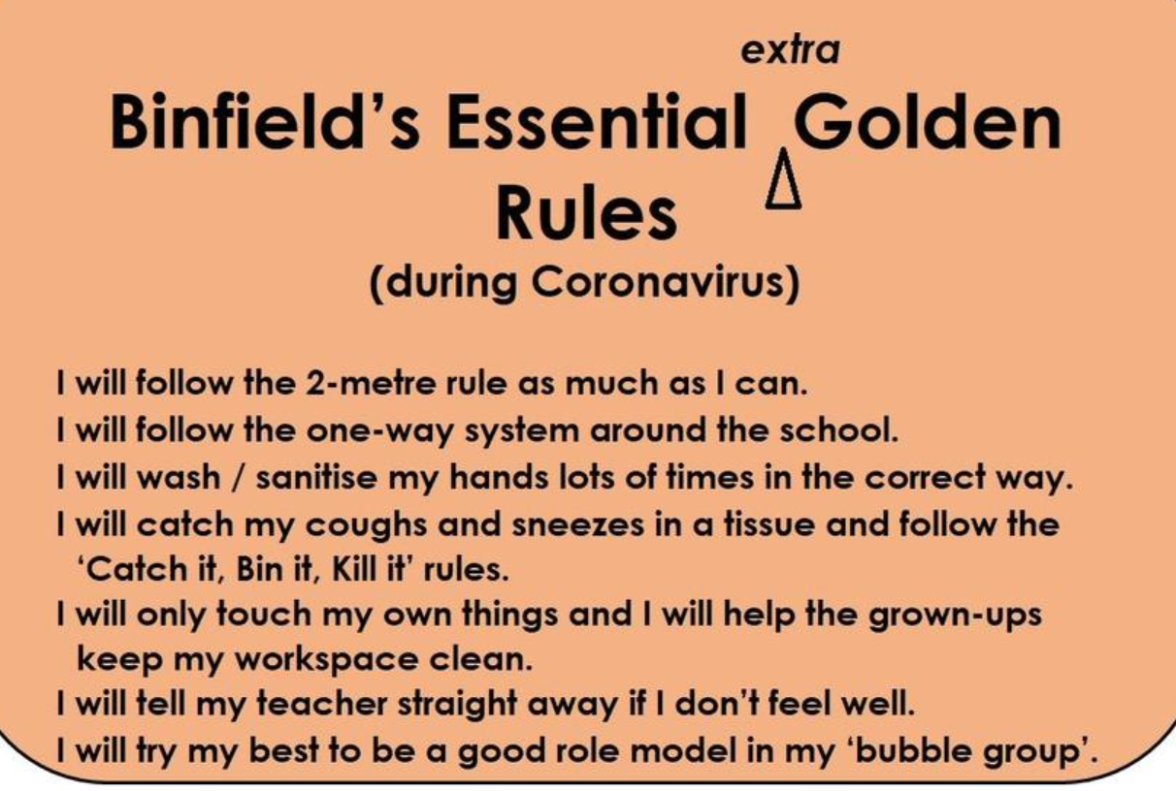

Slide 4
Connect us:
Play Hedgehogs. Children to move around the room to the music, when the music stops children curl up on the floor like hedgehogs. Ask the children to close their eyes. Put a blanket over one child, the others stand up and guess who is under the blanket. Ask the children what they like about the person who is under the blanket, being the hedgehog. Repeat as time allows.

Slide 5
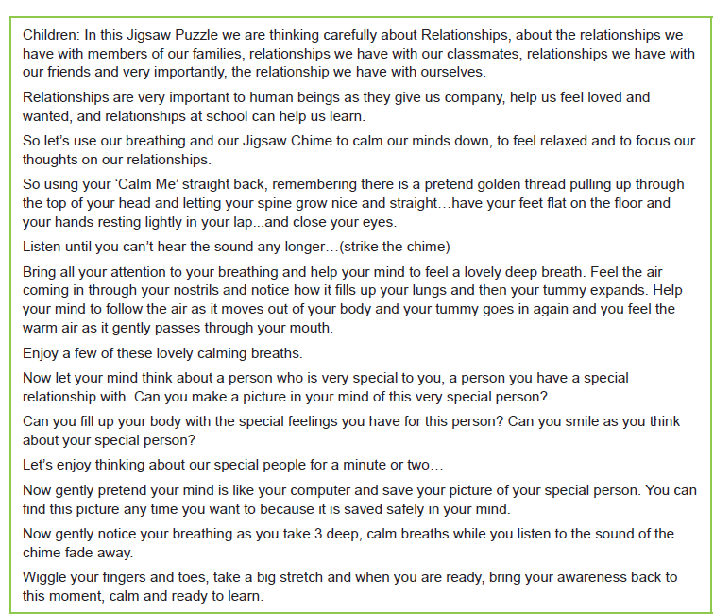
Calm me

Slide 6
Listen to the song:
What do we like about our friends in class?

Slide 7
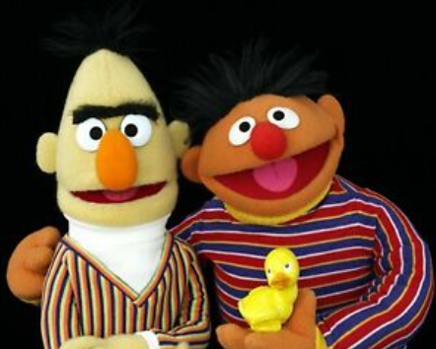
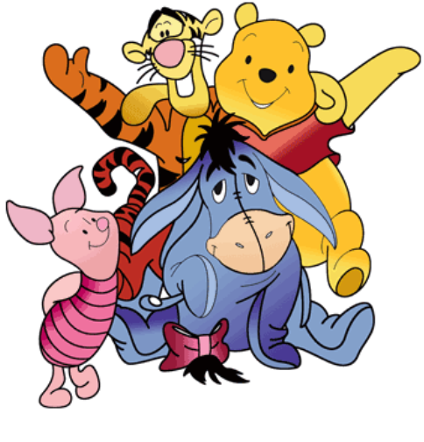
Think about the stories you read or watch. What characters do you know that get on really well together?
Why do they get on well? Do they always get on? Do they ever disagree or fall out with each other? What do they enjoy doing together?

Slide 8
In order to have good friends, we need to be a good friend!
What is a friend?
What makes people friends?
Do friends always get on well?
What makes a good friend?
What helps people to make friends?
What do you look for in a friend?

Slide 9
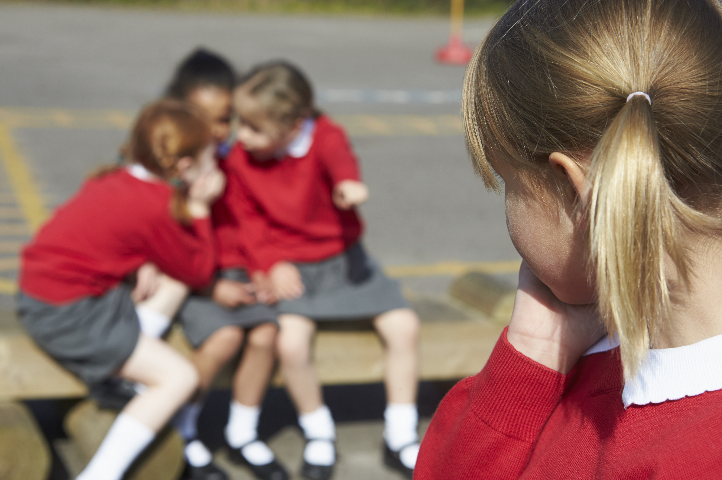
Why might this girl be on her own?
How could you be a good friend to her?

Slide 10
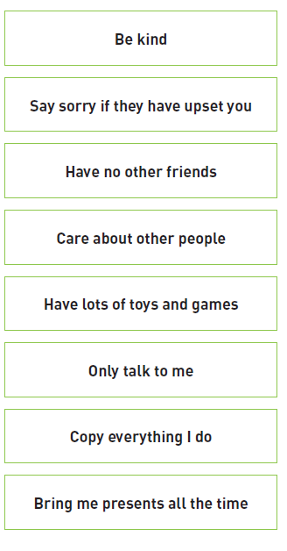
Let me learn: What makes a good friend?
Read the statements about what makes a good friend carefully and sort them into two piles, true or false.
Red Pen: What do you think is the most important quality that a friend should have? Explain why.

