Slide 1
LO: I know how my body has changed since I was a baby.
I understand that growing up is natural and that everybody grows at different rates
Context: Changing Me.

Slide 2

Recap Binfield Golden rules and Extra golden rules

Slide 3
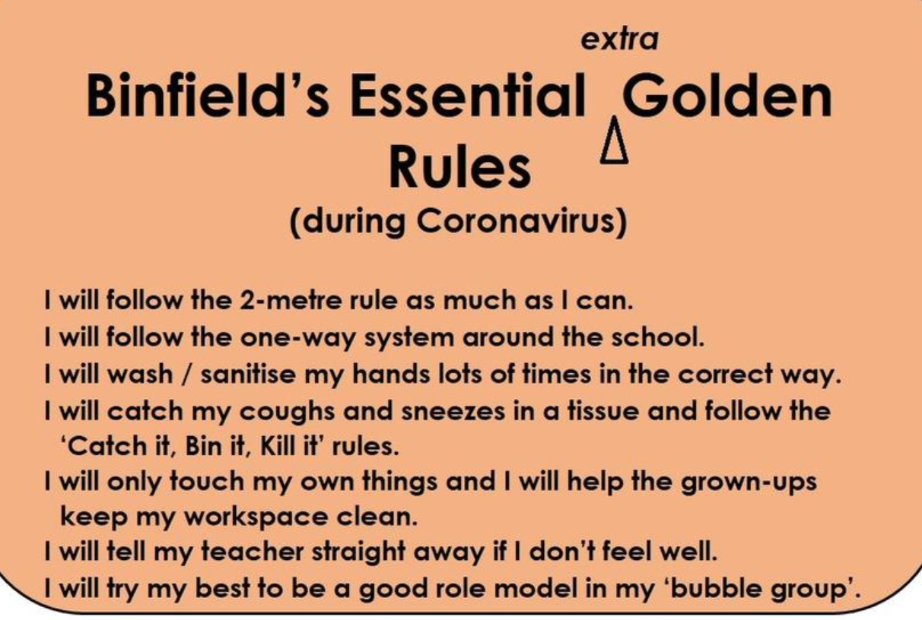

Slide 4
Connect us: Play Simon Says.

Slide 5
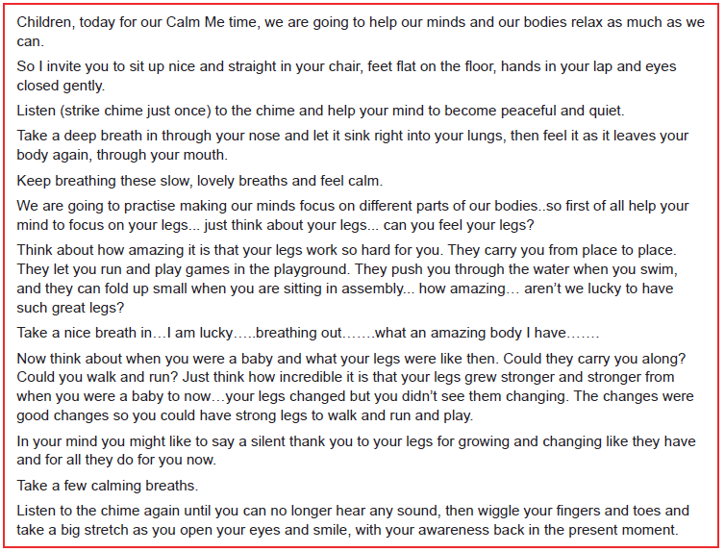
Calm me:

Slide 6
Listen and appraise:
What does this song teach us about changing and growing up?

Slide 7
Tell me/Show me
We are all changing all the time. We are still ‘us’, I am still me, even though my body grows and changes every day.
In pairs, talk about all the ways you can think of that you have changed since you were babies. Share round the circle the ideas you have come up with. Can you think of a change in your body as well as another change e.g. abilities, personality etc.
Write some ideas on the whiteboard in two columns labelled ‘Body changes’ and ‘Other changes’.

Slide 8
Let me learn
Draw a picture of yourself as a baby.
Around the picture, write some of the different ways you have changed since you were a baby.
* Use some of the ideas that we wrote down as a class if you get stuck.

