Slide 2
Rosh Hashanah - Bing video

Slide 3
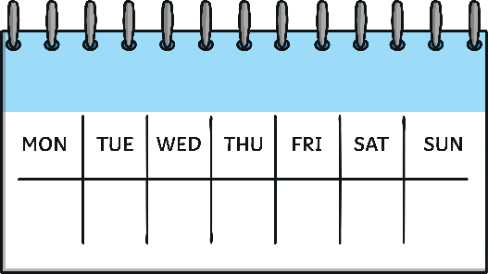
New Year
Talk About
It
New Year is a time when people think about the year that has passed and make promises about what they’ll do next year. Sometimes, we call these promises New Year resolutions. Have you ever made a New Year’s resolution? What was it? Did you keep it?
All across the world, people have different New Year festivals. This is because in the past (and sometimes still today) different countries and groups of people had their own calendars and celebrated events such as New Year’s Eve at different times.
Many people celebrate New Year’s Day on 1st January.
Chinese New Year (sometimes called Lunar New Year) is in January or February.

Slide 4
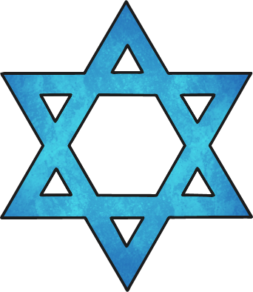
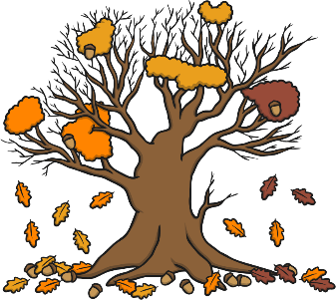
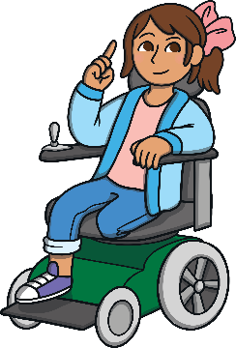
Rosh Hashanah
Rosh Hashanah is a festival that is celebrated by people who belong to the Jewish faith. It celebrates the Jewish New Year and beginnings. Rosh Hashanah lasts for two days.
It is celebrated in the autumn, although the exact day changes each year.
Rosh Hashanah means ‘head of the year’. Just like the brain in your head controls everything you do, Jewish people believe their actions during Rosh Hashanah will affect the rest of the year.

Slide 5
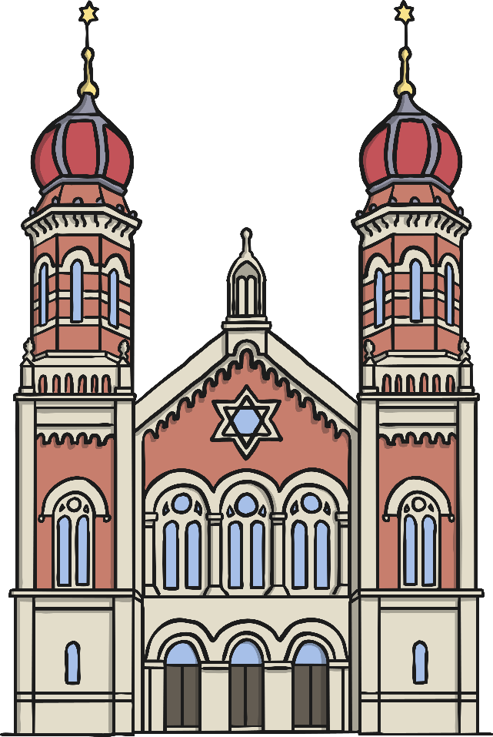
How is Rosh Hashanah Celebrated?
Jewish people don’t go to work during Rosh Hashanah.
They will visit the synagogue, which is the place where Jewish people go to pray and learn about God.

Slide 6
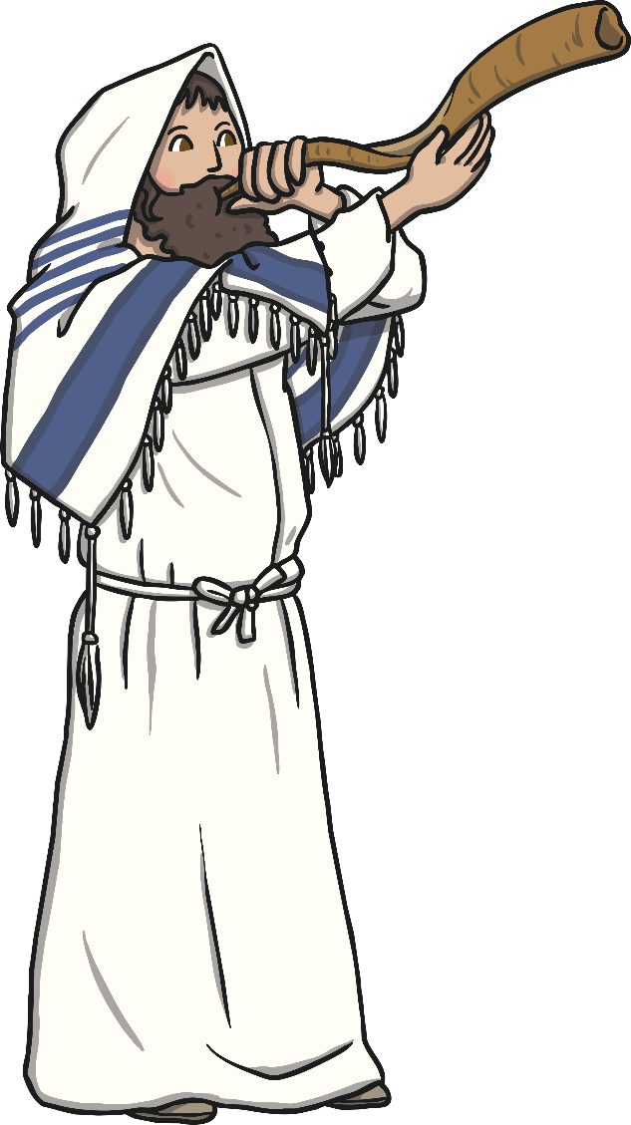
How is Rosh Hashanah Celebrated?
A special horn called a ‘shofar’ is blown to signal the start of the new year.
A shofar is made from a ram’s horn.
The shofar can be blown up to 100 times each day of Rosh Hashanah. It is very loud!
Hearing the shofar is an important part of Rosh Hashanah. If someone is ill and can’t get to a synagogue, they might ask someone to visit their house to blow the shofar.

Slide 7
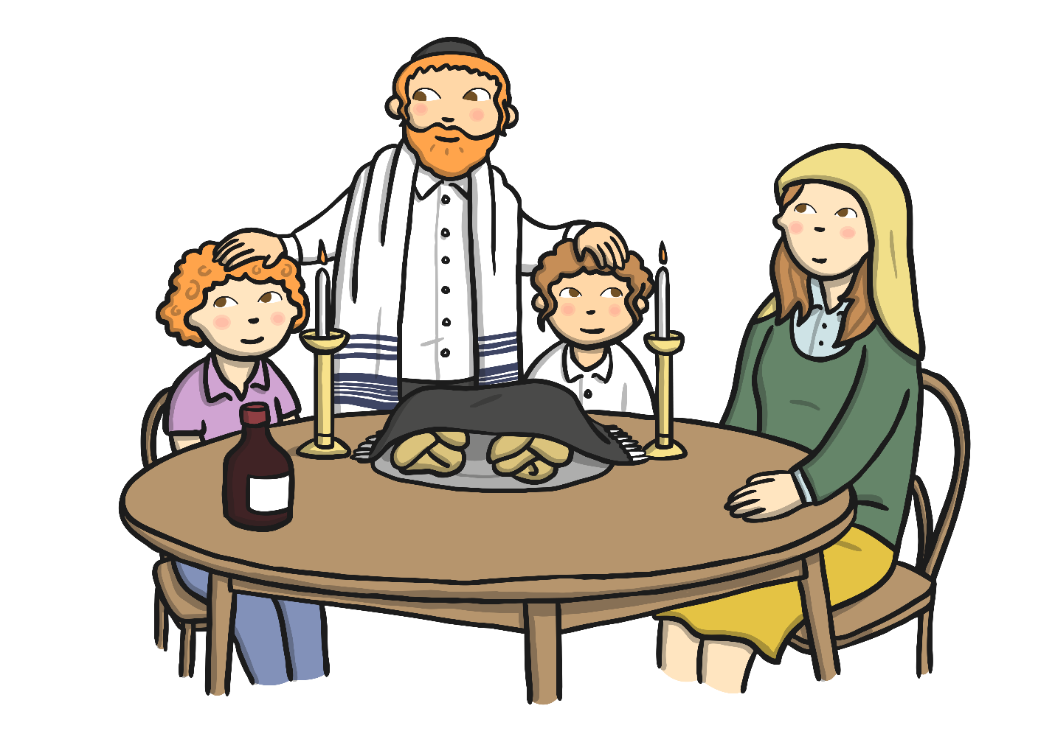
How is Rosh Hashanah Celebrated?
Family meals are an important part of Jewish life. At Rosh Hashanah, families eat together, light candles and say prayers.

Slide 8
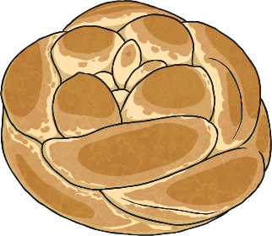
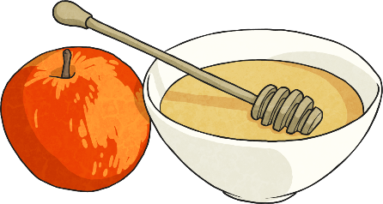
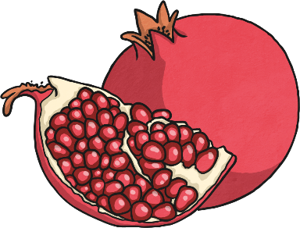
How is Rosh Hashanah Celebrated?
As part of meals during Rosh Hashanah, people eat special food.
Challah bread is dipped in honey.
Sweet food like apples and honey make people think about the good things ahead in the new year.
Pomegranates are eaten to express the wish that in the new year, people will do as many good deeds as the number of seeds in a pomegranate.

Slide 9
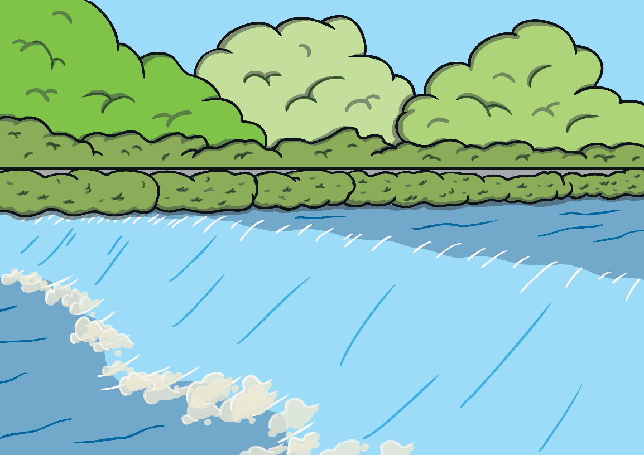
How is Rosh Hashanah Celebrated?
On the first afternoon of Rosh Hashanah, Jewish people will often visit a lake, river or the sea and say special prayers. They think about their sins (things that they have done wrong) and imagine throwing these into the water. This makes people feel free from their sins.

Slide 10
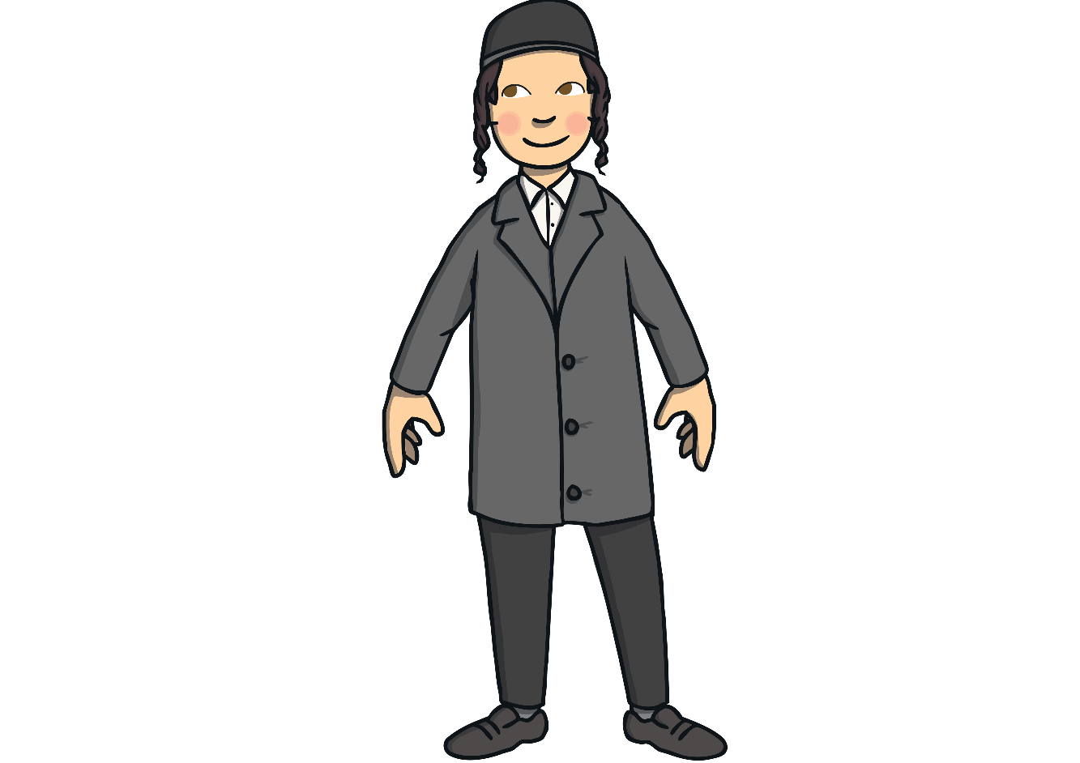
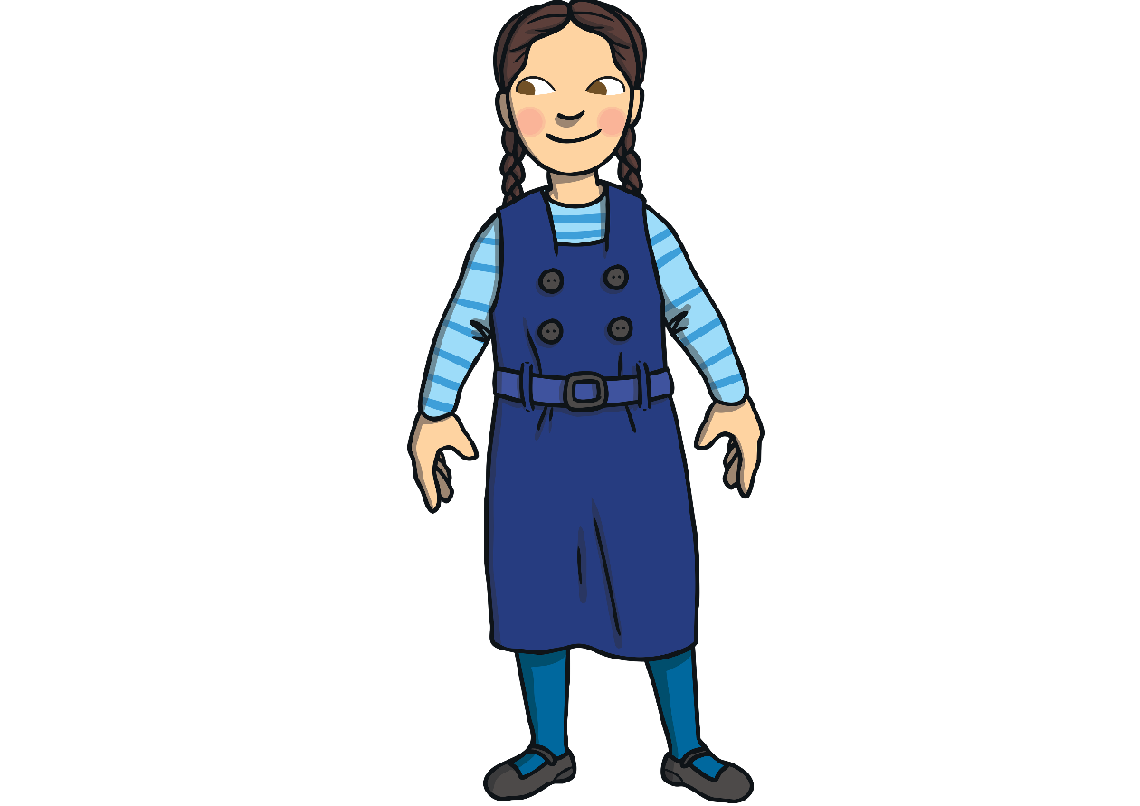
Yom Kippur
A week after Rosh Hashanah has finished, there is another Jewish festival called Yom Kippur.
The time in-between Rosh Hashanah and Yom Kippur is a time for Jewish people to try and be kind and good. They use this time to try to sort out any arguments they have had with people. They believe that if they do this, God will forgive them for anything they have done wrong.

Slide 11
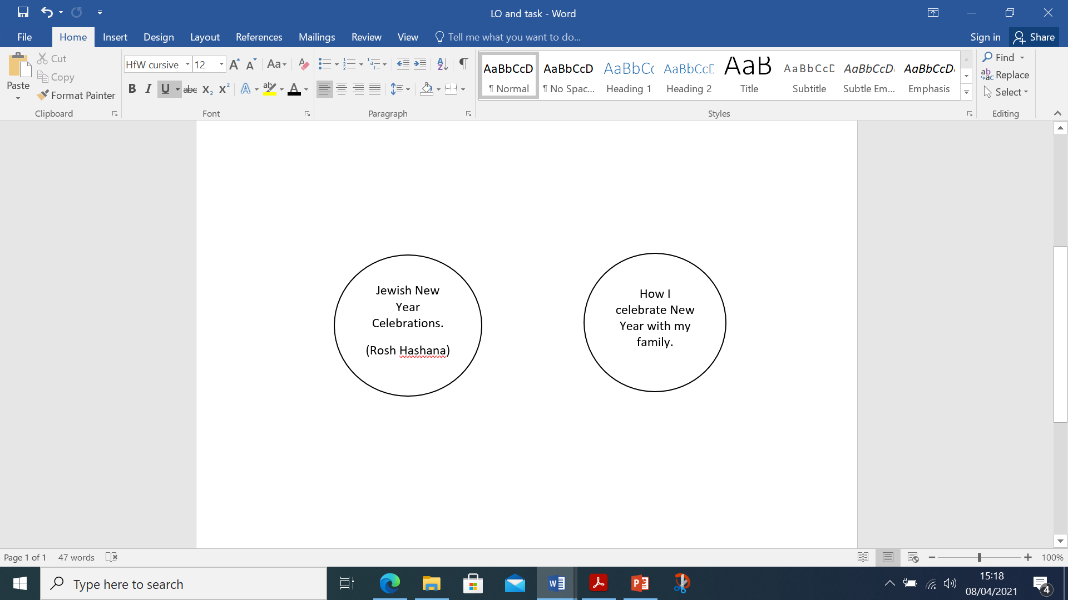
Rosh Hashanah is the Jewish way of celebrating the New Year. How do you and your families celebrate the new year?

Slide 13
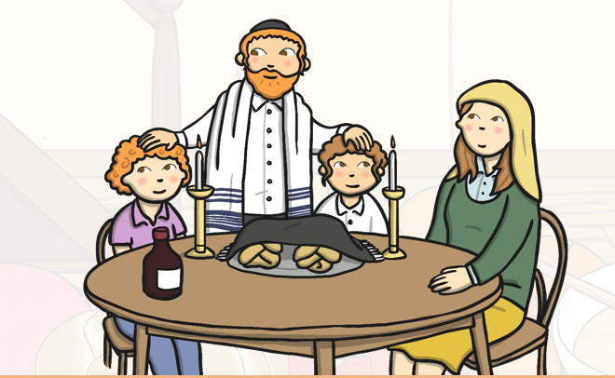
v

