Slide 1
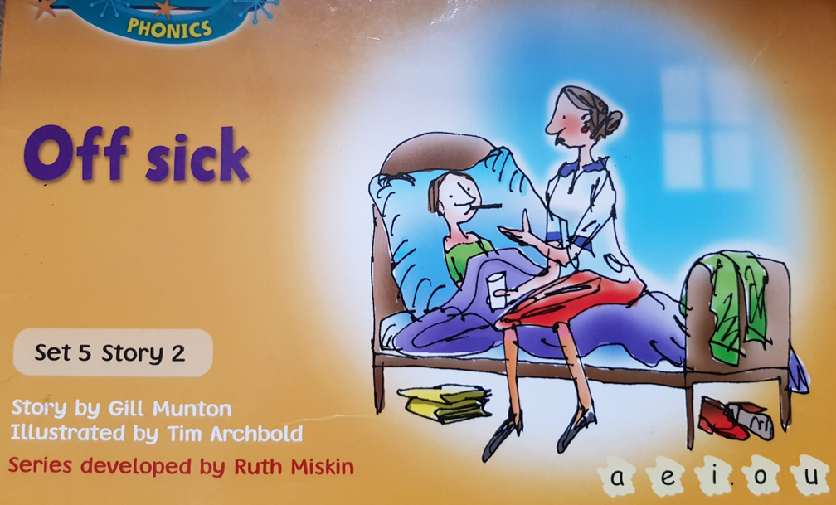


Slide 2
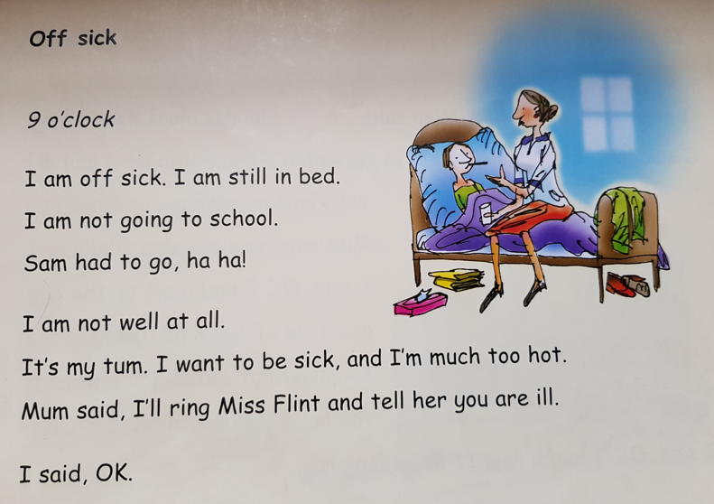
Why isn’t the girl going to school? How is she feeling?

Slide 3
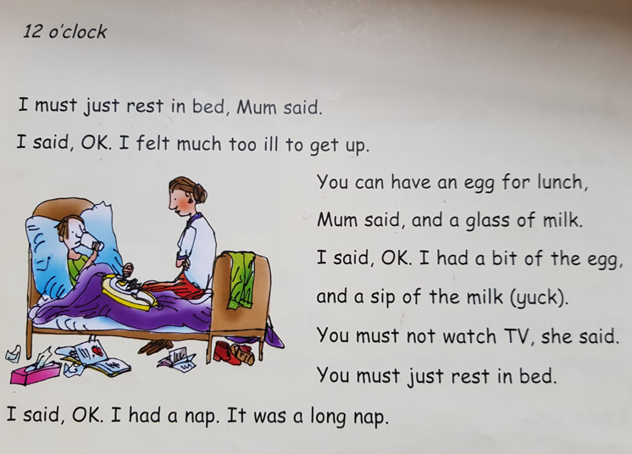
How does she spend her time from 12 o’clock?

Slide 4
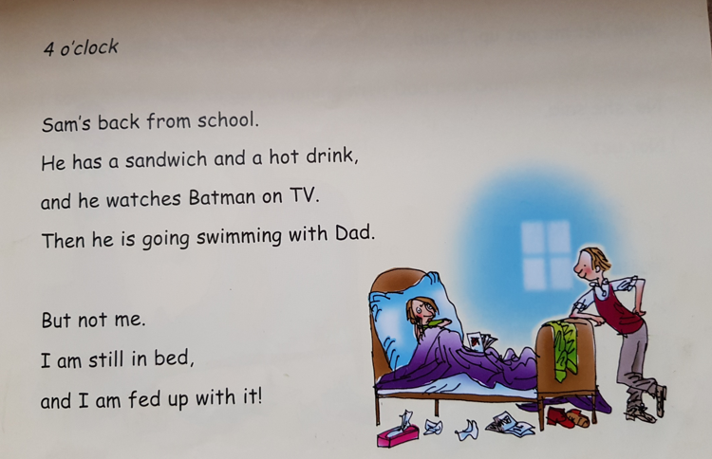
How does she feel when Sam gets back from school and why?

Slide 5
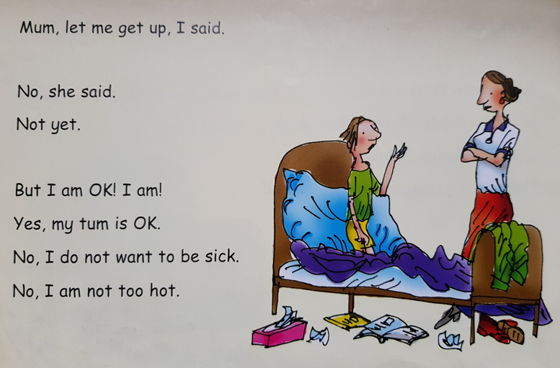
How does she try to convince her mum that she should get up?

Slide 6
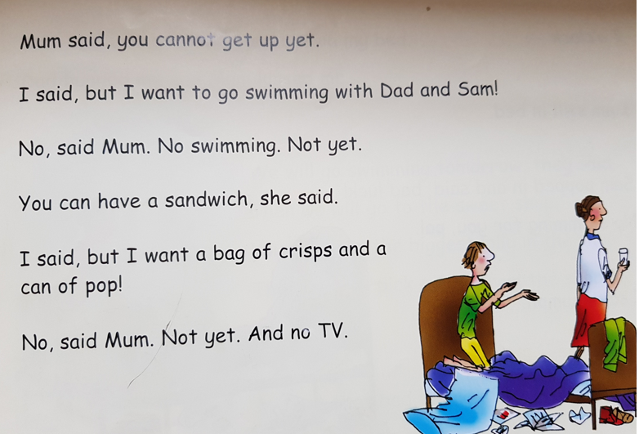

Slide 7
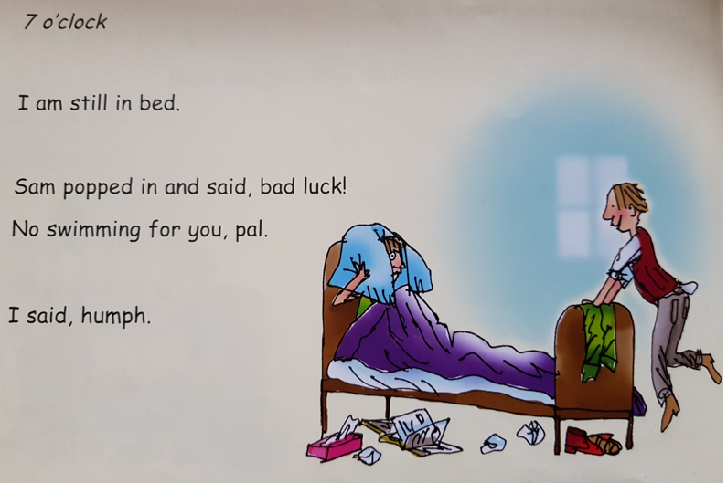
How does Sam make her feel even worse?

Slide 8
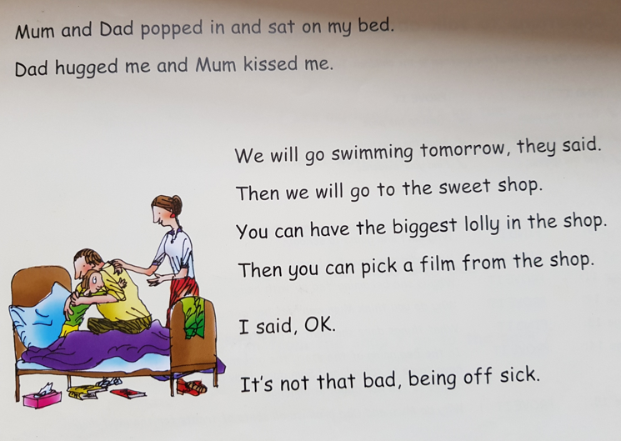
How do her mum and dad make her feel better?

