Slide 1
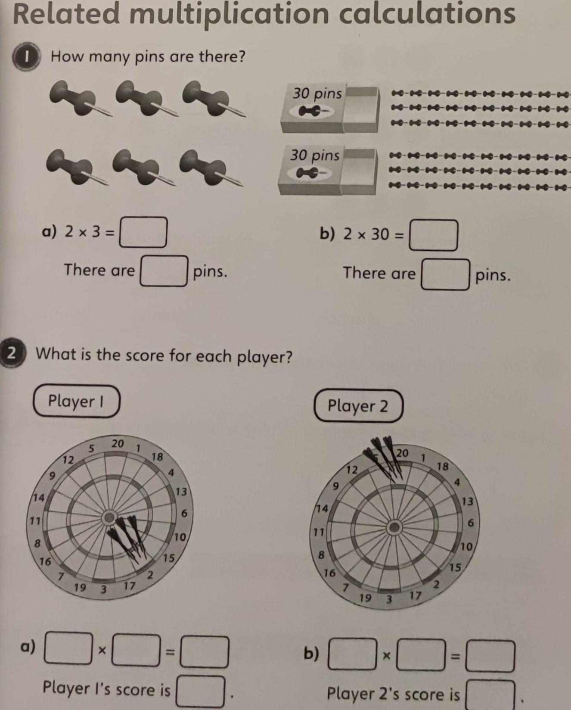

Slide 2
L.O: Multiplication and Division C: Multiply 2-digits by 1-digit (recap from home learning)
2 4
X 5

Slide 3
3 5
X 2
7 4
X 4

Slide 4
Snorkelling
3 2
X 4
4 2
X 5

Slide 5
Snorkelling
6 2
X 2
2 5
X 3

Slide 6
Snorkelling
7 4
X 4

Slide 7
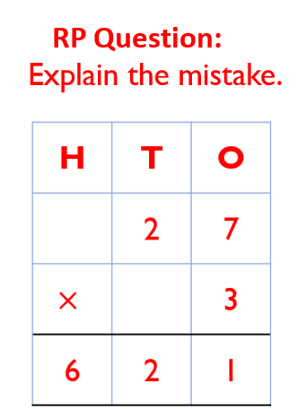
Snorkelling

