Slide 1
LO: I can tell you why I appreciate someone who is special to me.
I can express how I feel about them.
C: Relationships.

Slide 2
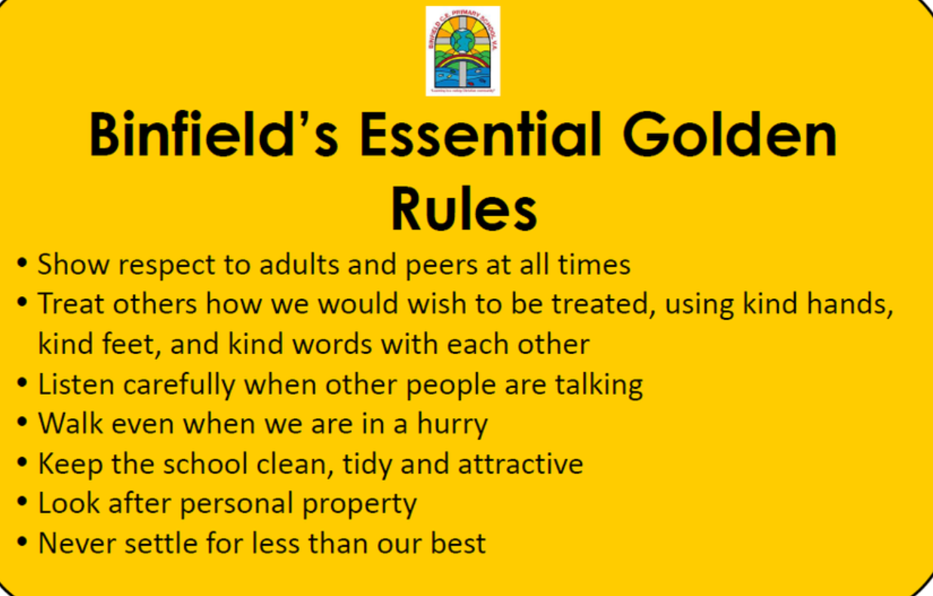
Recap Binfield Golden rules and Extra golden rules

Slide 3
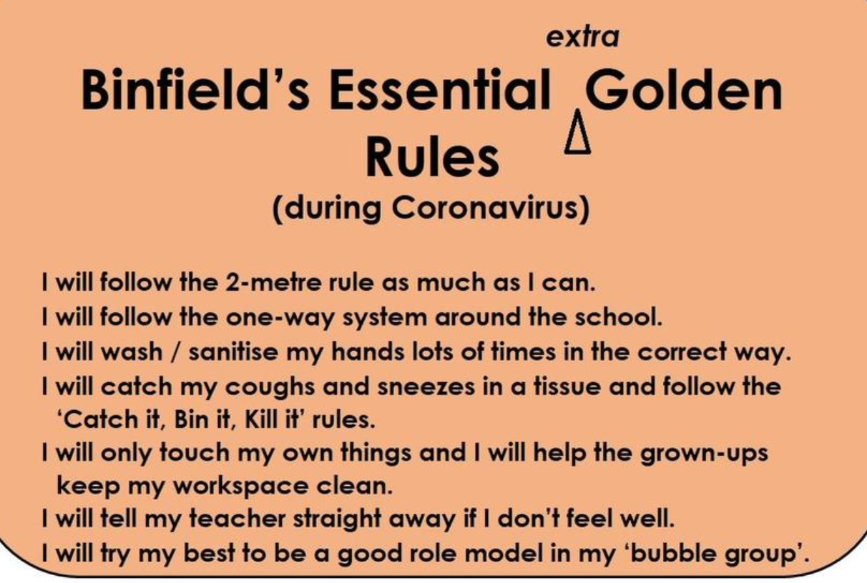

Slide 4
Connect us: Invite chn to talk about someone that is special to them.
My Nannie is special to me because…
My brother is special to me because…
***** is special to me because….

Slide 5
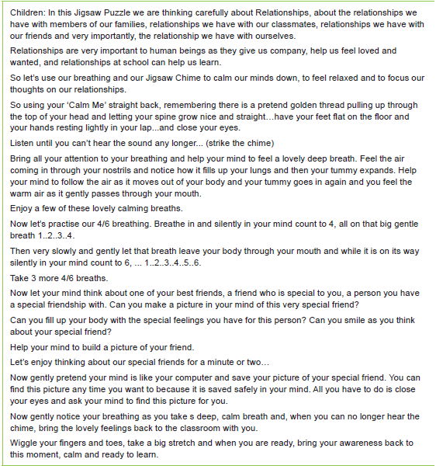
Calm me:

Slide 6
Open my mind:
Who is special to you in your life?
Why are they special?
Think, Pair, Share

Slide 7
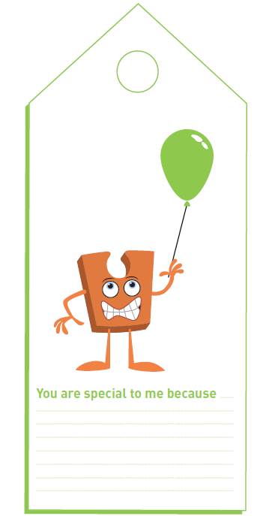
Let me learn: Task(Model to chn)
Draw the person that is special to you in the balloon template provided and complete the sentence.
You are special to me because…

