Slide 1
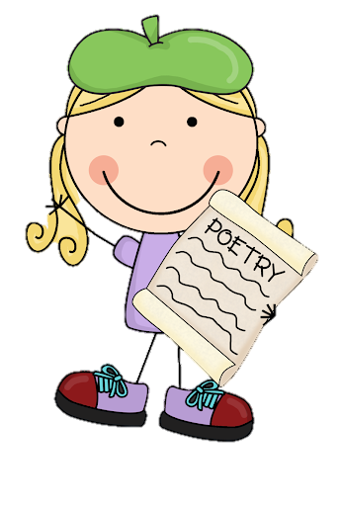
Monday 8th March 2021
L.O: To use the main features of a type of writing to write, edit and improve.
C: Cinquain Poems

Slide 2

Quick reminder:
A cinquain is a special kind of poem. Over the next two weeks, we are going to investigate the features and create our own!

Slide 3

Today we are going to finish writing a cinquain together!

Slide 4
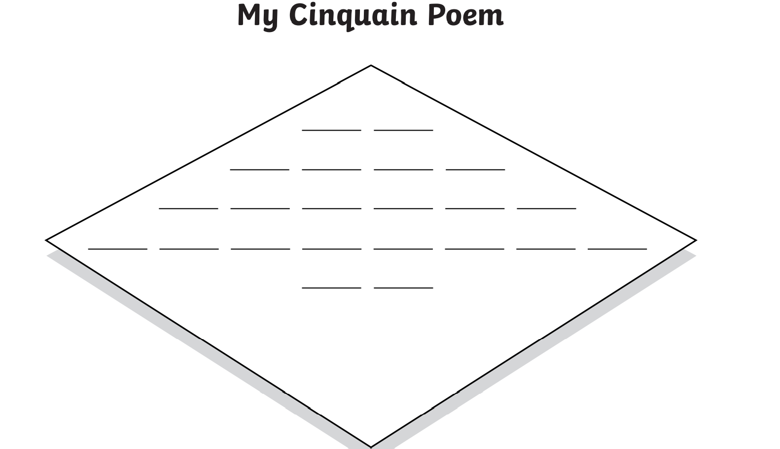
Let’s remind ourselves what we wrote last lesson…
Biscuits
Crunchy, golden

Slide 5

Our next step is to continue to reflect on and create the end of our poem.
Let’s remind ourselves of the pattern of themes used in a cinquain poem.

Slide 6
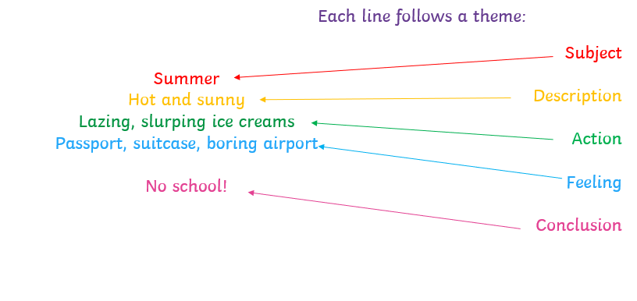
Our next step is to organise and refine our ideas!
Let’s remind ourselves of the
These are the themes used in the poem. We have completed the first two lines already.

Slide 7
As we organised our ideas yesterday, let’s try to write the next few lines of our poem! Try to remember your ABC from last lesson.
Let’s remind ourselves of the syllable pattern used in a cinquain poem.

Slide 8
Let’s remind ourselves of the features!
Cinquains have five lines;
The syllables follow a pattern in each line (2, 4, 6, 8, 2);
They form a diamond shape;
The lines are centered in the middle
The lines follow a theme pattern.

Slide 9
Let’s continue to use this template to help us! Each line represents a syllable not a word.
Biscuits
Crunchy, golden

Slide 10

RED PEN CHALLENGE!
Edit and Improve
Reflect on your ABC from last lesson.
Have you done what you set out to do?
Use a red pen to improve your structure and word choice.

