Slide 1

LO: To understand practices and lifestyles
C: Comparing Chanukah and Christmas

Slide 2
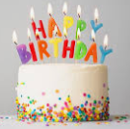
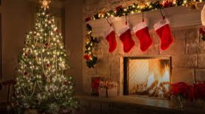
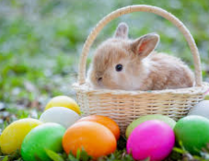
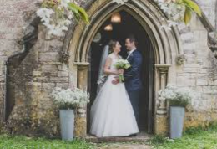
Quick Review: What does celebration mean?
What special things do we do when we celebrate a special time like Christmas or someone’s birthday?

Slide 3
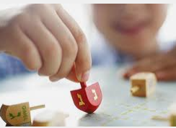
Party games are great fun!
During Chanukah, Jewish children play a game called Dreidel
https://www.bbc.co.uk/bitesize/topics/znwhfg8/articles/zj446v4
https://www.bbc.co.uk/programmes/p02n2kp0

Slide 4
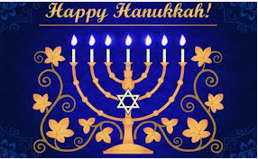
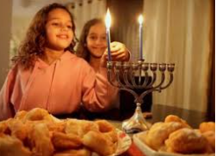
What is Hanukkah?
Hanukkah or Chanukah is the Jewish festival of light.
The word Hanukkah means rededication.
It dates back to two hundred years before the start of Christianity.
Hanukkah celebrates one of the greatest miracles in Jewish history.

Slide 5
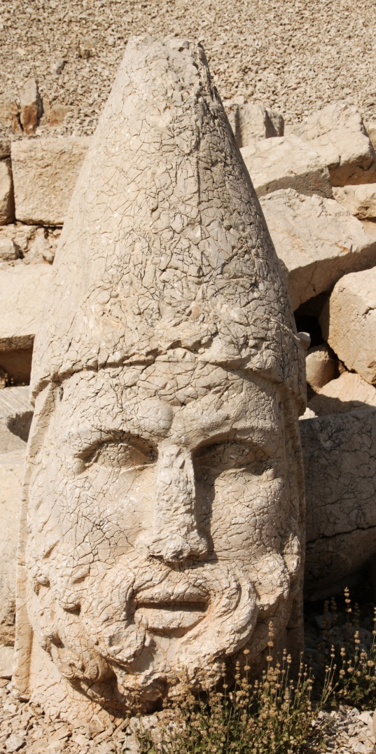
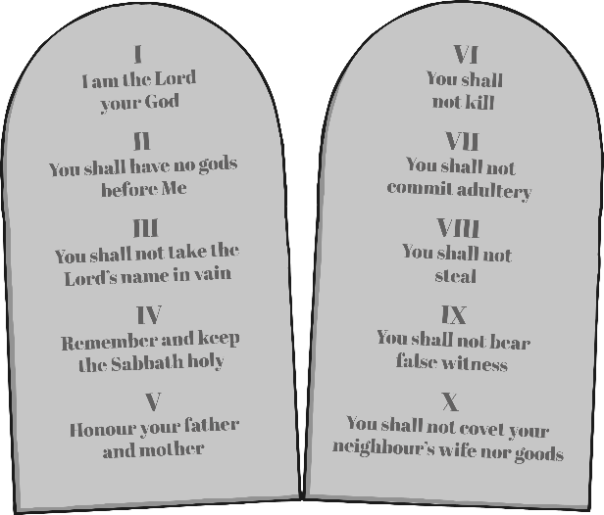
The Story of Hanukkah
The festival reminds Jews of when, 2500 years ago, a Syrian king tried to make the Jewish people worship Greek gods and bow to statues.
This was forbidden by the Ten Commandments.
Photo courtesy Klearchos Kapoutsis(@flickr.com) - granted under creative commons licence - attribution

Slide 6
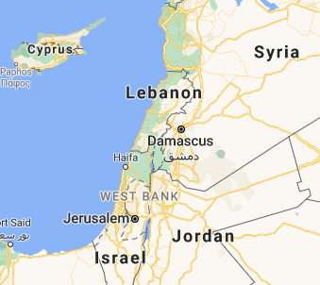
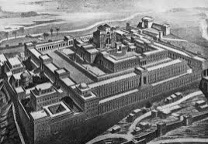
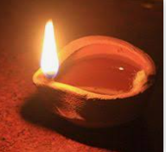
A small group of Jews called the Maccabees rebelled.
After a three year war, the Maccabees recaptured Jerusalem from the Syrians.
The Jews repaired the temple which had been ruined and rededicated it to God by lighting a lamp. The Jews only had enough oil to light the lamp for one day but, miraculously, it stayed alight for eight days.

Slide 7
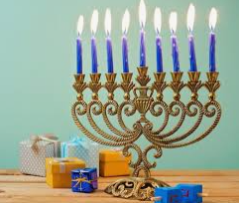
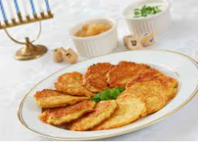
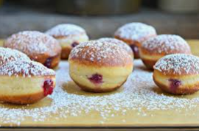
Traditions during the eight-day celebration include lighting the candles of the menorah and reciting blessings. Games are common. Potato pancakes and deep-fried doughnuts are traditional Hanukkah treats.
But why do Jews have this celebration?

Slide 8
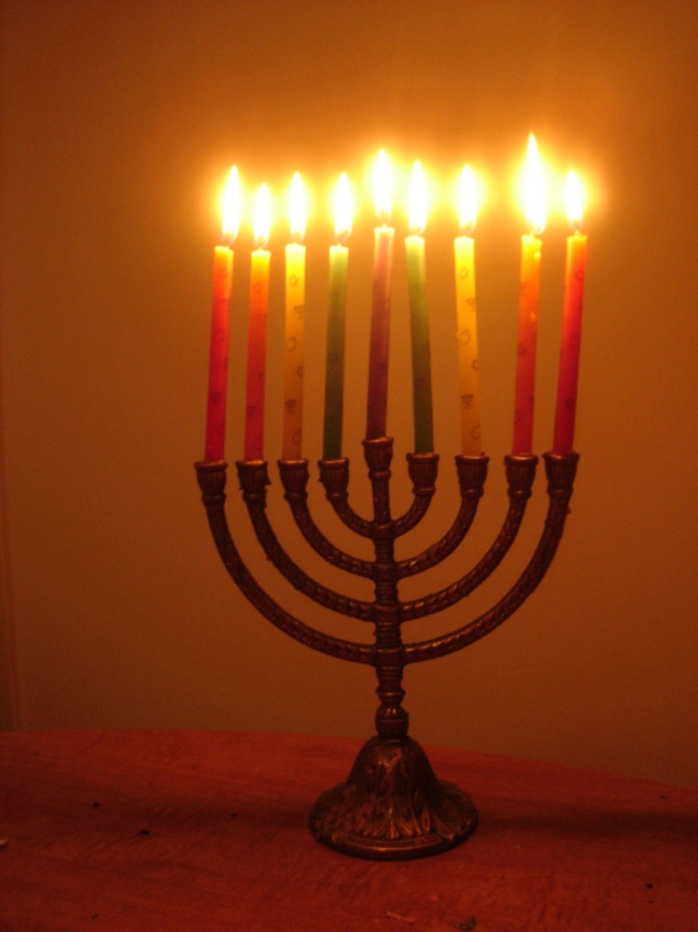
How is Hanukkah Celebrated?
A Hanukiah is lit by Jewish people. One candle is lit for each day of the festival.
Photo courtesy Shoshanah(@flickr.com) - granted under creative commons licence - attribution

Slide 9
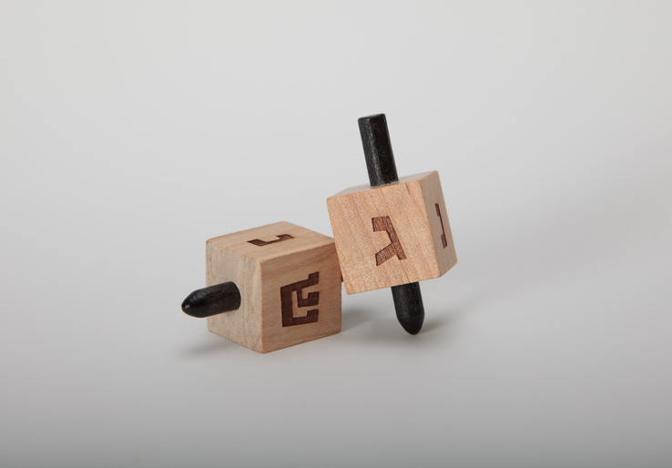
Dreidel is played.
Photo courtesy Staccabees @flickr.com) - granted under creative commons licence - attribution

Slide 10
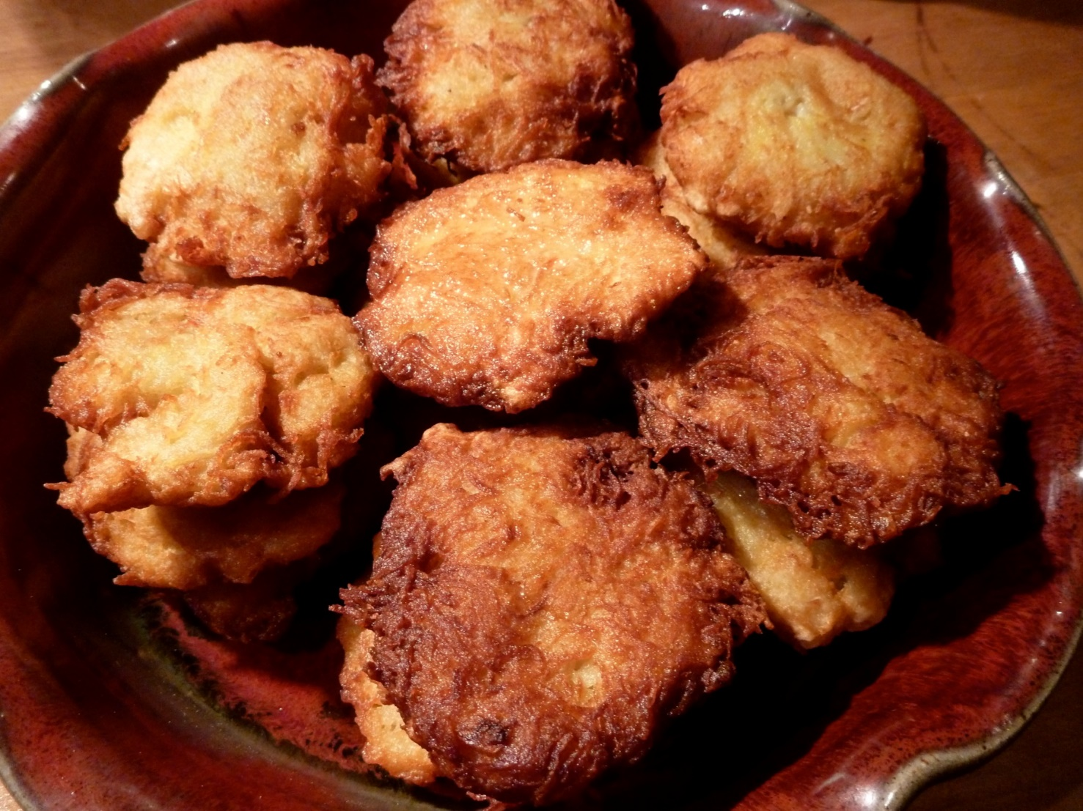
Latkes are eaten.
Photo courtesy grongar@flickr.com) - granted under creative commons licence - attribution

Slide 11
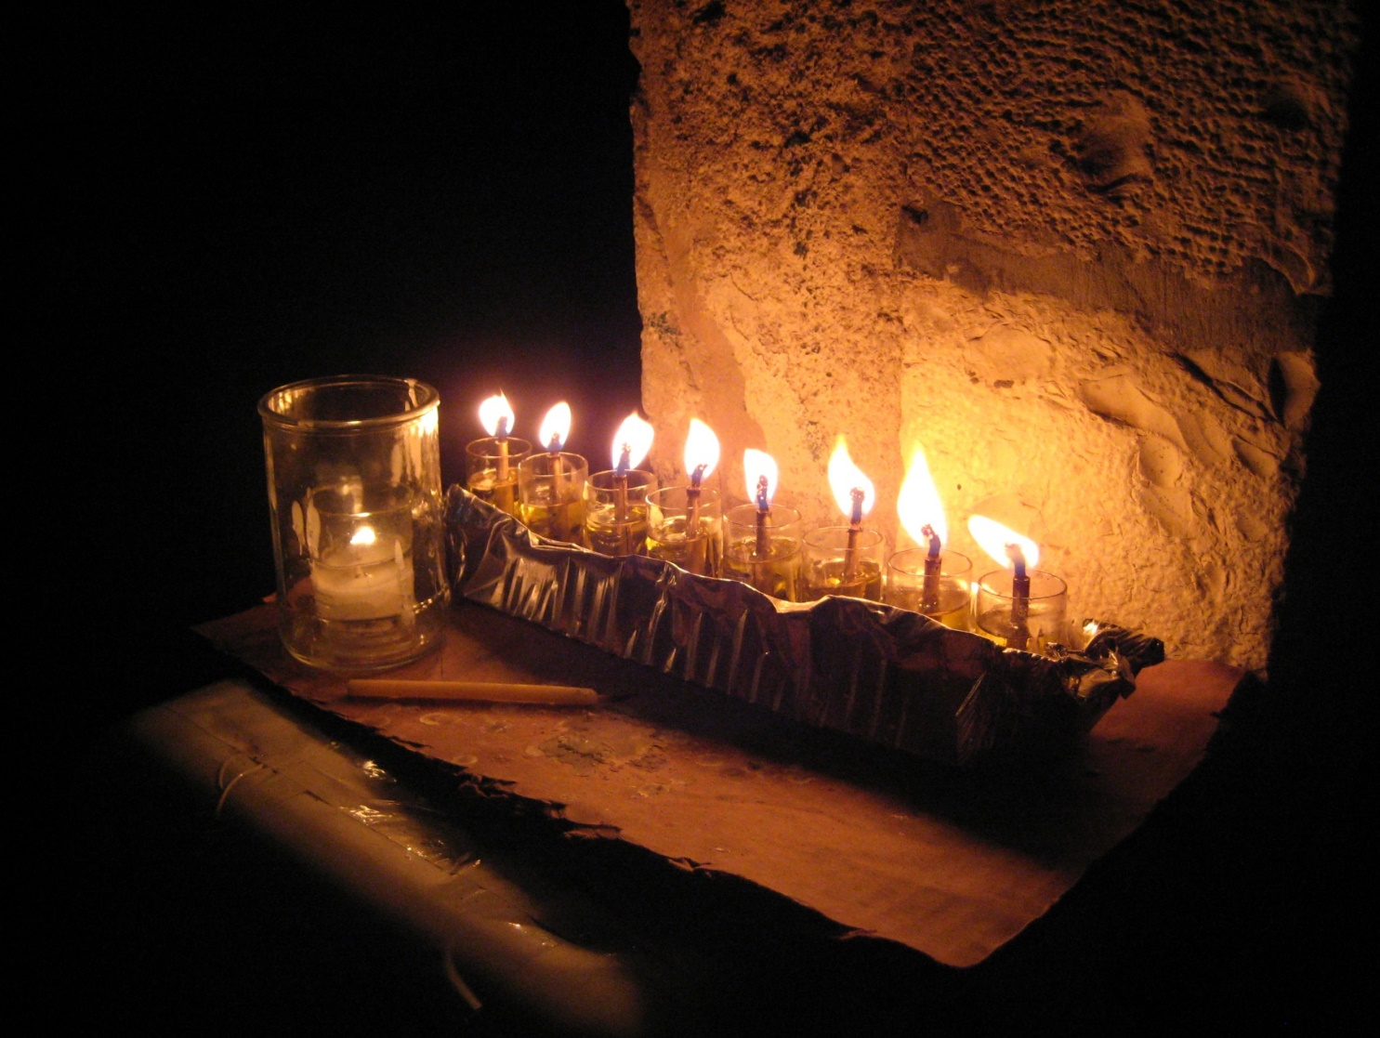
Candles are lit.
Photo courtesy andydr@flickr.com) - granted under creative commons licence - attribution

Slide 12
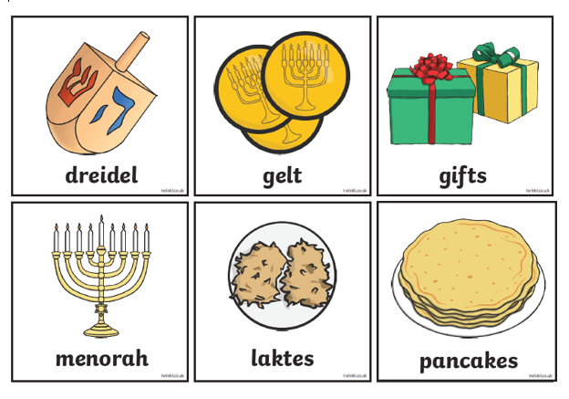
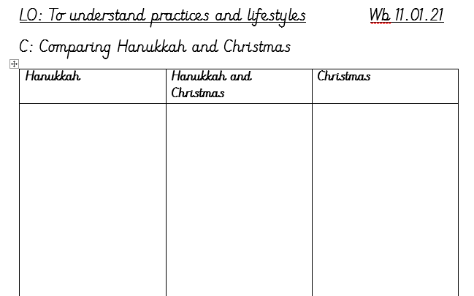
How similar is Hanukkah to Christmas?
Now cut out the pictures and stick them in the correct column. Are the pictures just for Hanukkah, for Hanukkah and Christmas, or just Christmas?

Slide 13
Now answer the red pen question:
Red Pen: If you were a Jewish child, how would celebrating Chanukah make you feel?

