Slide 1
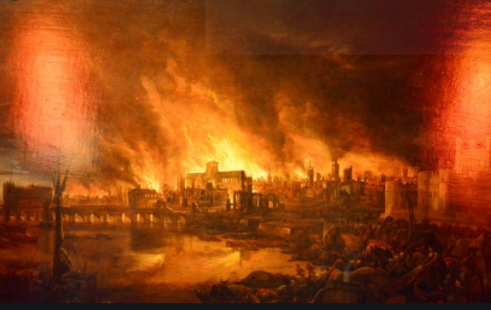

The Great Fire of London

Slide 2
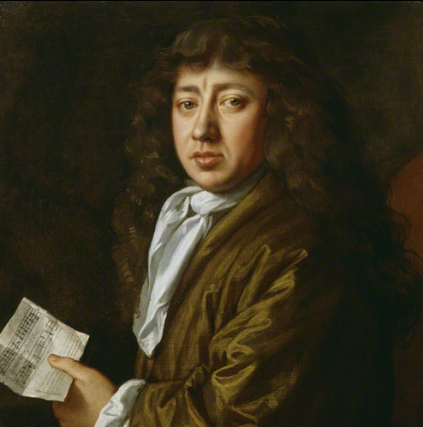
Who is the man in the photo? Is he alive now?

Slide 3
He is Samuel Pepys. He wrote a diary about the Great Fire of London. What do you notice about the painting?

Slide 4
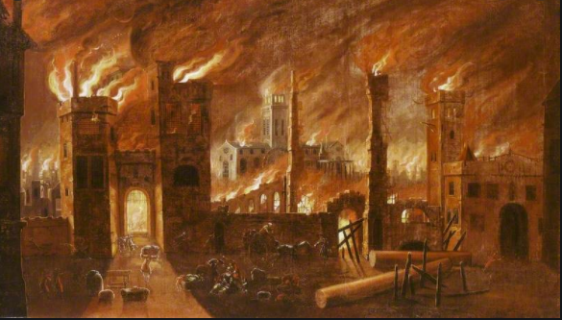
As well as Pepys' diary, we can also look at paintings to find out what happened.
Which colours can you see?

Slide 5
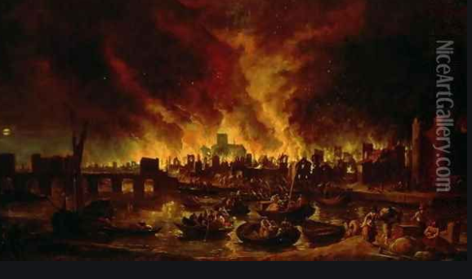

Slide 6
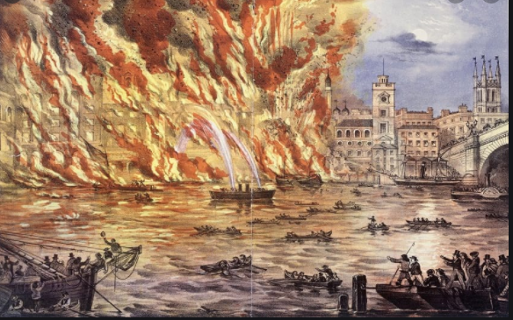

Slide 7
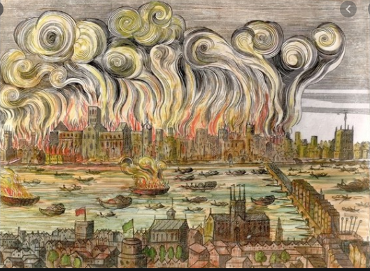

Slide 8
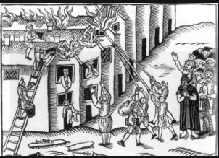

Slide 9
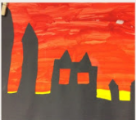
Next week we are going to make a picture similar to this one. How is it similar to the other paintings?

Slide 10
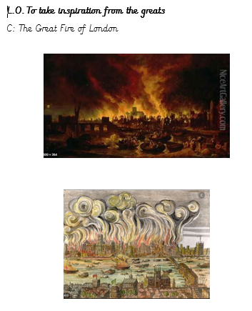
Dark colours
yellow
People in boats

