Slide 1
L.O. To understand materials
C: How do we recover a substance from a solution? (Dissolving)

Slide 2
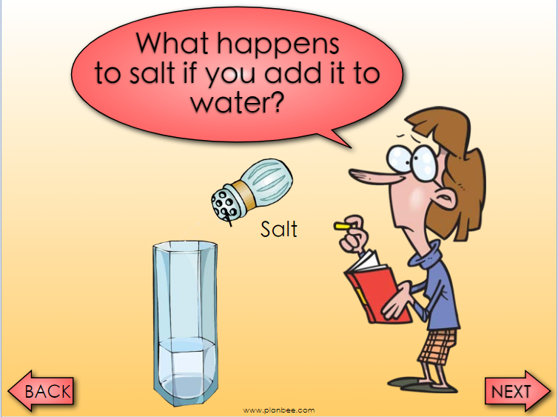

Slide 3
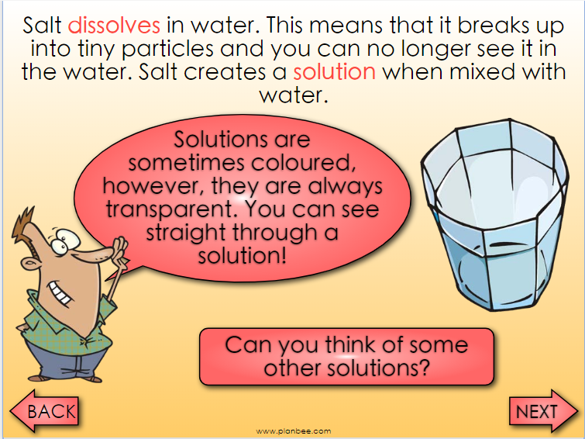

Slide 4
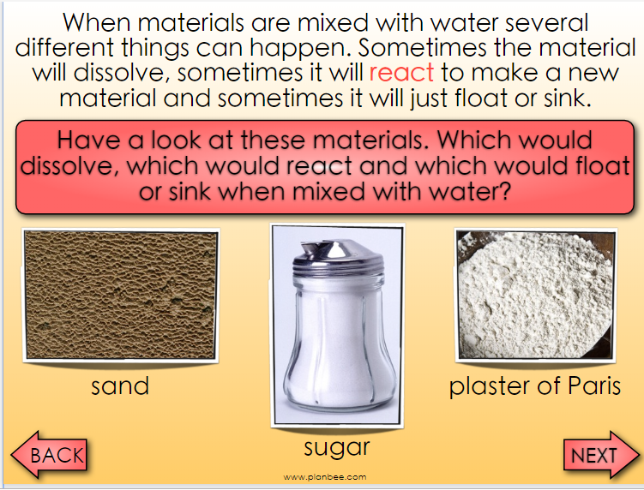

Slide 5
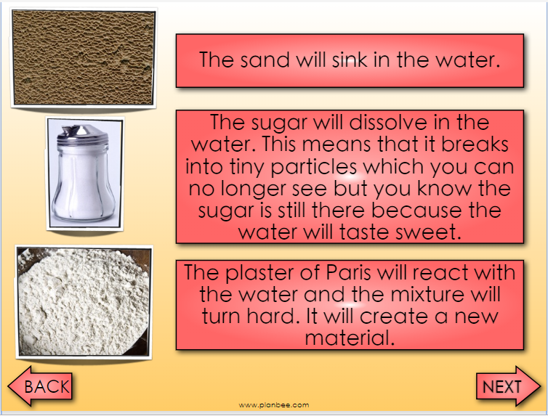

Slide 6
Can you think of any other materials that would dissolve, react, float or sink in the water?

Slide 7
TASKS
Paddling In the table, mix the various solutions and record what happens? Children to mix each with water and describe what happened to each in words and pictures. Salt, sugar, clay, sand and course pepper
Snorkelling Same as paddling but describing in words what is happening in each mixture.
Diving Same as snorkelling including which materials are dissolve in water.

Slide 8
Let’s do this…
Mix salt and water together, leave it in the classroom overnight…
What do you think is going to happen?
Explain your answer…
RP: Can you give an example of when we make solutions everyday?

