Slide 1
Monday 8th March 2021
L.O: To understand texts- prediction
C: Boy

Slide 2
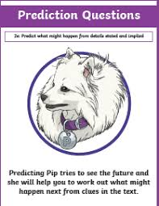
Today we are beginning to explore our new book!
We are going to use our Predicting Pip skills to help us make accurate predictions about the story.

Slide 3
I’m going to reveal the book sleeve in stages and we will make lots of predictions along the way!
First, let’s reveal the author…

Slide 4
Roald Dahl!
Stick in your picture and answer your prediction!
What kind of books does he usually write?
What genre are they?
What might the audience for this book be?
What kind of language are you expecting to find?

Slide 5
Next, let’s reveal the title…

Slide 6
Boy
Stick in your picture and answer your prediction!
How has your prediction changed?
What do you think this book might be about?
What audience do you think this book is aimed at?

Slide 7
Next, let’s reveal front cover…

Slide 8

Next, let’s reveal front cover…

Slide 9
Boy
Stick in your picture and answer your prediction!
How has your prediction changed?
What do you think this book might be about?
How do the pictures influence your prediction? What can you see? What is he wearing?...

Slide 10
Finally, let’s reveal the blurb…

Slide 11

Finally, let’s reveal the blurb…

Slide 12
Boy
Stick in your picture and answer your prediction!
How has this blurb changed and influenced your current prediction?
What theme might this book be?
Has your predicted audience changed?

Slide 13

Red Pen Challenge:
1. Write three questions you would like answered.
2. Number these in priority order. Which is most important?

