Slide 1

Tuesday 9th March 2021
L.O: To understand the Earth’s movement in space
C: Working Scientifically

Slide 2
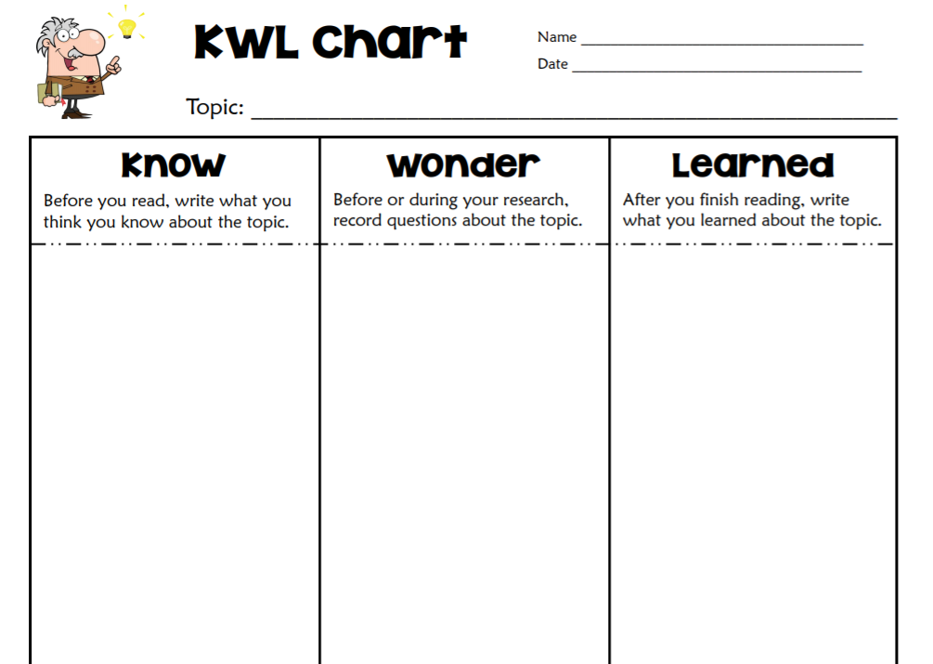
First, I want to see what you already know about the Earth, Sun, Moon and Space!
Can you fill in the know box?
If you are finished begin to fill in the wonder box.

Slide 3
To begin developing our understanding of space, we are going to watch this video.
https://www.youtube.com/watch?v=libKVRa01L8
It is quite scientific, so we will pause throughout to discuss.

Slide 4
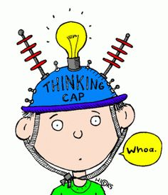
What have we learned?
Can you add anything into your KWL Grid?

Slide 5
The earth rotates on its axis every 24 hours. Let’s watch this video for more help.
https://www.bbc.co.uk/bitesize/clips/zkynvcw
Can you complete your sheet to explain how we get day and night?

Slide 6
Let’s explore our planet a bit further…
https://www.bbc.co.uk/bitesize/clips/z6vfb9q

Slide 7
Let’s explore our planet a bit further…
https://www.bbc.co.uk/bitesize/clips/z6vfb9q
Can you draw a diagram showing the earth orbiting the Sun?
Can you write a sentence to explain how we get years and seasons?

Slide 8

Red Pen Challenge: BOOK ON BOOK
Look at your peer’s work. What do you like about their work? How could they edit and improve?

