Slide 1
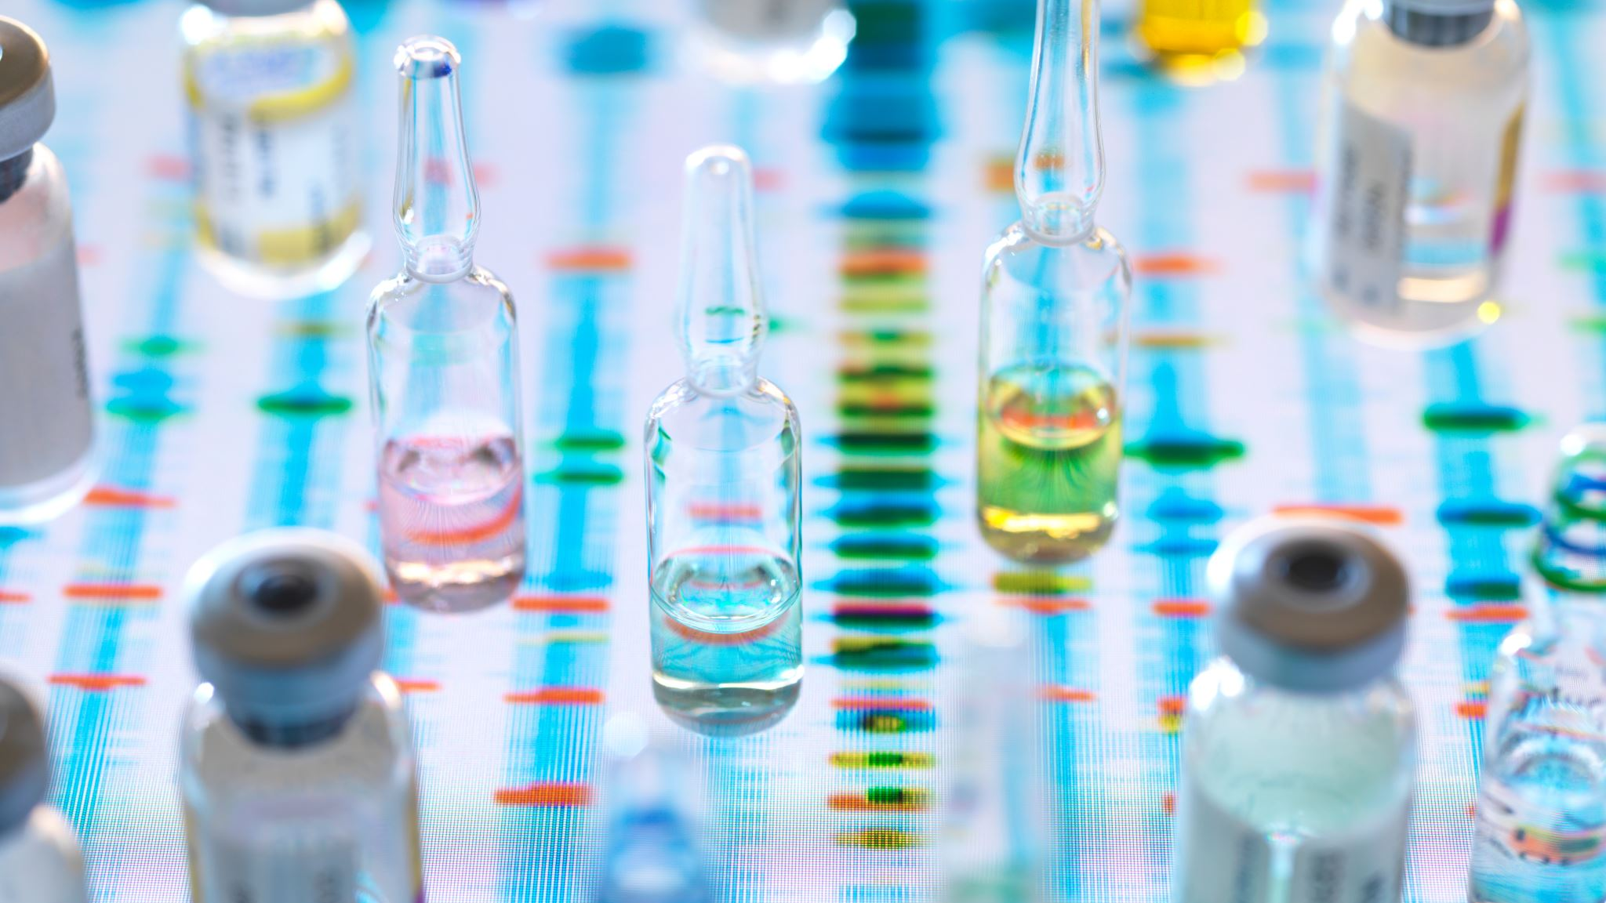
Science
Reversable and irreversible changes

Slide 2

Video

Slide 3
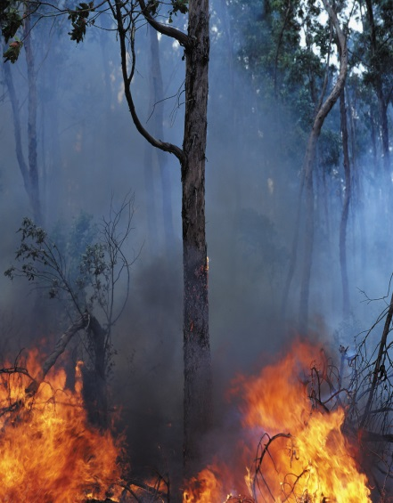
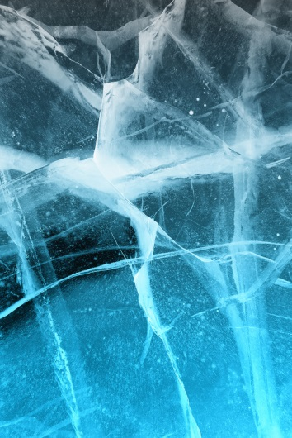
In order to change a material, we can...
Heat it
Burn it
Or
Mix it

Slide 4
In order to change a material, we can...
Burning
Burning is an example of an irreversible change. When you burn wood you get ash and smoke. You cannot change the ash and smoke back to wood again.

Slide 5
In order to change a material, we can...
Mixing
Mixing substances can cause an irreversible change. For example, when vinegar and bicarbonate of soda are mixed, the mixture changes and lots of bubbles of carbon dioxide are made. These bubbles and the liquid mixture left behind, cannot be turned back into vinegar and bicarbonate of soda again

Slide 6
In order to change a material, we can...
Heating​
Heating can cause an irreversible change. For example you heat a raw egg to cook it. The cooked egg cannot be changed back to a raw egg again.

Slide 7
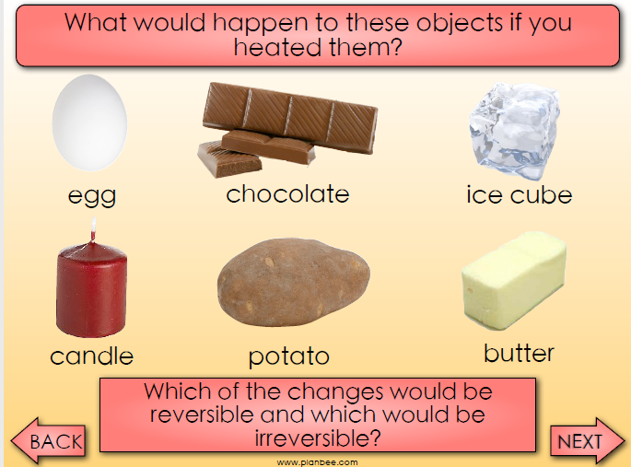

Slide 8
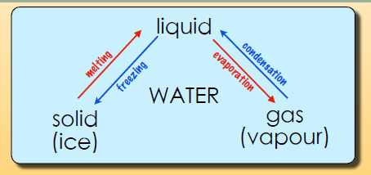
Some materials change state when they are
heated or cooled. This means that they can turn
from a gas to a liquid to a solid and back again. For
example, when water is at room temperature it is a
liquid. If it is heated it evaporates and turns into
water vapour which is a gas. To turn it back into a
liquid you need to cool the gas down again. This is
called condensation. If you cool liquid water it turns
into ice which is a solid. This is called freezing. As the
ice heats again it melts to turn back into a liquid.

Slide 9
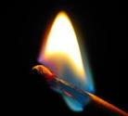
Irreversible changes are permanent. They cannot be undone. For example you cannot change a cake back into its ingredients again.
This Photo by Unknown author is licensed under CC BY-SA.

Slide 10
Reversible changes
Reversible and irreversible reactions are different.
A reversible change is a change that can be undone or reversed.
If you can get back the substances you started the reaction with, that's a reversible reaction.
A reversible change might change how a material looks or feels, but it doesn't create new materials.
Examples of reversible reactions include dissolving, evaporation, melting and freezing.

Slide 11
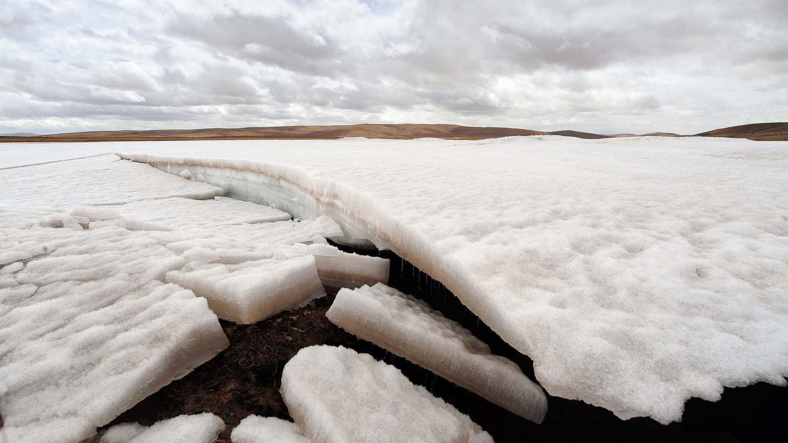
What reversible and irreversible changes can you see in this video?
This Photo by Unknown author is licensed under CC BY-NC-ND.

Slide 12
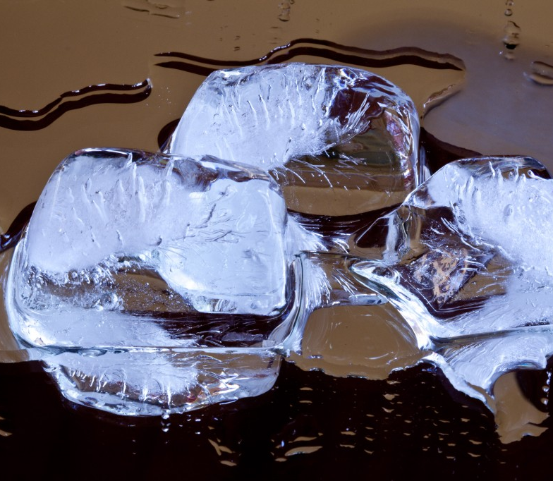
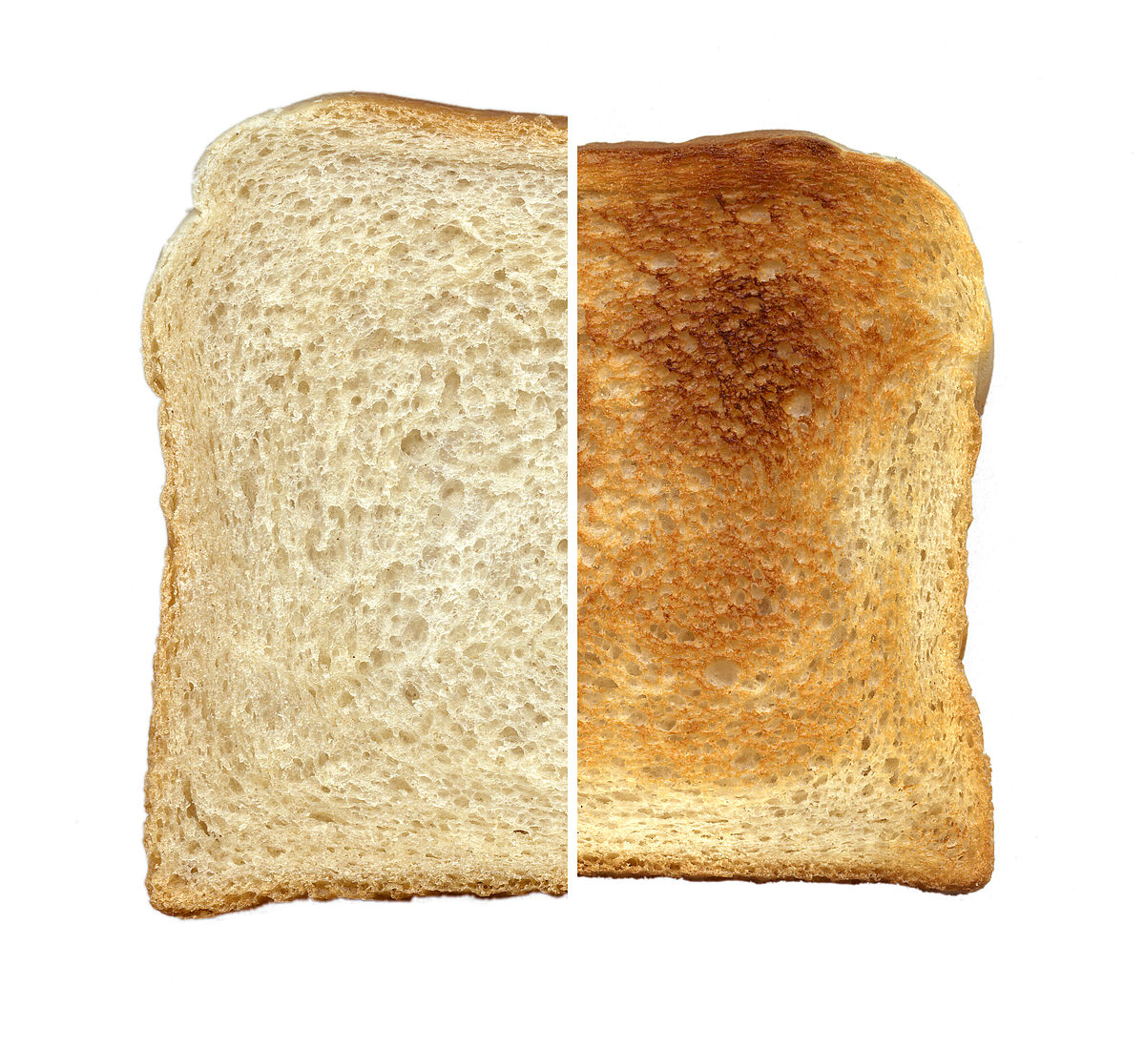
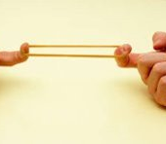
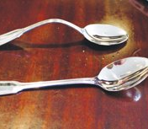
DO YOU THINK THESE CHANGES ARE REVERSIBLE OR IRREVERSIBLE?
This Photo by Unknown author is licensed under CC BY-SA-NC.
This Photo by Unknown author is licensed under CC BY-SA.
Bent metal
Stretched elastic band
Burnt toast
Melted ice

Slide 13

Tasks

Slide 14
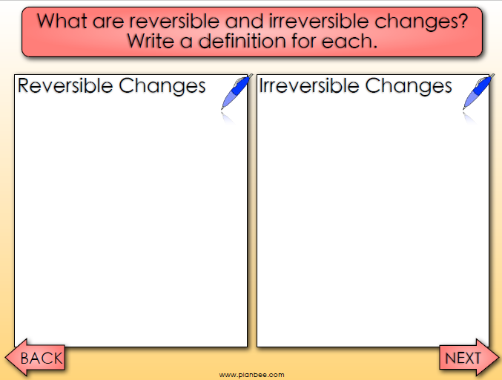
Paddling

Slide 15
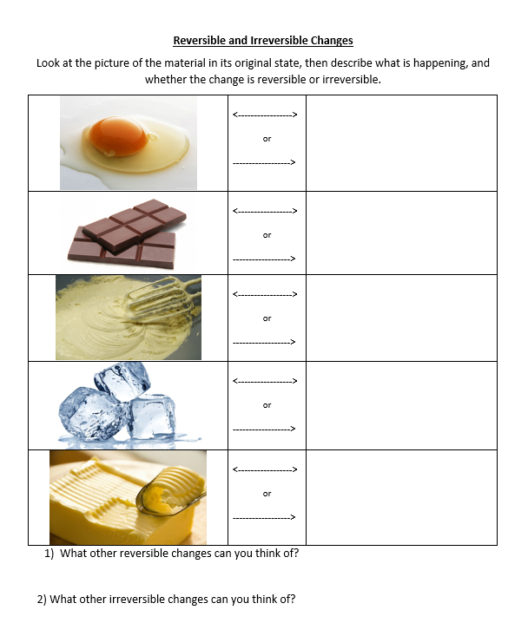
Snorkeling

Slide 16
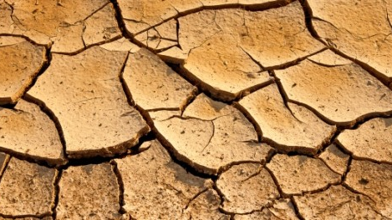
Diving
Produce an information sheet for Year 4 about reversable and irreversible changes. Remember to include:
Definitions of reversable and irreversible changes
Examples
This Photo by Unknown author is licensed under CC BY.

