Slide 1
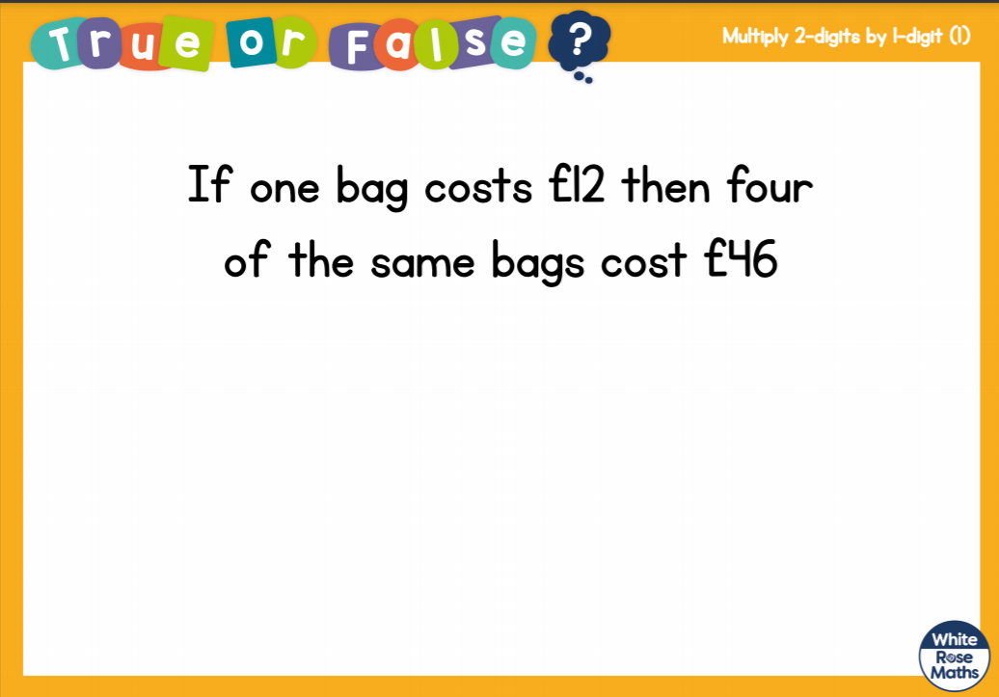

Slide 2
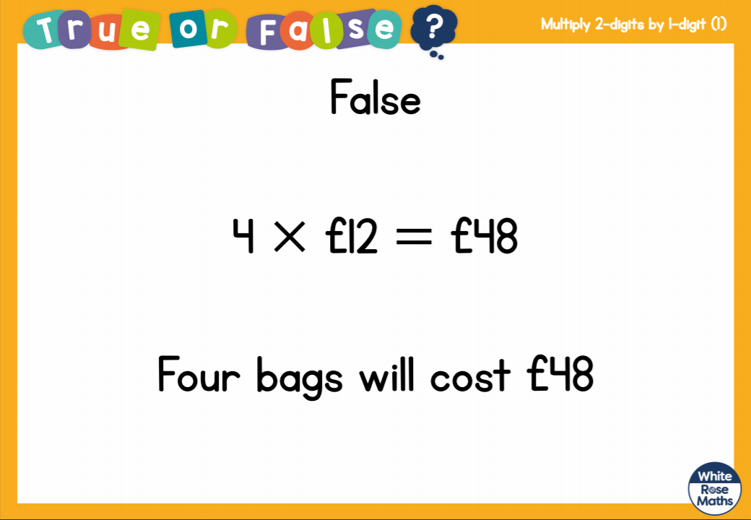

Slide 3


Slide 5


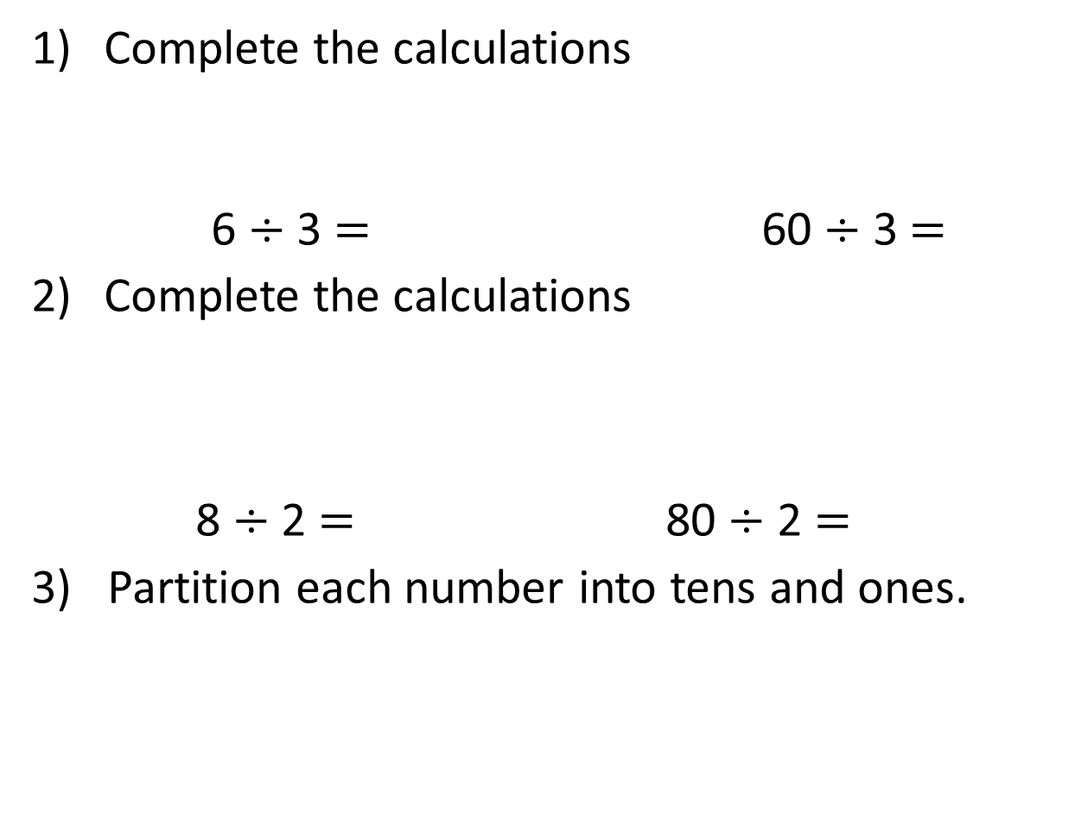
Complete the calculations
6 $÷$ 3 $=$ 60 $÷$ 3 $=$
Complete the calculations
8 $÷$ 2 $=$ 80 $÷$ 2 $=$
3) Partition each number into tens and ones.
24
42
48

Slide 6
Complete the calculations
6 $÷$ 3 $=$ 60 $÷$ 3 $=$
Complete the calculations
8 $÷$ 2 $=$ 80 $÷$ 2 $=$
3) Partition each number into tens and ones.
2
20
4
40
24
42
48
20
4
40
2
40
8

Slide 8




There are 4 counters in each group.
But your counters have different values. The value of each group must be equal too.

Slide 9
39 ÷ 3 =
13
Tens | Ones

Slide 10

84 ÷ 4 =
21
Have a think
Tens | Ones

Slide 11

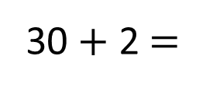
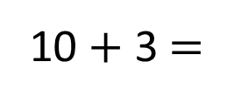
39 ÷ 3 =
13
96 ÷ 3 =
32
39
96
Have a think
30
9
90
6
÷ 3
÷ 3
÷ 3
÷ 3
10
3
30
2
10 + 3 $=$
13
30 + 2 $=$
32

Slide 12
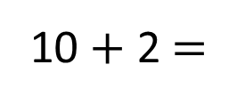
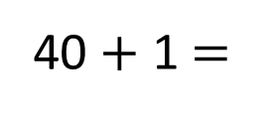
48 ÷ 4 =
12
82 ÷ 2 =
41
48
82
Have a think
40
8
80
2
÷ 4
÷ 4
÷ 2
÷ 2
10
2
40
1
10 + 2 $=$
12
40 + 1 $=$
41

