Slide 1
Dharma in Hinduism

Slide 2
What are your ambitions?

Slide 3
What are your ambitions?
What do you need to do to fulfill your ambitions?

Slide 4
Ambitions in religion
Most religions throughout the world say the most important ambition a person can have is to be ‘united’ with God.
In Christianity this means loving Jesus.
In Hinduism, the main ambition is to reach Brahman. Hindus believe there are 4 main goals in life.

Slide 5
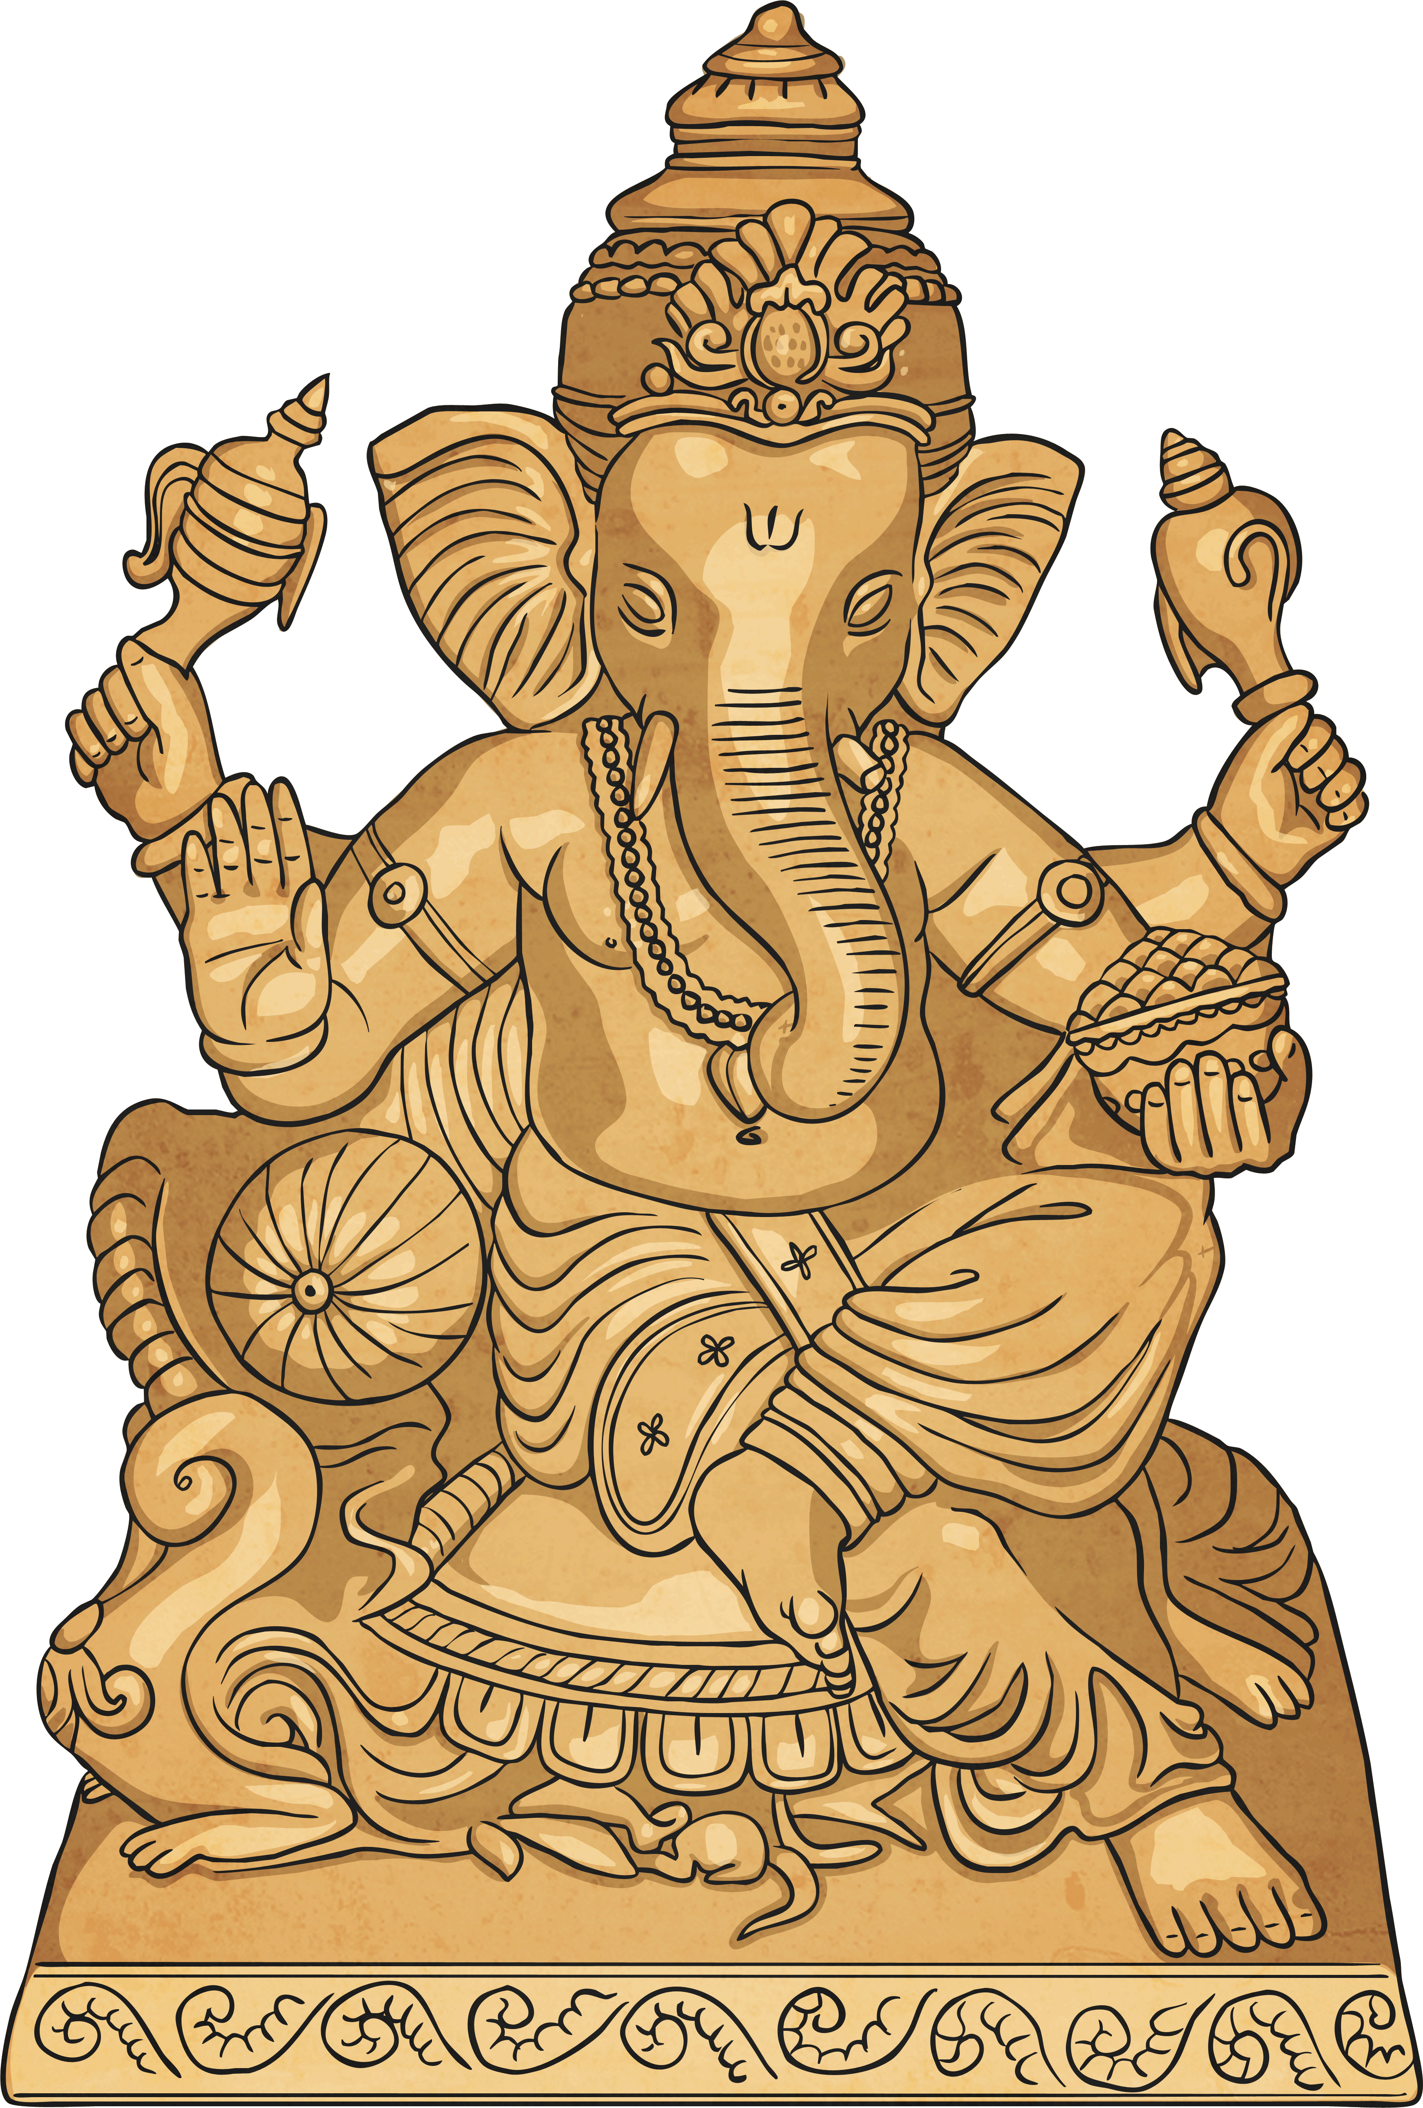
Hinduism
Hinduism is a religion which has fused many different traditions and practices. There is no one way to be a Hindu, nevertheless, there are certain fundamental principles that all Hindus share.

Slide 6
Goal 1
Moksha - each person has a soul. Hindus believe the soul can be released to be with Brahman. So if a person dies they do not have to go through rebirth and be born again. This can be done through Yoga, meditation and devotion to god and by working selflessly.

Slide 7
Moksha
Moksha is…
Liberation – from samsara: the cycle of birth, death and rebirth.
Salvation – of the soul which is rescued from the material world and delivered into the spiritual world.
The Goal – of Hindus who eventually hope to achieve moksha. Though many accept this might not happen for their next rebirth they aim to produce positive karma in the hope of a good rebirth that might be a little closer to moksha

Slide 8
Goal 2
Dharma – this is a code for leading one’s life:
Religious duty – reading the Holy Scriptures and the daily act of Puja
The Hindu family. This includes grandparents, uncles, aunts, cousins and in-laws.

Slide 9
Goal 3
Artha – make money in a good way

Slide 10
Goal 4
Karma – to be pure and good. To have knowledge and show devotion. If you achieve this you will be reborn to a higher level, when you die.

Slide 11

Karma
Can you explain?
Notes:
In a lifetime people build up karma, both good and bad, based on their actions within that lifetime. This karma affects their future lives and existences. People must take responsibility for their actions either within this life time or the next

Slide 12
Karma
Karma refers to the law of cause and effect i.e. actions have consequences.
Hindus believe this is a law of the universe -> Every single action has an affect on something else.
Karma decides where you come back and what you come back as.
If your actions are good you will get a good rebirth into pleasant circumstances; if they are bad you will get a bad one.
Notes:
In a lifetime people build up karma, both good and bad, based on their actions within that lifetime. This karma affects their future lives and existences. People must take responsibility for their actions either within this life time or the next

Slide 13
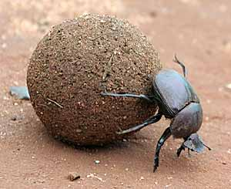
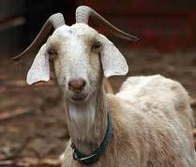

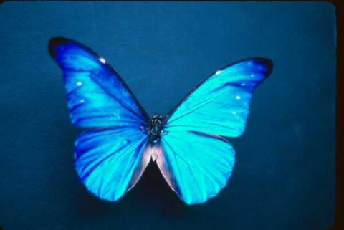
Karma
In a lifetime people build up karma, both good and bad, based on their actions within that lifetime.
Influences circumstances of future lives.
There are lots of different types of rebirth in samsara, e.g. human or a pig; a prince or a homeless person, in India or Ireland.
It all depends on what you deserve.

Slide 14
Summary
SAMSARA IS THE CYCLE OF LIFE
REINCARNATION IS A RESULT OF PREVIOUS KARMA
KARMA RELATES TO ACTIONS AND THEIR CONSEQUENCES
MOKSHA IS LIBERATION FROM SAMSARA

Slide 15

Dharma
In Hinduism, ‘dharma’ means duty, religion, virtue and morality; it is a central part of a Hindu’s daily life. Hindus believe that there are right and wrong ways to behave so they must behave correctly, follow the moral law and take their duties seriously. According to dharma, it is best to do the right thing at all times.

Slide 16
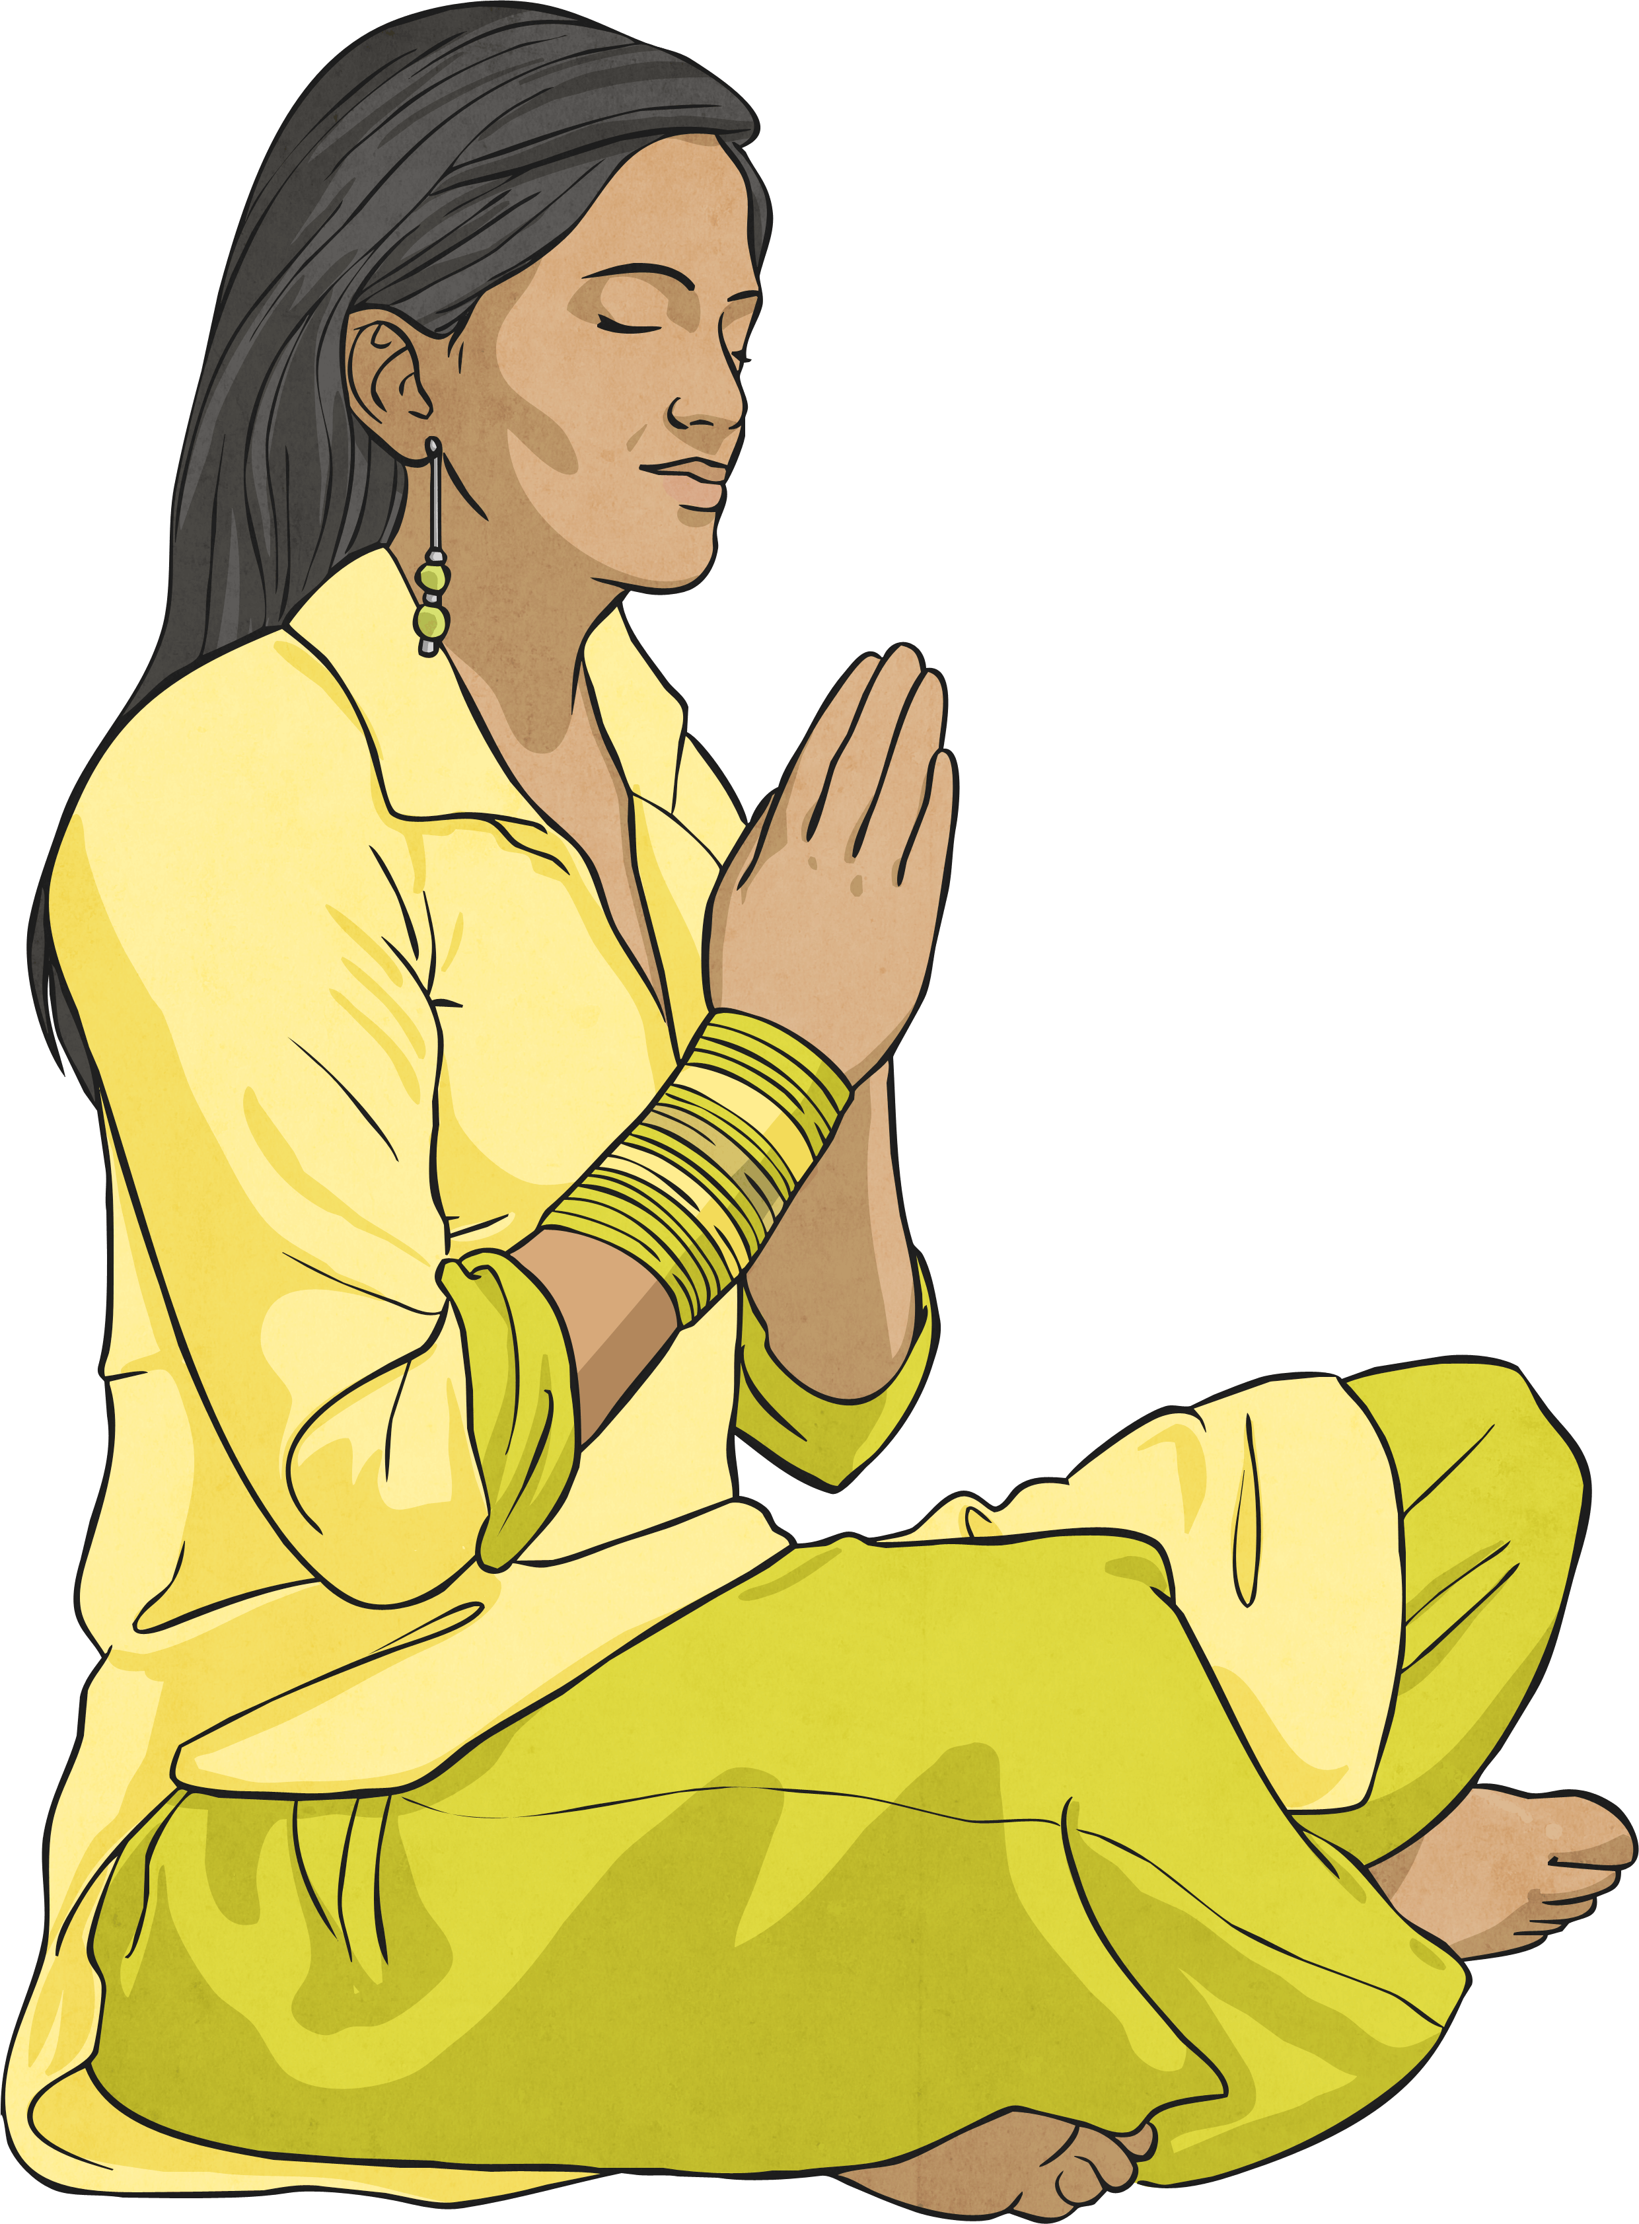
Dharma Examples
For example, a pupil’s dharma is to work hard at school; the parents’ dharma is to raise and support their family; and the dharma of the police is to protect others. At different stages of a Hindu’s life, their dharma will change, however, it is everyone’s dharma to be kind, honest, religious and to be a good person in society.

Slide 17
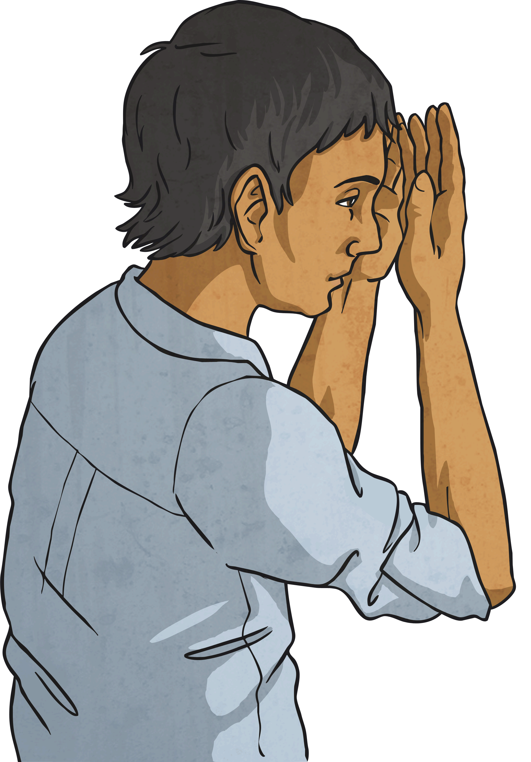
Adharma
Hindus believe that following their dharma allows them to feel happy and live a rewarding life. Not acting in accordance with your dharma is believed to be wrong and called ‘adharma’.

Slide 18
Job
Learning at school
Looking after a sibling
Being a sportsperson
Being a politician
Being a friend
Duties (Dharma)
Being patient
Being kind
Being empathetic (understanding the world from other people’s point of view)
Concentrating and not being distracted from your work
Being a role model to other people

Slide 19
Job
Being a sportsperson
Duties (Dharma)
Being patient
Being kind
Being empathetic (understanding the world from other people’s point of view)
What would this look like?
Supporting teammates – even if they make a mistake
Speaking using encouraging words to teammates at all times

