Slide 1
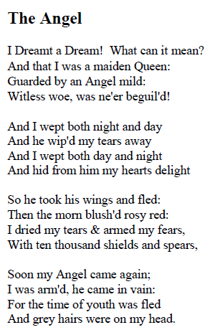
Have a look at William Blake’s poem called ‘The Angel’. Highlight any words or phrases that you like or find interesting. Does this poem remind you of anything in Skellig?

