Slide 1

Tuesday 9th March 2021
L.O: To understand texts- retrieval skills
C: Boy

Slide 2
Starter:
Let’s read and reflect on our red pen challenge from yesterday.
Do you think we will get some answers today?
Divers: What is the likelihood of finding out all your answers today?

Slide 3
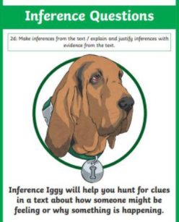
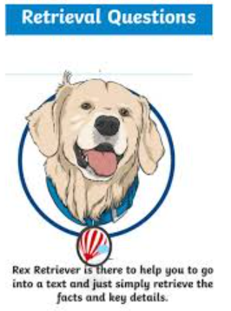
We are going to begin reading the story today.
We will be using our Rex Retriever and Inference Iggy skills today!

Slide 4
Class Read: Start-p.5 “boiled egg”.

Slide 5
Let’s answer our questions!
Presentation is important! Please write the question number in the margin and a neat answer.
Leave a line between each answer.

Slide 6
Question 1
Class Read: Start-p.5 “boiled egg”.
What is an autobiography?
(1 mark)
Remember to use your fastest finger when skim-reading and use evidence from the text.

Slide 7
Question 2
Look at page 3. What do you think “prosperous” means? Afterwards, find an accurate definition from a dictionary. (2 marks)
Class Read: Start-p.5 “boiled egg”.
I should use my fastest finger to find “prosperous” then go back and read the whole sentence.

Slide 8
Question 3
Class Read: Start-p.5 “boiled egg”.
How do you think Roald’s father felt when they pulled his arm?
(2 marks)
This is a two mark question, so we need to also use evidence from the text to provide a reason.

Slide 9

Red Pen Challenge:
Do you think Roald is proud of his father? Why? Why not?

