Slide 1

Thursday
L.O- To understand texts.
C: 2d

Slide 2

What would be your five ingredients for a perfect society?

Slide 3
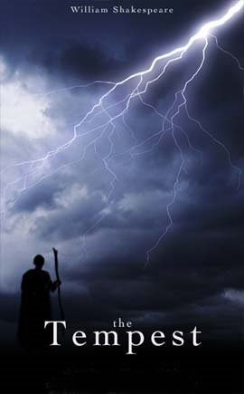
Act 2 Scene 1
A remote part of the island
Cast List
Gonzalo
Sebastian
Antonio
Alonso
Ferdinand
What do we learn about Gonzalo? How is he different to Antonio?

Slide 4
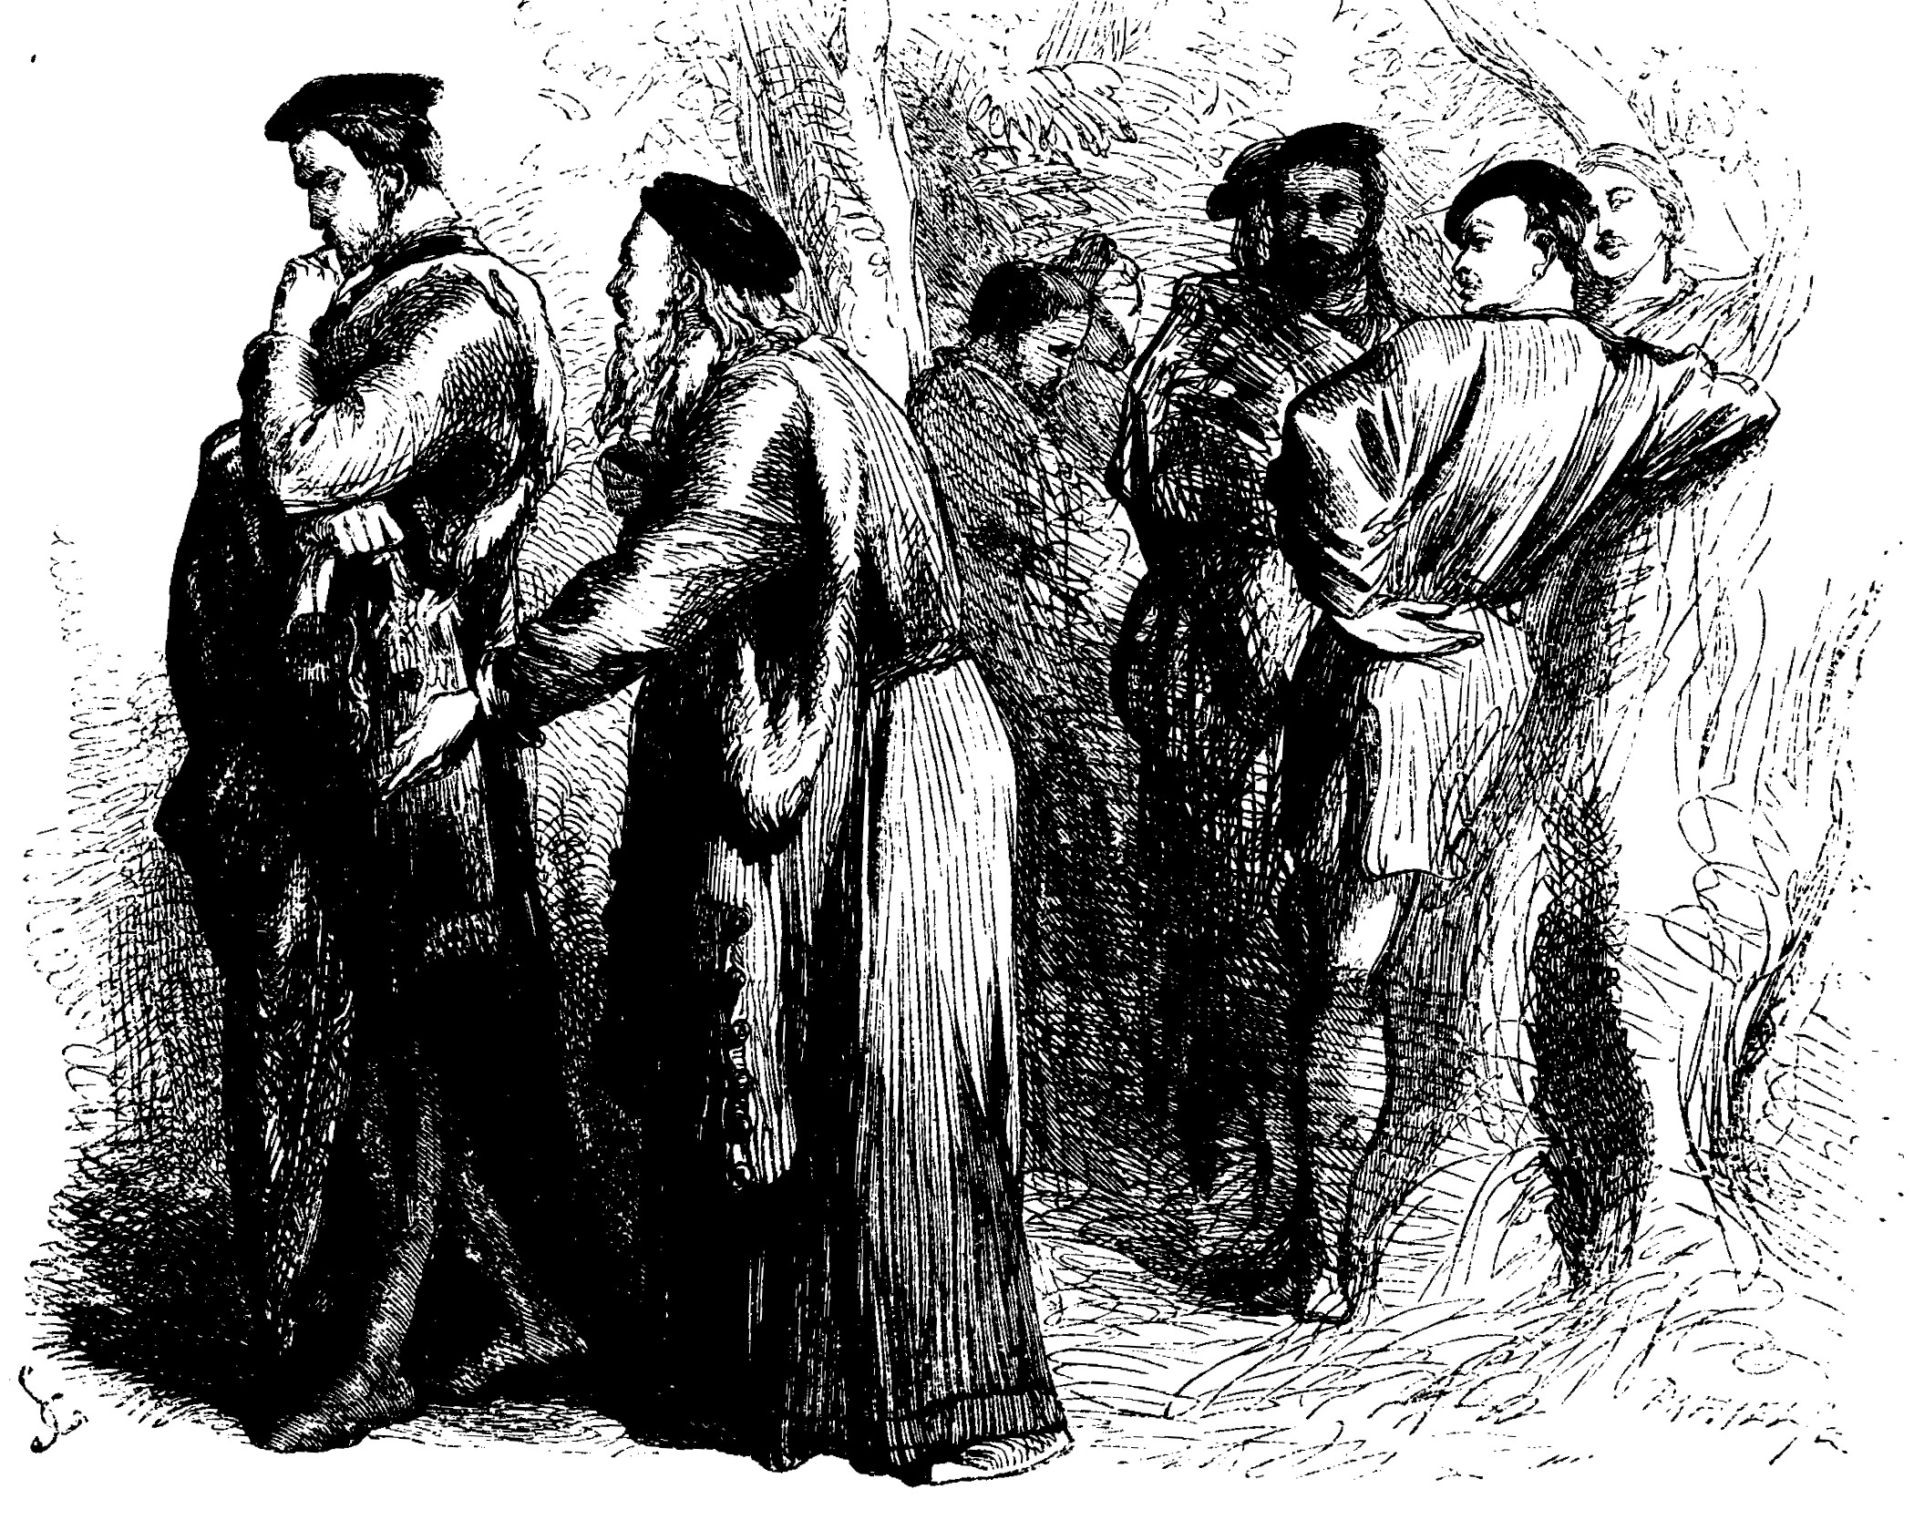
Gonzalo’s Speech
Read Gonzalo’s speech and in pairs match the aspects of society to Gonzalo’s speech. Find a quote for each one:
Wealth
Social hierarchy
Land ownership
Nature
Business
War
Monarchy

Slide 5
Write a paragraph in role.
Imagine you are Gonzalo but you
are using modern English. What
does he think the perfect society
should be like?

Slide 6
Plenary
Contrasts in Gonzalo’s speech
In his speech, Gonzalo attempts to cheer the King with an account of an ideal world, where everything is opposite to usual social arrangements.
What are these ‘opposites’?

Slide 7
Prep
Complete another page of your contrast log.
This must be on Gonzalo’s speech (Act 2, Scene
1)
Stick the speech in and write notes around it
about the contrasts. You could also highlight the
key quotes. Use your classwork to help you.

