Slide 1

Monday
L.O- To understand texts.
C: 2a

Slide 2
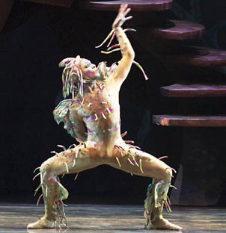
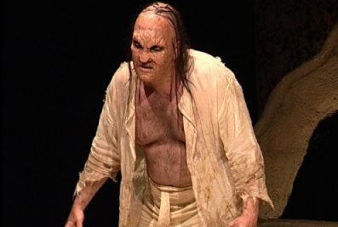
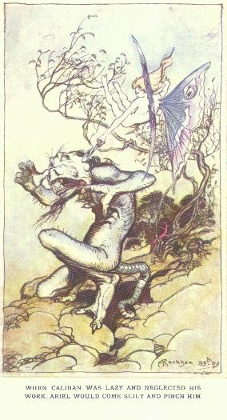
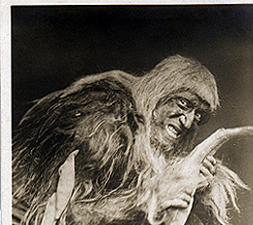
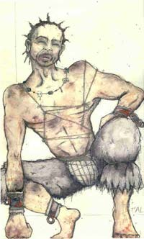
Imagine you are putting on a stage production of The Tempest at school. Which of the images is closest to how you would portray Caliban, and why?
Rank the pictures from most to least!
Notes:
Tell pupils that Caliban has been portrayed in a range of ways – both as an exploited native, forced to learn a new language, adapt to new customs and to give up the riches of his island to a colonial exploiter and as brutish, evil monster – capable of rape and without remorse.
Ask pupils, in pairs, to decide how they would present the character if they were staging the play and which of the above images they would therefore choose.

Slide 3
TASK
Now, select a picture that you think represents Caliban.
Write adjectives to describe Caliban and what Prospero thinks of him.

Slide 4
Tuesday
L.O- To understand texts.
C: 2d

Slide 5
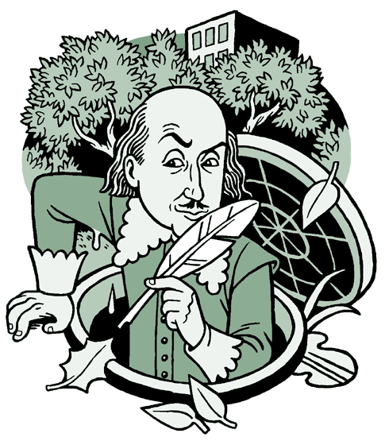
How does Shakespeare use language to portray the relationship between Caliban and his master, Prospero?

Slide 6

Model Answer
One way in which Shakespeare portrays the relationship between Prospero and Caliban is through the use of derogatory language towards Caliban, ’thou most lying slave’. This shows Prospero’s hatred for Caliban. Furthermore, the repeated use of the word ‘slave’ in place of Caliban’s name emphasises the hierarchy between these two characters and the possible disdain Prospero feels towards Caliban.

Slide 7
How does Shakespeare use language to portray the relationship between Caliban and his master, Prospero?
Think about what Prospero calls Caliban and link this with the hierarchy work we have completed.

