Slide 1
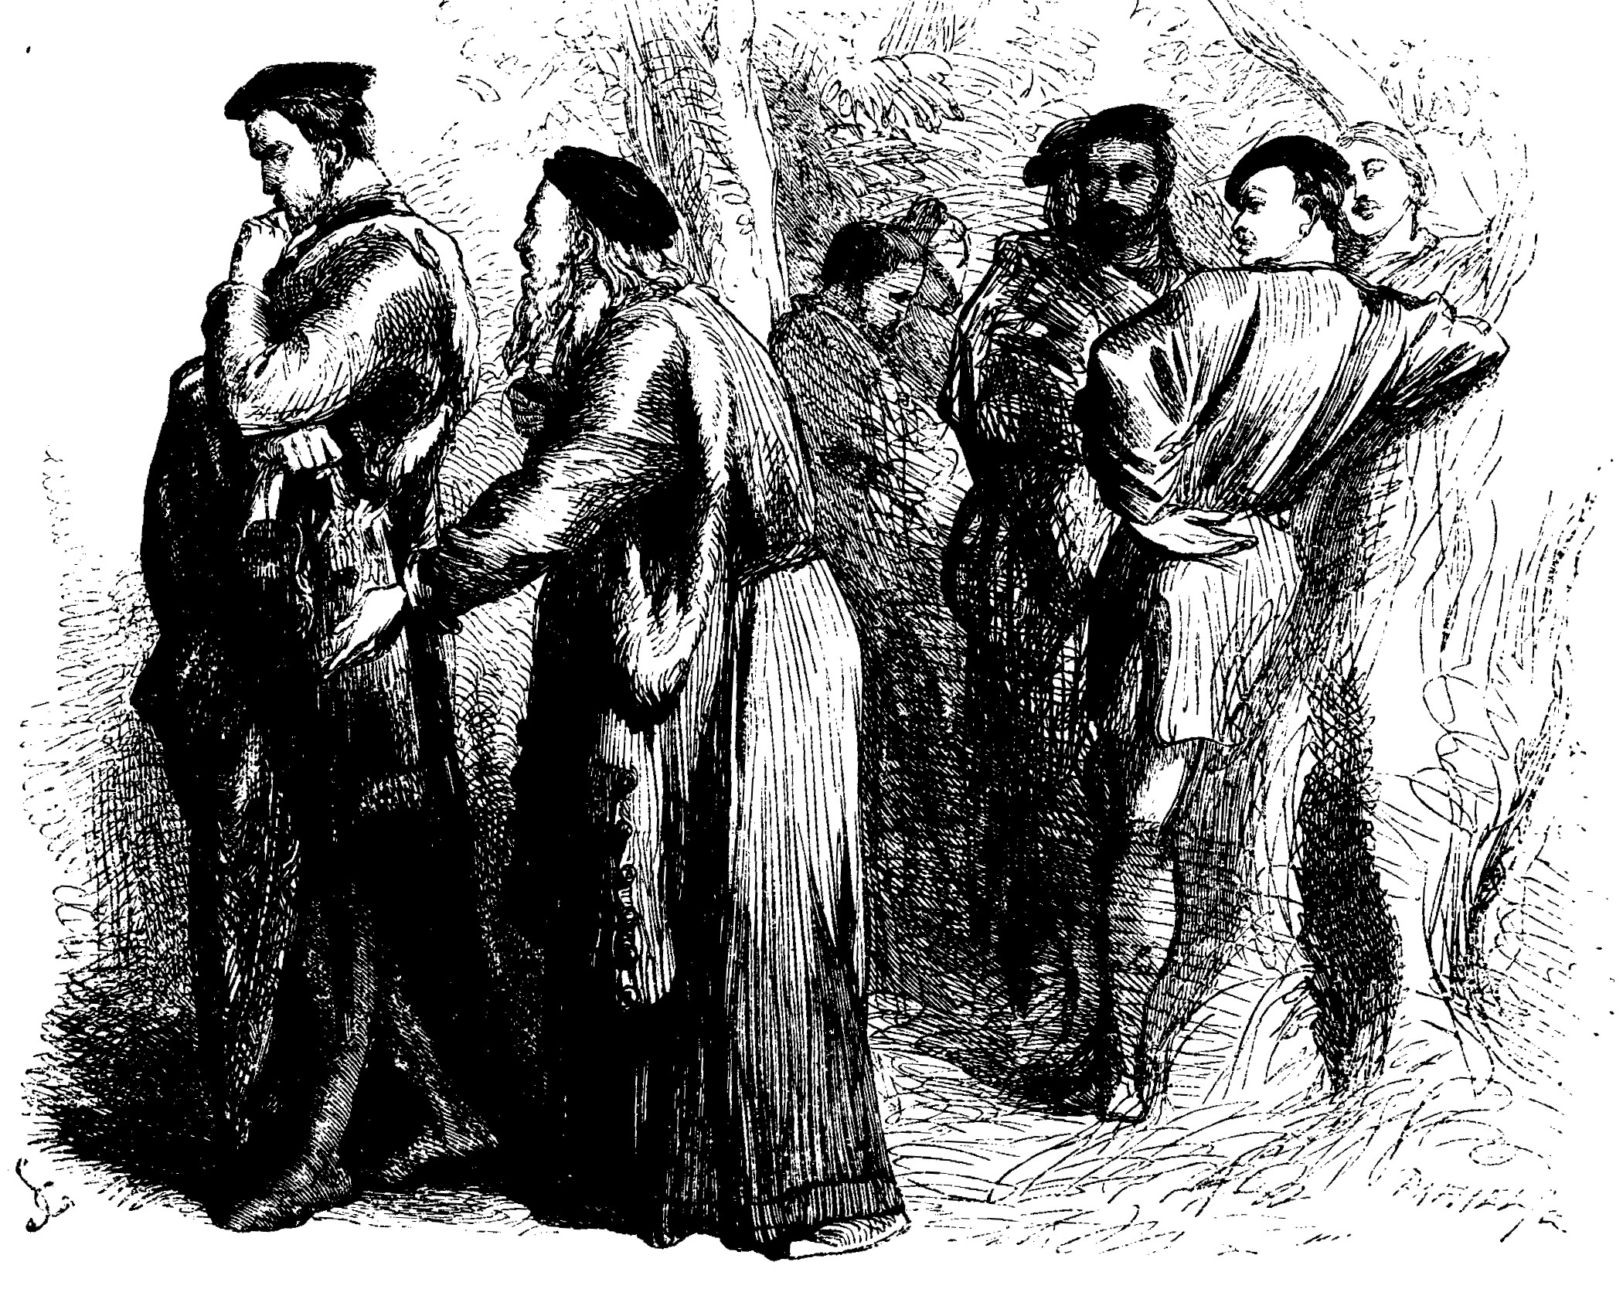
Rewrite Gonzalo’s speech.
Imagine you are Gonzalo but you
are using modern English. What
does he think the perfect society
should be like?

Slide 2
Gonzalo’s World
Gonzalo’s ideal | Positive | Negative

