Slide 1


Slide 3


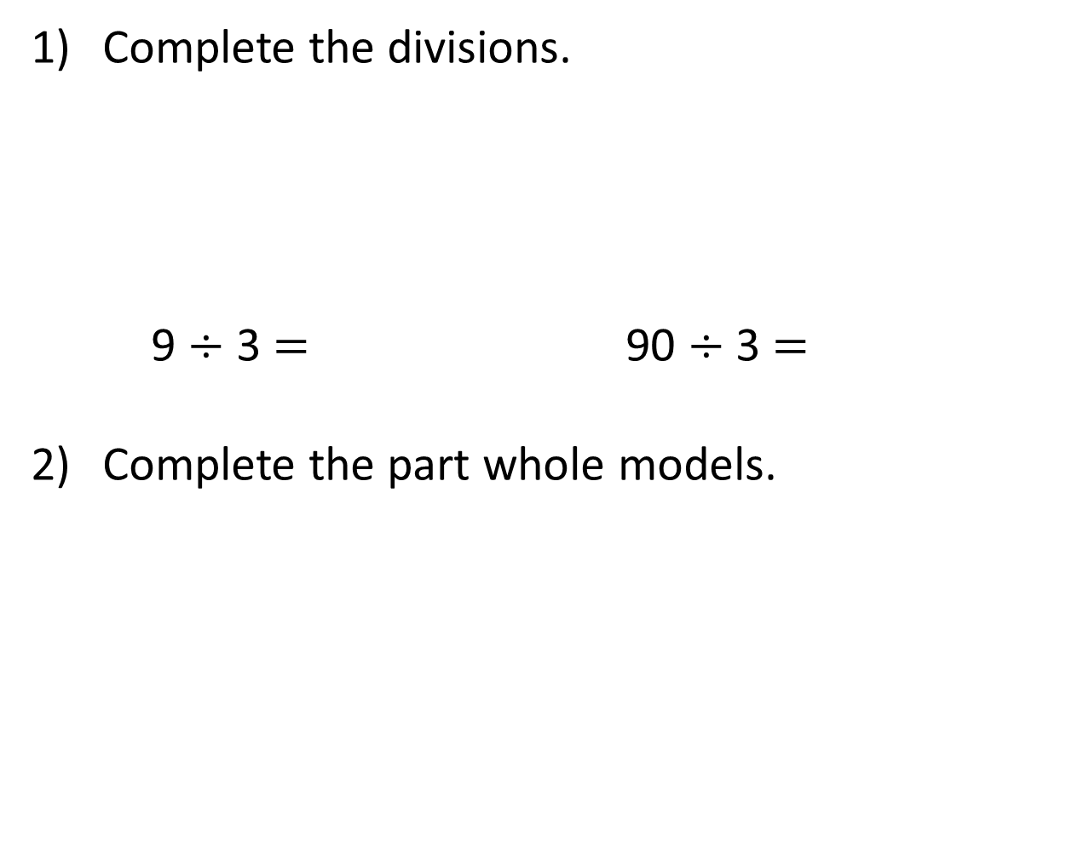
Complete the divisions.
9 $÷$ 3 $=$ 90 $÷$ 3 $=$
Complete the part whole models.
39
42
42
30
40
30

Slide 4
Complete the divisions.
9 $÷$ 3 $=$ 90 $÷$ 3 $=$
Complete the part whole models.
3
30
39
42
42
30
9
40
2
30
12

Slide 6



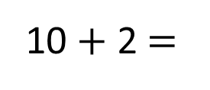
48 ÷ 4 =
12
48
Tens | Ones
40
8
÷ 4
÷ 4
10
2
10 + 2 $=$
12

Slide 7

42 ÷ 3 =
14
But those groups aren’t equal!
Tens | Ones
42
40
30
12
2

Slide 8

96 ÷ 4 =
24
Have a think
Tens | Ones

Slide 9
51 ÷ 3 =
17
Have a think
Tens | Ones

Slide 10
Now, using your resources, try the following:
75 ÷ 3 =
52 ÷ 4 =
72 ÷ 4 =
65 ÷ 5 =

