Slide 1

Lesson 6:
Poor Prospero
L.O- To understand texts
C: 2a and 2b

Slide 2
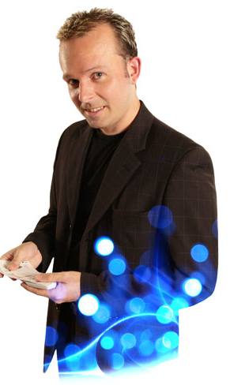
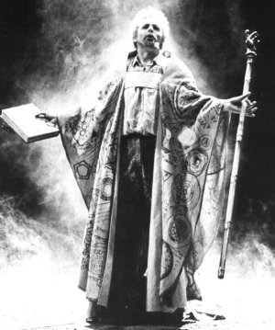
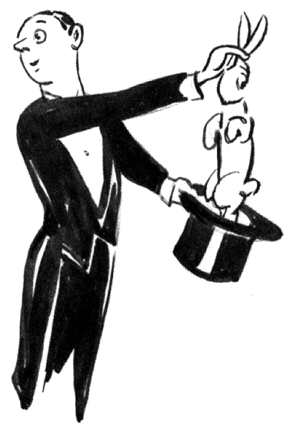
Prospero possesses magical powers. What characteristics, appearance and skills do you associate with a magician?

Slide 3
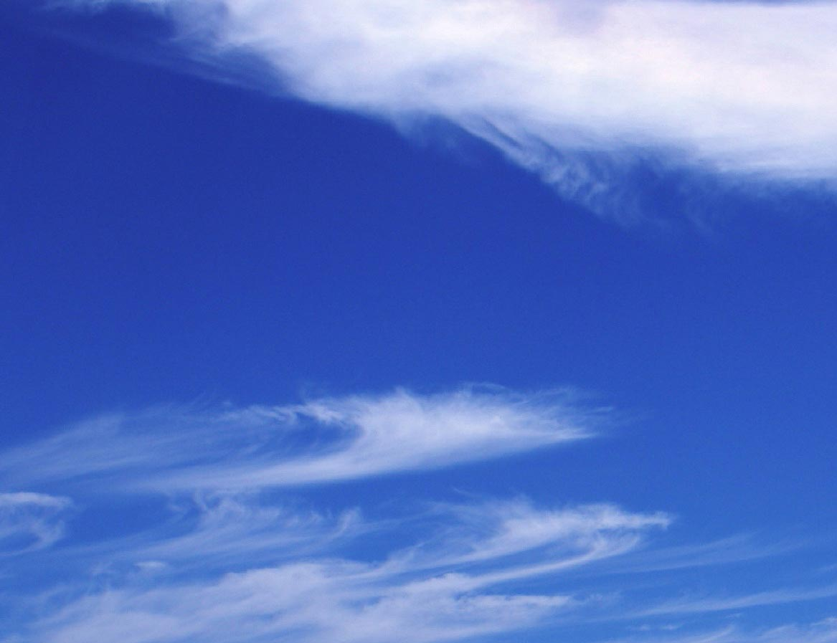
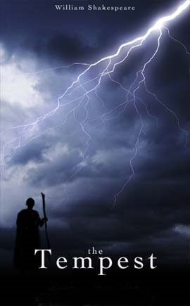
Act 1 Scene 2 (to line 189)
In this scene we meet Prospero and his daughter
Miranda. Prospero was formerly the Duke of
Milan, but was usurped by his brother Antonio
and banished to the island when Miranda was a
baby.
At the beginning of this scene the audience
learn something startling news – what is it?

Slide 4
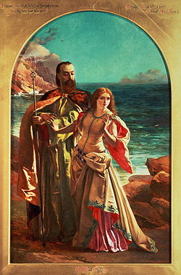
First Impressions?
Prospero and Miranda

Slide 5
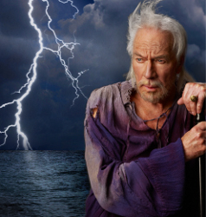
Prospero
What do these quotes tell us about Prospero?
Well demanded, wench;
Line 139, page 17
Me, poor man
Line 109, page 15
Me, poor man
Line 109, page 15
O’ a cherubin thou was that did preserve me. Thou didst smile, infused with a fortitude from heaven
Top of page 19

Slide 6
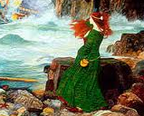
Miranda
What do these quotes tell us about Miranda?
Oh, the heavens!
Line 59, page 13
O good sir, I do.
Line 88, page 13
Your tale, sir, would cure deafness
Line 107, page 15
I should sin to think nobly of my grandmother – Good wombs have borne bad sons
Bottom of page 15
Alack, what trouble bottom of page 17

