Slide 1

Lesson 8:
Prospero’s People

Slide 2
Imagine that you have a magical servant who can change shape, become invisible, control the weather and create hypnotic music.
Make a list of things you would tell your servant to do.

Slide 3
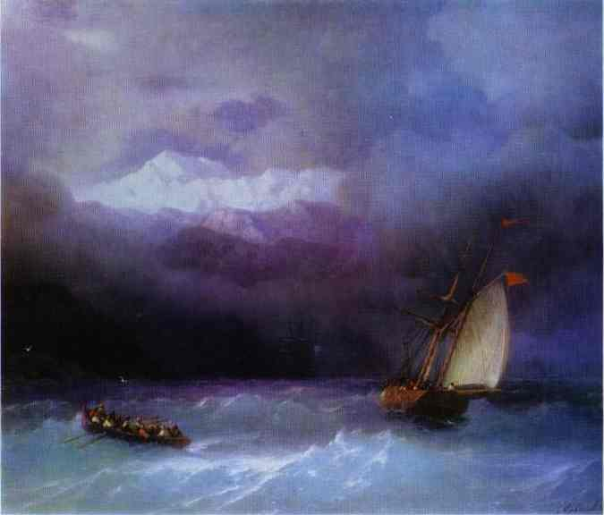
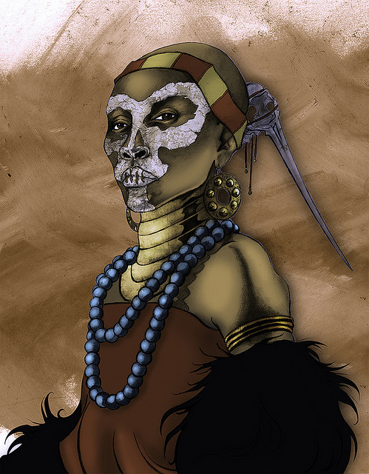
Sycorax
Sycorax is an unseen character in William Shakespeare's play ‘The Tempest’. She is a vicious and powerful witch and the mother of Caliban, one of the few native inhabitants of the island on which Prospero, the hero of the play, is stranded. Looking at the picture on the right- what impressions do we get of her? E.g. powerful, frightening.

Slide 4
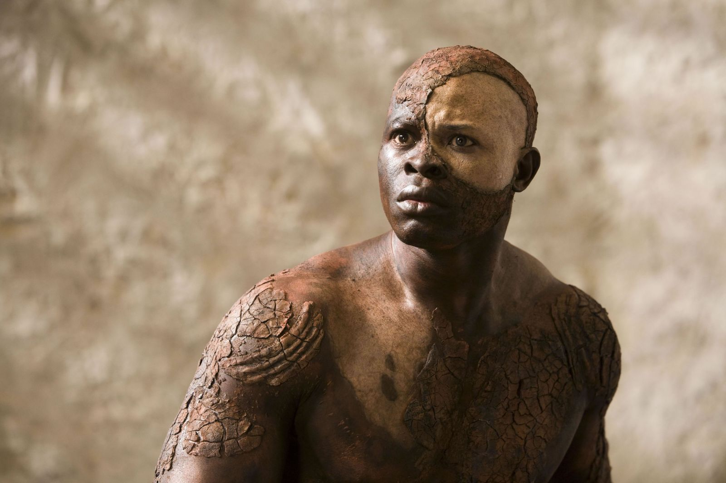
What do these words suggest about Caliban, Sycorax’s son?
Freckled whelp
Hag born
She did litter here
Not honour’d with a human shape

Slide 5
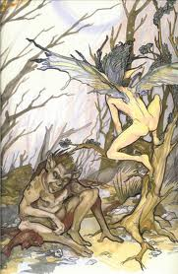
Caliban | Ariel
Make a list of words using your script. That show the difference between Caliban and Ariel.

