Slide 1

Wednesday 10th March 2021
L.O: To understand texts- vocabulary skills
C: Boy

Slide 2
Starter:
Thinking Question:
Why is it important that we learn the meaning of new words?

Slide 3
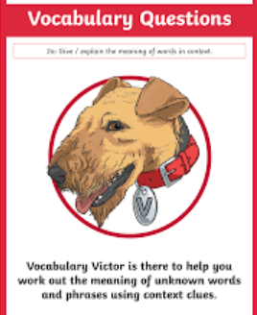
We are going to continue reading the story today.
We will be using our Vocabulary Victor skills today!

Slide 4
Class Read: p.5-p.11

Slide 5
These are some new words for us to learn:
amiable,
tomfool,
forbade,
trawlers,
château

Slide 6
Your challenge
We have hidden the definitions around the edge of the field.
You need to find them and match them to the correct word on your sheet.
Think about how the word relates to the rest of the sentence.

Slide 7
Let’s mark our work!
amiable
“Their own father, an amiable giant nearly seven foot tall…”

Slide 8
Let’s mark our work!
amiable
“Their own father, an amiable giant nearly seven foot tall…”
Friendly, pleasant

Slide 9
Let’s mark our work!
tomfool
“he refused to support this tomfool idea.”

Slide 10
Let’s mark our work!
tomfool
“he refused to support this tomfool idea.”
foolish

Slide 11
Let’s mark our work!
forbade
“When he forbade them to go…”

Slide 12
Let’s mark our work!
forbade
“When he forbade them to go…”
Forbid, banned

Slide 13
Let’s mark our work!
trawlers
“He owned a fleet of trawlers…”

Slide 14
Let’s mark our work!
trawlers
“He owned a fleet of trawlers…”
Large fishing boats

Slide 15
Let’s mark our work!
château
“a large château in the country…”

Slide 16
Let’s mark our work!
château
“a large château in the country…”
A large, french house or castle

Slide 17

Red Pen Challenge:
Can you use one of the new words in a sentence?

