Slide 1

Becoming a Prospero Expert!
L.O- To understand texts
C: 2f

Slide 2
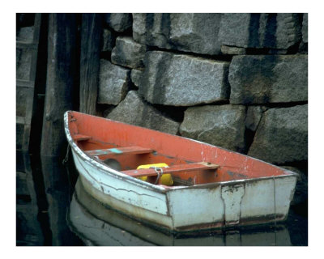
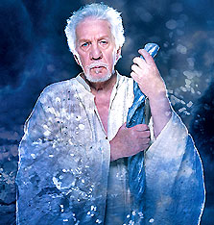
Starter: In your groups, create an acrostic poem on what we have learnt so far about the character of Prospero.
P – POSSESSES MAGICAL POWERS
R
O
S
P
E
R
O

Slide 3
Prospero Character Study
1) Write down 5 adjectives that you feel describe Prospero
2) Use your thesaurus to come up with interesting adjectives
Cruel
Mean
Nasty
Malicious
Unkind

Slide 4
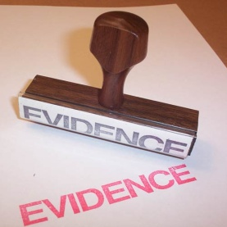

Prospero Character Study
Evidence it
1)
Find quotes to prove your initial responses on the character of Prospero
2)
Can you add any more attributes to your character study. They could be mental or emotional
Cruel
Mean
Nasty
Malicious
Unkind
‘I’ll rack thee with old cramps, Fill all thy bones with aches, make thee roar’

