Slide 1

Lesson 7:
Prospero
L.O- To understand texts
C: 2d

Slide 2
On the following slide is your task about Prospero.
Think about the following when answering the question on the next slide:
What is Prospero planning to do with Antonio and the crew?
Do you believe that Prospero wants revenge or do you think the storm was enough to scare them?

Slide 3
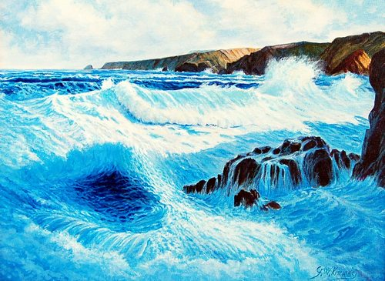
TASK
What should Prospero do now that he has his foes within his grasp? Remind yourself of the part each of the following characters played in his exile (being barred or banished from one’s country).
Antonio (Prospero’s brother)
Alonso (The King of Naples)
Ferdinand (Alonso’s son)
Sebastian (Alonso’s brother)
Gonzalo (a nobleman of Alonso’s)
Notes:
being

