Slide 1
L.O. To understand materials
To work scientifically
C: How do we separate materials?

Slide 2
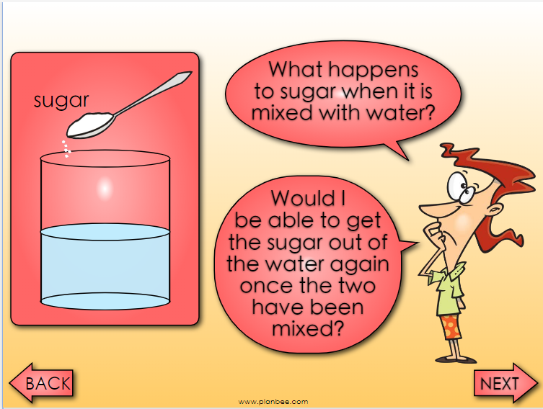

Slide 3
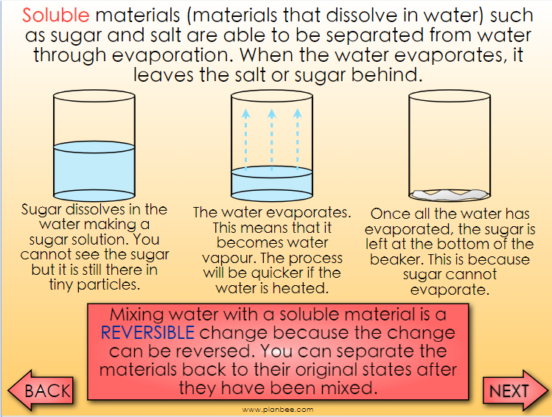

Slide 4
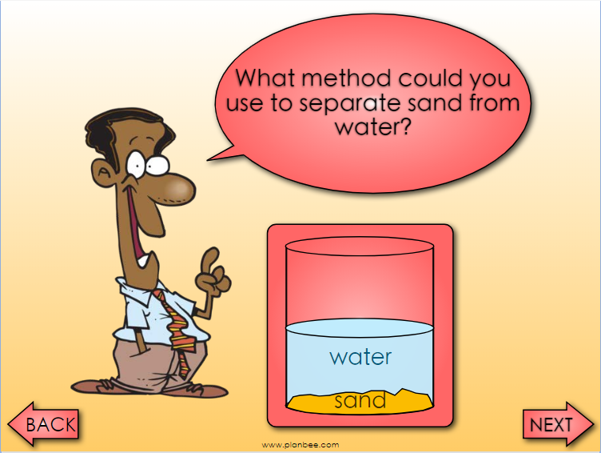

Slide 5
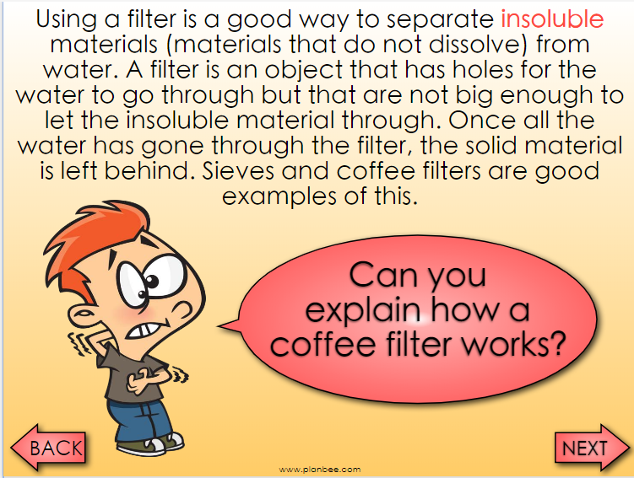

Slide 6
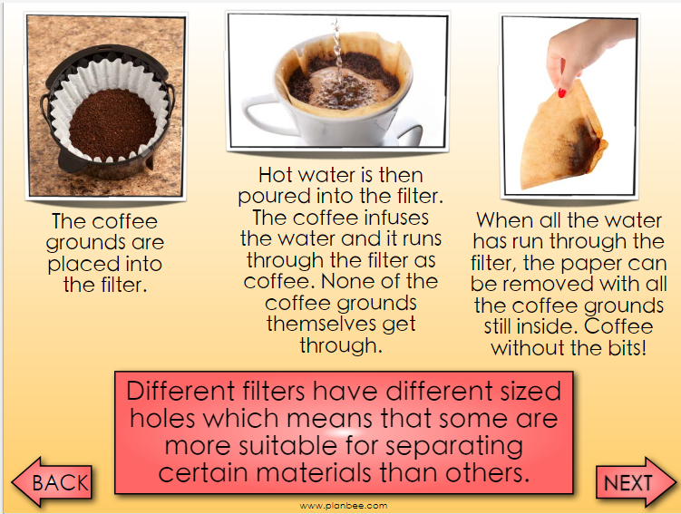

Slide 7
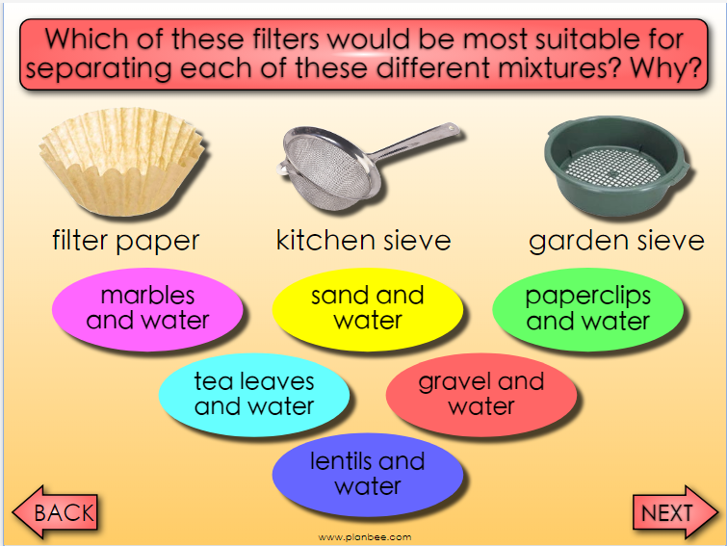

Slide 8
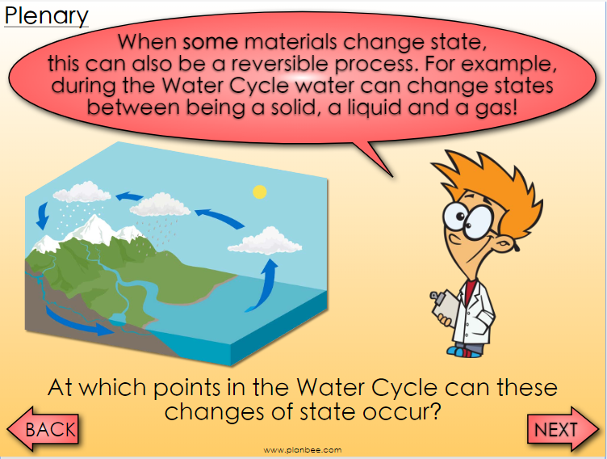

Slide 9
Can you think of any other mixing processes, dissolving processes or changes of state that are reversible?
Discuss your ideas.

