Slide 1
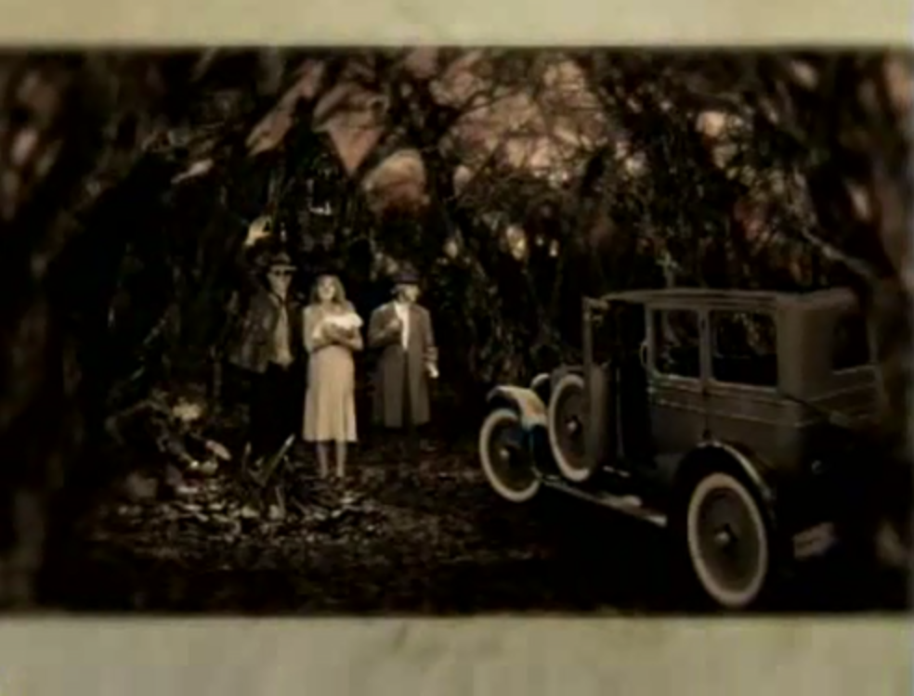
A woman holding what looks like a baby.
There’s an old-fashioned vehicle parked in a forest.
Three men wearing hats- one man is smiling with his hand up- maybe waving at someone.

