Slide 1
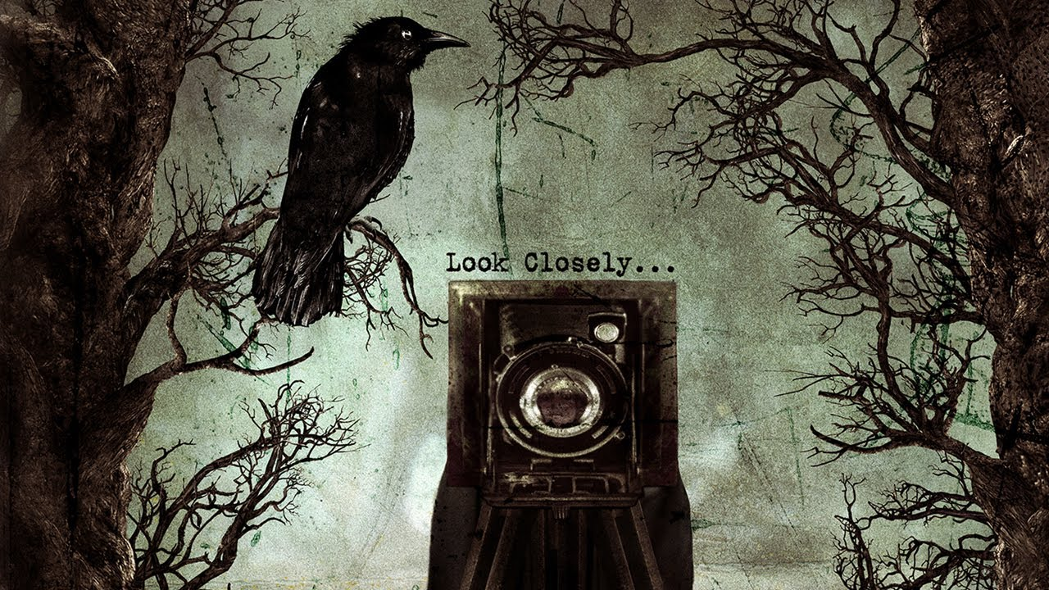

Slide 2
decay
Look for clues
Zoom into the detail of the crime
Death
Why is there a camera?
What does the raven represent?
How does the colour of the picture make you feel?
sinister
darkness
depressed
frightened
curious

