Slide 1

Thursday 11th March 2021
L.O: To use the main features of a type of writing to plan and write.
C: Cinquain Poems

Slide 2

Quick reminder:
A cinquain is a special kind of poem.
Today, you are going to begin to write the last two lines of your own Cinquain poem!

Slide 3

First, I would like you to review your star and a wish from yesterday.

Slide 4
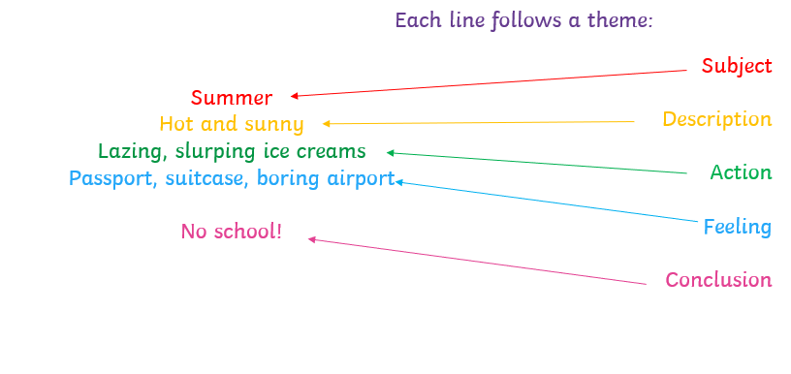

Our next step is to organise and refine our ideas!
Let’s remind ourselves of the
We are going to write the last two lines today!

Slide 5
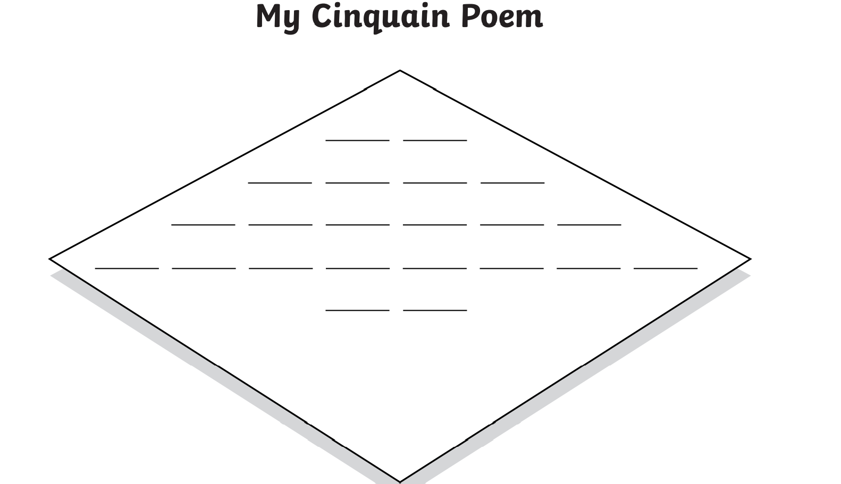
Let’s use this template to help us! Each line represents a syllable not a word.

Slide 6
Our next step is to organise and refine our ideas!
Let’s remind ourselves of the
Firstly, let’s begin with the feeling line. This should be eight syllables.

Slide 7
Our next step is to organise and refine our ideas!
Let’s remind ourselves of the
Let’s share our ideas. Do they follow the syllable pattern?

Slide 8
Next, let’s try the conclusion line. We need to link this back to the subject. This line should be two syllables long.

Slide 9
Our next step is to organise and refine our ideas!
Let’s remind ourselves of the
Let’s share our ideas. Do they follow the syllable pattern?

Slide 10

RED PEN CHALLENGE!
Star and a wish
Reflection!
Did you achieve your wish from yesterday? Why? Why not?

